Slide 1
MinoanER: Schema-Agnostic, Non-Iterative, Massively Parallel Resolution of Web Entities
Vasilis Efthymiou (IBM Research),
George Papadakis (University of Athens),
Kostas Stefanidis (Tampere University)
Vassilis Christophides (INRIA Paris)

Slide 2
Entity Descriptions in the Web of Data
“United Kingdom of Great Britain and Northern Ireland”
Restaurant
Restaurant
“J. Lake”
“chef”
“J. Lake”
label
label
category
official name
type
trainedAs
Jonny Lake
“The Fat Duck”
John Lake A
United Kingdom
fieldOfstudy
studied
inCountry
“Physics”
headChef
hasChef
“Physics”
name
name
Restaurant2
“The #fat duck”
Restaurant1
?
cuisine
cuisine
county
territorial
“French”
“French Gastronomy”
Berkshire
Bray
inception
postal code
post code
distinction
“1995”
local dialing code
dial code
“SL6”
Michelin Restaurant
“01628”
“SL6”
“01628”
Wikidata
locatedIn
Berkshire
DBpedia
Comprehensive machine-readable descriptions of real-world entities in the WoD
Notes:
identifiable set of attribute-value pairs (expressed as RDF triples in the Web of data)
instance of multiple semantic types
values can be literals or entity identifiers (entity neighbors)
due to the open and decentralized nature of the Web, descriptions of the same real-words entities could spread in different KBs

Slide 3
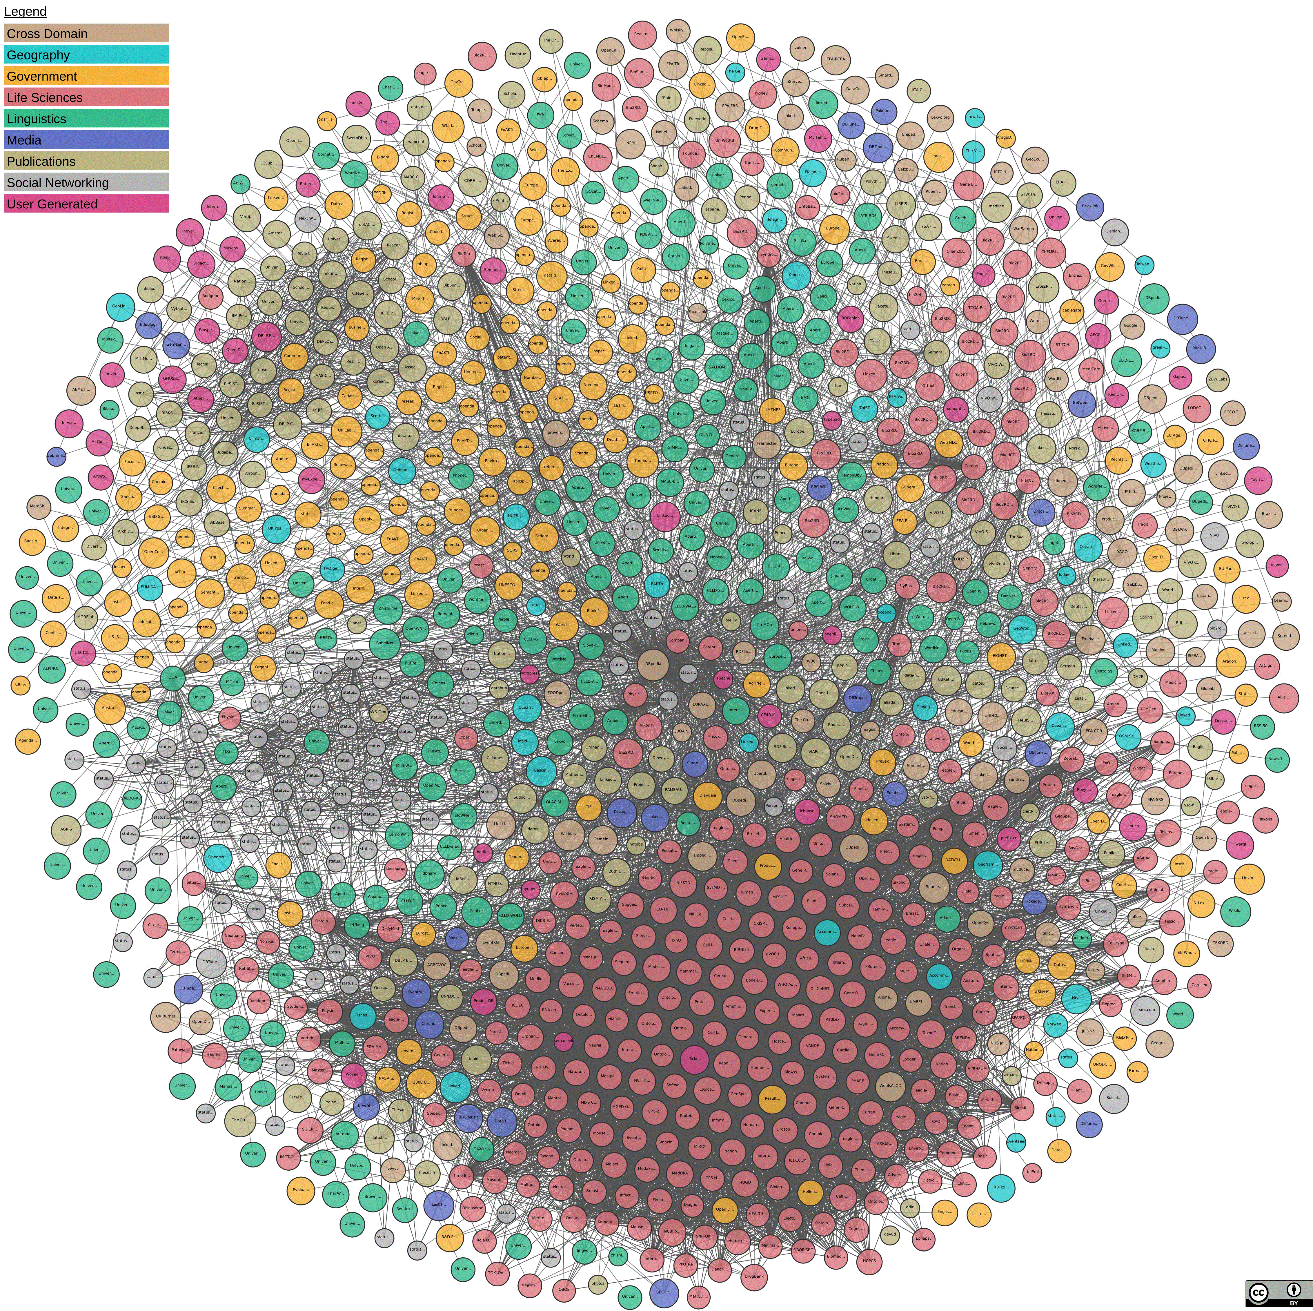
LOD Cloud and Web KBs
sameAs
exactMatch
closeMatch
seeAlso
1,234 Knowledge Bases
~200B Triples
660 vocabularies
adapted from Suchanek & Weikum tutorial@SIGMOD 2013
Notes:
The Web of data is usually referred to as the LOD cloud
nodes are KBs (aka RDF datasets) and
edges are links crossing KBs
Linked Open Data as large integrated knowledge base
- A dataset (node) is a set of RDF triples that are published, maintained or aggregated by a single provider
- A linksetis a collection of RDF links between two datasets: An RDF link is an RDF triple whose subject and object are described in different datasets
Cross-domain encyclopaedic KBs such as… contain descriptions of multiple types, extracted mostly from Wikipedia, so they cover more or less the same entity types in very similar ways (strongly similar), vs. domain-specific KBs
heterogeneous KBs small intersection of types, different data sources, DBpedia alone contains over 170 domains

Slide 4
Entity Resolution (ER)
The two core ER problems, how can we
effectively compute entity similarity?
efficiently resolve sets of entities across KBs?
are challenged by the
important number of KBs (~ hundreds)
large number of entity types & properties (~ thousands)
massive volume of entities (~millions)
Notes:
1)Matching decision typically relies on the schema-based sim of 2 descriptions, based on their values or also their neighbors. When neighbors… iterative, because we exploit the matching decisions of one iteration to help the decisions of the next iteration (Convergence requires multiple iterations in the WoD)
2) The second problem is how we can perform matching efficiently, i.e., how we can reduce the number of comparisons we have to perform. In this respect, blocking is practically an indexing that places candidate matches in the same group (block). In DBs blocking (indexing) keys are schema-based, while existing schema-agnostic blocking methods in WoD only consider the entity values to identify strongly similar matches, ignoring entity neighbors
-Blocking can be accompanied by Meta-blocking, which offers a compact representation of entity pairs that need to be compared and filters out candidate pairs that are unlikely to match, suggested due to data veracity (e.g., stopwords)
Pre-processing (cleaning) input data: casing, special characters, tokenization (if needed)
schema-based, iterative
indexing placing candidate matches in the same block (schema-based blocking keys in relational DBs), while existing schema-agnostic blocking methods ignore entity neighborhoods

Slide 5
Web Scale ER: Requirements
Near similarity support:
identify matches with low similarity in their content
Schema-agnostic:
do not rely on a given set of attributes used by all descriptions
No human in the loop:
do not rely on domain-experts for training data, aligned relations, matching rules
Non-iterative:
iterative methods converge after too may iterations in the WoD
Scalable to massive volumes of data:
massively parallel architecture needed
No ER framework satisfies all requirements at the same time!

Slide 6
State of the art
 | SiGMa | LINDA | RiMOM | PARIS | MinoanER
Near similarity | ✓ | ✓ | ✓ | ✗ | ✓
Schema agnostic | ✓ | ✓ | ✓ | ✓ | ✓
No Human in the Loop | ✗ | ✓ | ✗ | ✓ | ✓
Non-iterative | ✗ | ✗ | ✗ | ✗ | ✓
Scalable | ✗ | ✓ | ✗ | ✗ | ✓
Notes:
SiGMa and RiMOM involve human input for aligning “compatible neighbors” for neighborhood similarity propagation
Open-source: RiMOM (with no execution instructions), PARIS and MinoanER

Slide 7
MinoanER Value Similarity
The value similarity of two descriptions e_{i} ϵ E₁, e_{j} ϵ E₂ is:
$valueSim\left(e_{i},e_{j}\right)=\sum_{t∈tokens(e_{i})∩tokens(e_{j})}{\frac{1}{\log_{2}\left({EF}_{E1} (t\right)∙{EF}_{E2}\left(t\right)+1)}}$
where EF_{E}(t) = |{e_{i} | e_{i} ϵ E ∧ t ϵ tokens(e)}| is the number of entity descriptions in E having token t in their values
the more common tokens, the better
the less frequent the common tokens, the better
valueSim is a similarity metric, as it satisfies the following properties:
valueSim(e_{i},e_{i}) ≥ 0 (non-negativity)
valueSim(e_{i},e_{i}) ≥ valueSim(e_{i},e_{j})
valueSim(e_{i},e_{j}) = valueSim(e_{j},e_{i}) (symmetry)
valueSim(e_{i},e_{i}) = valueSim(e_{j},e_{j}) = valueSim(e_{j},e_{i}) ⇒ e_{j} = e_{i} (identity of indiscernibles)
valueSim(e_{i},e_{j}) + valueSim(e_{j},e_{l}) ≤ valueSim(e_{i},e_{l}) + valueSim(e_{j},e_{j}) (triangle inequality)
Notes:
With this similarity, the maximum contribution of a single token is 1 (when EF_{E1}(t) = EF_{E2}(t) = 1), when it appears only in the values of the entities that we compare and in no other entity
the proofs for sim metric are in the thesis
(Jaccard and most of the similarity measures captured by Meta-blocking’s weighting schemes do not consider token frequencies but this is a strong indication for match. Another indication is the number of common tokens, captured from the sum)

Slide 8
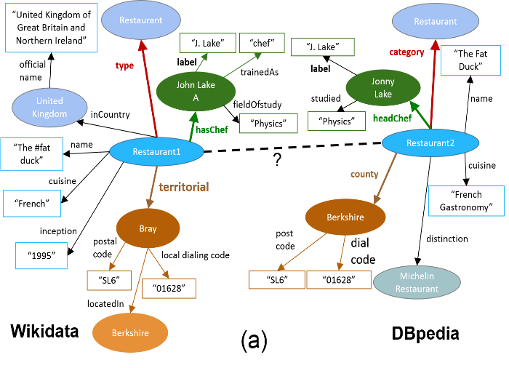
MinoanER valueSim Example
common tokens:
“lake”, “physics” (frequent)
valueSim(JLA, JL) = 0.4
common tokens:
“the”, “fat”, “duck”, “french” (very frequent)
valueSim(R1, R2) = 0.2
common tokens:
“SL6”, “01628” (rare)
valueSim(Br, Be) = 1.2
EF | lake | physics | the | fat | duck | french | SL6 | 01628
E1 | 5 | 8 | 33M | 300 | 46 | 1M | 2 | 1
E2 | 6 | 4 | 33M | 200 | 30 | 1M | 1 | 2
Notes:
(Restaurant1, Restaurant2) are nearly similar
Their neighbors, (John Lake A, Jonny Lake) connected via the important relations (hasChef, headChef) are highly similar
Those relations are important, because they appear frequently in their KBs with many different values
The same holds for Bray and Berkshire

Slide 9
MinoanER Neighbor Similarity
The most important entity relations can provide additional matching evidence for the connected entities
We define a relation’s importance as the harmonic mean of its
support (i.e., frequency in an entity collection) and
discriminability (i.e., how many distinct values it has)
For each entity, we consider only its neighbors connected via one of the top-N most important relations of this entity
Then, neighbor similarity of two descriptions e_{i}ϵE₁, e_{j}ϵE₂ is:
$neighborNSim\left(ei,ej\right)=\sum_{\begin{aligned}nei∈topNneighbors(ei) \\ nej∈topNneighbors(ej)\end{aligned}}{valueSim(nei,nej)}$
where EF_{E}(t) = |{e_{i} | e_{i} ϵ E ꓥ t ϵ tokens(e)}| is the number of entity descriptions in E having token t in their values
neighborNSim is a metric as a sum of metrics [Chen et al., 2009]
Notes:
with the same process, we determine the most important (datatype) attributes per entity, acting as names
we complement valueSim with matching evidence from the neighbors

Slide 10
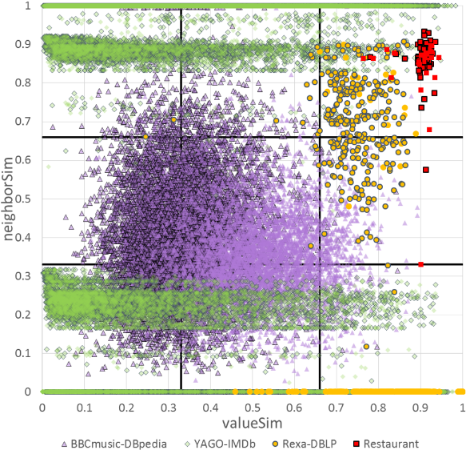
Value & Neighbor Similarity of Matches
nearly similar
strongly similar
4 / 59,801 types
3 types
Notes:
Restaurant contains descriptions of restaurants and their addresses from two different KBs. This is one of the benchmark OAEI datasets. Ground truth only contains restaurant matches (single type)
Rexa-DBLP contains descriptions of publications and their authors. It exhibits the greatest difference with respect to the size of the KBs to be matched (DBLP is 2 orders of magnitude bigger than Rexa in terms of descriptions.
BBCmusic-DBpedia contains descriptions of musicians, bands and their birthplaces, from BBCmusic and the BTC2012 version of DBpedia. The most challenging characteristic of this dataset is the high heterogeneity between its two KBs in terms of both schema and values: (among other stats from the paper) DBpedia uses on average 4 times more tokens than BBCmusic to describe an entity.
YAGO-IMDb (introduced in PARIS) contains descriptions of movie-related entities (e.g., actors, directors, movies) from YAGO and IMDb. A large number of matches in this dataset has low value similarity, while a significant number has high neighbor similarity.

Slide 11
Disjunctive Blocking
Given an entity collection E, disjunctive blocking is defined by a set of indexing functions H for which the generated blocks B = ∪_{hkey ϵ H} B^{key} satisfy the following conditions:
Ɐe_{k},e_{l} ϵ b : b ϵ B, o_{H}(e_{k},e_{l}) = true,
Ɐ(e_{k},e_{l}) : o_{H}(ek,el) = true, ⱻb ϵ B, e_{k}, e_{l} ϵ b,
where o_{H}(e_{k},e_{l}) = V_{hkey ϵ H}o_{key}(e_{k},e_{l})
Disjunctive Blocking introduces redundancy in entity blocks
Overlapping, schema-agnostic indexing
entities of the same block are candidate matches by at least one indexing function
candidate matches share at least a common block of any type
Notes:
The first step for a non-iterative matching is to push all the different matching evidence to the step of blocking
For this reason, we extend blocking from atomic to composite, which captures matching evidence coming from the values, the neighbors, or the names of the descriptions, in a non-iterative way. To do that, we need to combine several indexing functions, resulting in different types of blocks.
The co-occurrence function is a disjunctive condition

Slide 12
Disjunctive Blocking: Example
sl6
Bray, Berkshire
duck
Restaurant1, Restaurant2
lake
John Lake A, Jonny Lake
french
Restaurant1, Restaurant2
token blocks
J. Lake
John Lake A, Jonny Lake
the #fat duck
Restaurant1
the fat duck
Restaurant2
name blocks
disjunctive co-occurrence function
Candidate matches if:
common token block, OR
common name block, OR
neighbors from top relations have a common block

Slide 13
Disjunctive Blocking Graph
J. Lake
John Lake A, Jonny Lake
the #fat duck
Restaurant1
the fat duck
Restaurant2
…
duck
Restaurant1, Restaurant2
sl6
Bray, Berkshire
lake
John Lake A, Jonny Lake
french
Restaurant1, Restaurant2
add valueSim (0.4) as partial neighborSim of neighbors (Restaurant1,Restaurant2)
John Lake A
(T, 0, 0)
Jonny Lake
John Lake A
Jonny Lake
(T, 0.4, 0)
(F, 0.2, 1.6)
Restaurant1
(F, 0.2, 0)
Restaurant2
Restaurant1
Restaurant2
sum partial neighborSims as final neighborSim
Bray
(F, 1.2, 0)
Berkshire
Bray
Berkshire
name blocking
add valueSim (1.2) as partial neighborSim of neighbors (Restaurant1,Restaurant2)
α : identical names (T/F)
β : valueSim
γ : neighborNSim
(α,β,γ) edge label corresponds to
token blocking
Notes:
By extending a composite blocking, we also need to extend the notion of blocking graph and connect its nodes if there is at least one common block from composite blocking in which they co-occur. Those edges are labeled using 3 values, 1for names, 1 for values and 1 for neighbors.
Start from an empty graph
Start adding (T,0,0)-labeled edges (from the name blocks)
Update the β labels of existing edges, or add new (F,valueSim,0)-labeled edges (Meta-blocking on token blocks using our valueSim as weighting scheme)
Having computed the value similarity of pairs of entities, we are going back to the neighborhoods of entity descriptions and we sum the value similarity of their neighbors, and this similarity is used as the third value of the edge labels
No extra blocking needed for the neighborSim computations
The time complexity is dominated by the processing of value evidence, which iterates twice over all comparisons in the token blocks BT . In the worst-case, this results in one computation for every pair of entities O(|E1||E2|).
In practice, though, we bound the number of computations by removing excessively large blocks that correspond to highly frequent tokens
(e.g., stop-words), (+Block Filtering)
For name evidence: single iteration of name blocks
For neighbor evidence, we check all pairs of N neighbors between every entity ei and its K most value-similar descriptions,
performing K N^2 (|E1|+|E2|) operations;
the cost of estimating the top in-neighbors for each entity is dominated by the ordering
of all relations in E1 and E2 (i.e., |Rmax| log|Rmax|), where |Rmax| stands for the maximum number of relations in one of the KBs.

Slide 14
Pruning the Disjunctive Blocking Graph
For each entity keep its edges with:
top-2 value weight
top-2 neighbor weight
List of candidates per entity in descending valueSim (β) weight:
e1: e4, e5, e7, e8, e6
e2: e6, e8, e7
e3: e8, e9, e6
e4: e1
e5: e1
e6: e2, e1, e3
e7: e1, e2
e8: e2, e1, e3
e9: e3
e4
(F, 1.2, 0)
e1
(F, 1.1, 1.8)
e5
(F, 0.2, 0.1)
(T, 0.7, 1.4)
(F, 1.7, 1.4)
e6
List of candidates per entity in descending neighborSim (γ) weight:
e1: e5, e7, e8, e6
e2: e6, e8
e3: e8, e6
e4: -
e5: e1
e6: e2, e3, e1
e7: e1
e8: e2, e1, e3
e9: -
e2
(F, 0.1, 0)
(F, 0.8, 1)
e7
(F,0.1,0.1)
(F, 0.3, 0.8)
e3
(F, 0.2, 0.7)
e8
(F, 0.1, 0)
e9
Notes:
the blocking graph is only a logical representation of the comparisons we need to perform
in practice, we have a distributed representation of the graph, in which the candidate matches of each node are represented by different lists
assuming that we want to keep the top-2 (2 is only an example, it can be defined dynamically)
…after pruning we end up with a directed graph, as we may lose some of these edges from one or the other direction
For example, after pruning e7 from the list of e1’s value-candidates, we have set its β=0, but we have not pruned e1 from e7’s value-candidates, so these opposite edges have different weights.
Moreover, we have removed e6 from both candidate lists of e1, so there is no edge at all from e1 to e6, but there is one from e6 to e1.
Each node knows with which other nodes it has to be compared

Slide 15
Pruning the Disjunctive Blocking Graph
For each entity keep its edges with:
top-2 value weight
top-2 neighbor weight
List of candidates per entity in descending valueSim (β) weight:
e1: e4, e5, e7, e8, e6
e2: e6, e8, e7
e3: e8, e9, e6
e4: e1
e5: e1
e6: e2, e1, e3
e7: e1, e2
e8: e2, e1, e3
e9: e3
e4
(F, 1.2, 0)
e1
(F, 1.1, 1.8)
e5
(F, 0.2, 0)
(T, 0.7, 1.4)
(F, 1.7, 1.4)
e6
List of candidates per entity in descending neighborSim (γ) weight:
e1: e5, e7, e8, e6
e2: e6, e8
e3: e8, e6
e4: -
e5: e1
e6: e2, e3, e1
e7: e1
e8: e2, e1, e3
e9: -
e2
(F, 0.1, 0)
(T, 0, 1.4)
(F, 0.8, 1)
e7
(F,0,0.1)
(F, 0.3, 0.8)
e3
(F, 0.2, 0.7)
e8
(F, 0.1, 0)
e9
Notes:
the blocking graph is only a logical representation of the comparisons we need to perform
in practice, we have a distributed representation of the graph, in which the candidate matches of each node are represented by different lists
assuming that we want to keep the top-2 (2 is only an example, it can be defined dynamically)
…after pruning we end up with a directed graph, as we may lose some of these edges from one or the other direction
For example, after pruning e7 from the list of e1’s value-candidates, we have set its β=0, but we have not pruned e1 from e7’s value-candidates, so these opposite edges have different weights.
Moreover, we have removed e6 from both candidate lists of e1, so there is no edge at all from e1 to e6, but there is one from e6 to e1.
Each node knows with which other nodes it has to be compared

Slide 16
Name Heuristic Matching: H1
H1: two entities match, if they have the same (unique) name
word1
e1, e7
word2
e2
word3
e3
name blocks
Like blocking keys in relational DBs, but automatically detected
Unique mapping assumption: when we find a matching pair, we skip examining these descriptions for other matches
Matches:
(e1,e7)
Notes:
We will see now how this pruned graph is used to find the final matches, using a set of heuristics
H1: from name blocks, we can immediately find the set of pairs with unique and identical names. This is a very effective method that can be applied to all descriptions, regardless of the employed similarity measures, resembling the usage of blocking keys in relational databases.

Slide 17
Value Heuristic Matching: H2
H2: two entities match, if they are strongly similar (β ≥ 1)
β-lists:
e2: e6 (β=1.7), e8 (β=0.8)
e3: e8 (β=0.2), e9 (β=0.2)
e6: e2 (β=1.7), e1 (β=0.2)
e8: e2 (β=0.8), e1 (β=0.3)
e9: e3 (β=0.2)
Unique mapping assumption…
remove e2 and e6 from all candidate lists
Matches:
(e2,e6)
Notes:
for the rest, not having identical and unique names, we return the strongly similar matches, with β≥1, for which we don’t need to consider their entity neighbors

Slide 18
Rank Aggregation Heuristic: H3
H3: matches e_{i} with e_{j}, when, based on all available evidence, there is no better candidate for e_{i} than e_{j}
β-lists:
e3: e8 (β=0.2), e9 (β=0.2)
e8: e2 (β=0.8), e1 (β=0.3)
e9: e3 (β=0.2)
γ-lists:
e3: e8, e6
e8: e2, e1
list scoring:
K/K | K-1/K | … | 1/K
actually a weighted sum
1
1
1/2
threshold-free
aggr. score(e3,e9) = 1/2+1=1.5
aggr. score(e3,e8) = 1+1=2
Matches:
(e3,e8)
Notes:
To identify the remaining matches, which are nearly similar, we consider matching evidence from their values AND their neighbors, using a threshold-free rank aggregation function of β and γ lists, (as opposed to existing works that linearly combine matching evidence from value sim and neighbor sim into an aggregate score). Each element in a list is assigned a score based on its position in the list (similar to Borda count)…

Slide 19
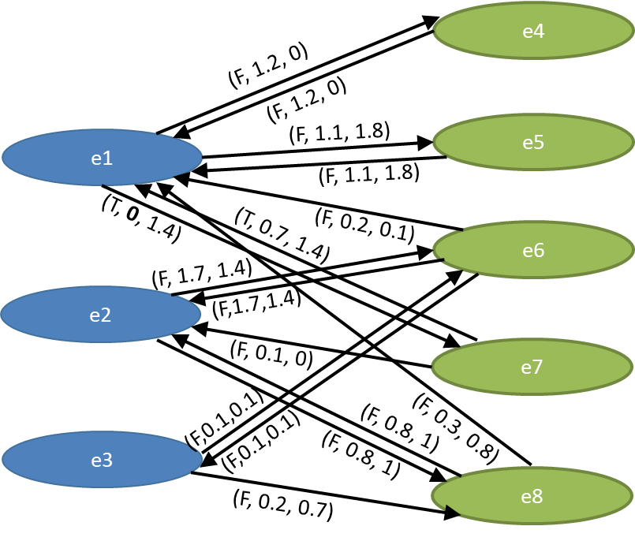
Reciprocity Heuristic Matching: H4
H4: two entities match, only if both of them “agree” that they are likely to match
β-lists:
e2: e6, e8
e3: e8, e9
e6: e2, e1
e8: e2, e1
e9: e3
γ-lists:
e3: e8, e6
e8: e2, e1
, e3
(e1,e7)
(e2,e6)
Matches:
(e3,e8)
Notes:
H4 aims to improve precision based on the rationale that two entities are unlikely to match, when one of them does not even consider the other to be a candidate for matching (The same idea has been applied to Meta-blocking significantly improving precision)

Slide 20
MinoanER Architecture in
get candidates by entity e_{i}: {e_{j}, e_{k}, …}
H1 (part)
Legend:
group by blocking key b_{l}: {e_{i},e_{j},…}
Name Bl. (part)
broadcast matches
data chunk
H1 (part)
blocking
Entity collection (part)
Name Bl. (part)
from α
statistics
H2 (part)
matching
Entity collection (part)
sync
Token Bl. (part)
from β
H2 (part)
ER results
Token Bl. (part)
H3 (part)
Entity collection (part)
broadcast value sims
H3 (part)
Top neighbors (part)
Neighbor sims (part)
H4 (part)
Top neighbors (part)
Neighbor sims (part)
from γ
H4 (part)
Notes:
the previous computations are performed in a fully distributed way
we use a fixed number of steps determined by the 4 heuristics and we avoid iterative matching that requires convergence

Slide 21
Experimental evaluation: Datasets
 | Restaurant | Rexa-DBLP | BBCmusic-DBpedia | YAGO-IMDb
E1 entities | 339 | 18,492 | 58,793 | 5,208,100
E2 entities | 2,256 | 2,650,832 | 256,602 | 5,328,774
E1 triples | 1,130 | 87,519 | 456,304 | 27,547,595
E2 triples | 7,519 | 14,936,373 | 8,044,247 | 47,843,680
E1 av. tokens | 20.44 | 40.71 | 81.19 | 15.56
E2 av. tokens | 20.61 | 59.24 | 324.75 | 12.49
E1 / E2 properties | 7 / 7 | 114 / 145 | 27 / 10,953 | 65 / 29
E1 / E2 relations | 2 / 2 | 103 / 123 | 9 / 953 | 4 / 13
E1 / E2 types | 3 / 3 | 4 / 11 | 4 / 59,801 | 11,767 / 15
E1 / E2 vocab. | 2 / 2 | 4 / 4 | 4 / 6 | 3 / 1
Matches | 89 | 1,309 | 22,770 | 56,683
most heterogeneous
Notes:
BBCmusic-DBpedia is the most heterogeneous: DBpedia contains 11K different properties, with entities of 60K types being connected via 953 different relations, also using the highest number of different vocabularies. It uses 4x mores tokens per entity than BBCmusic

Slide 22
Evaluation Results
 |  | Restaurant | Rexa-DBLP | BBCmusic-DBpedia | YAGO-IMDb
SiGMa | Pr / Re | 99 / 94 | 97 / 90 | - / - | 98 / 85
 | F1 | 97 | 94 | - | 91
LINDA | Pr / Re | 100 / 63 | - / - | - / - | - / -
 | F1 | 77 | - | - | -
RiMOM | Pr / Re | 86 / 77 | 80 / 72 | - / - | - / -
 | F1 | 81 | 76 | - | -
PARIS | Pr / Re | 95 / 88 | 93.95 / 89 | 19.4 / 0.29 | 94 / 90
 | F1 | 91 | 91.41 | 0.51 | 92
BSL | Pr / Re | 100 / 100 | 96.57 / 83.96 | 85.2 / 36.09 | 11.68 / 4.87
 | F1 | 100 | 89.82 | 50.7 | 6.88
MinoanER | Pr / Re | 100 / 100 | 96.74 / 95.34 | 91.44 / 88.55 | 91.02 / 90.57
 | F1 | 100 | 96.04 | 89.97 | 90.79
Notes:
SiGMa,LINDA&RiMOM rely on domain knowledge regarding the equivalence of relations between entity neighbors. First, they detect strongly similar matches & then, they use these as seeds for bootstrapping an iterative algorithm that detects new matches based exclusively on similarity propagation from neighbors (SiGMA, RiMOM from pre-defined compatible neighbors, LINDA from neighbors through similar – via edit distance relations), using a linear combination of value and neighbor similarity.
PARIS uses a probabilistic model to identify matching evidence, based on previous matches and the functional nature of entity relations. The degree by which a relation is close to being an inverse function (discriminability) and the alignment of relations along with previous matching decisions determine the decisions in subsequent iterations. PARIS does not target heterogeneous KBs, as MinoanER, while it performs both instance- and ontology matching. It also supports negative evidence from functional properties (but it has not proven to be quite useful). e.g., wasBornIn 1991 vs wasBornIn 1980
BSL: only value similarity 420 different configurations exhaustively and report the best (token 1-/2-/3-grams, TF and TF-IDF weights, Cosine, (general.) Jaccard, SiGMa

Slide 23
Evaluation of Heuristics
 |  | Restaurant | Rexa-DBLP | BBCmusic-DBpedia | YAGO-IMDb
H1 | Pr / Re | 100 / 68.85 | 97.36 / 87.47 | 99.85 / 66.11 | 97.55 / 66.53
 | F1 | 81.33 | 92.15 | 79.55 | 79.11
H2 | Pr / Re | 100 / 100 | 96.15 / 30.56 | 90.73 / 37.01 | 98.02 / 69.14
 | F1 | 100 | 46.38 | 52.66 | 81.08
H3 | Pr / Re | 98.88 / 98.88 | 94.73 / 94.73 | 81.49 / 81.49 | 90.51 / 90.50
 | F1 | 98.88 | 94.73 | 81.49 | 90.50
¬H4 | Pr / Re | 100 / 100 | 96.03 / 96.03 | 89.93 / 89.93 | 90.58 / 90.57
 | F1 | 100 | 96.03 | 89.93 | 90.58
No Neighbors | Pr / Re | 100 / 100 | 96.59 / 95.26 | 89.22 / 85.36 | 88.05 / 87.42
 | F1 | 100 | 95.92 | 87.25 | 87.73
Notes:
H1: high precision and decent recall in all cases
H2: high precision but lower recall (30%)
H3: the only solution for nearly similar matches. In Rexa-DBLP almost perfect
H4: the weakest, yielding a minor improvement (targets higher precision with low impact on recall)
no neighors (0 weight for γ lists in rank aggr.): neighbor evidence plays a minor or even no role in KBs with strongly similar entities, such as Restaurant and Rexa-DBLP, while having a bigger impact in KBs with nearly similar matches, such as in BBCmusic-DBpedia and YAGO-IMDb

Slide 24
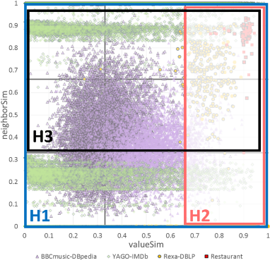
Summary and Future Work
Minoan ER fulfils the following requirements:
❶ full automation (no human in the loop, no domain-knowledge)
❷ support for highly heterogeneous entities (within/across domains)
❸ massively parallelizable blocking & matching processes (no iterative convergence)
Schema-agnostic similarity metrics guided by statistics that consider both the values and the neighbors of entities
Nearly similar matches are early identified even from the step of blocking, avoiding iterations during the matching phase
The employed heuristics manage to cover a wide area of matches. Still:
some areas are not covered sufficiently
recall of blocking > recall matching
Notes:
matches found by H1 are those with a border
Exploit these metrics in a disjunctive blocking scheme abstracted as a graph
Dynamically setting the fixed parameters of the matching phase
number of candidates kept from values & neighbors after pruning
number of most important relations
similar to global vs local pruning of the blocking graph
Optimizing the parallel algorithms
drastic reduce in execution time from MapReduce to Spark
minimize Spark synchronization

Slide 25
Related works in Distributed ER
Large-scale collective ER (Rastogi,Garofalakis,VLDB’11): Message passing in MR (message=set of matches found in one neighborhood and match dependencies), using “covers” instead of blocks. a cover contains similar entities (using canopy clustering) and the neighbors of those entities (from a specific relation). Black-box probabilistic entity matcher, running multiple instances of the matcher in different neighborhoods
Dedoop (Kolb, Thor, Rahm): An ER framework for relational DBs that performs standard blocking or sorted neighborhood in MR and then asks the user which similarity to apply for which attributes and what is the matching threshold
LINDA: implementation in MR (iterative, non-deterministic results -> depend on data partitioning)
Reference Reconciliation in Complex Information Spaces (Dong et al. SIGMOD‘05): collectively resolve entities of multiple types by propagating relational evidence in a dependency graph: a binary decision node for each potential pair of duplicates, which can be expensive in large datasets.
Collective ER (Getoor TKDD ‘07): Hierarchical agglomerative clustering on a linearly combined value and relational score

Slide 26
Questions?

Slide 27
License
These slides are made available under a Creative Commons Attribution-ShareAlike license (CC BY-SA 3.0): http://creativecommons.org/licenses/by-sa/3.0/
You can share and remix this work, provided that you keep the attribution to the original authors intact, and that, if you alter, transform, or build upon this work, you may distribute the resulting work only under the same or similar license to this one

