Slide 1

Entity Resolution in the Web of Data
Vassilis Christophides
INRIA Paris-Roquencourt (MUSE team, France)
Joint work with Vasilis Efthymiou (UoC-CSD, Greece)
& Kostas Stefanidis (Tampere University, Finland)

Slide 2
Matching and Resolving Entities (II): Iterative Resolution Techniques
Notes:
Linked Entities
Relational Entities
Graph-based Iterative Algorithms
Graph-based Progressive Algorithms
Open Challenges and Conclusions

Slide 3
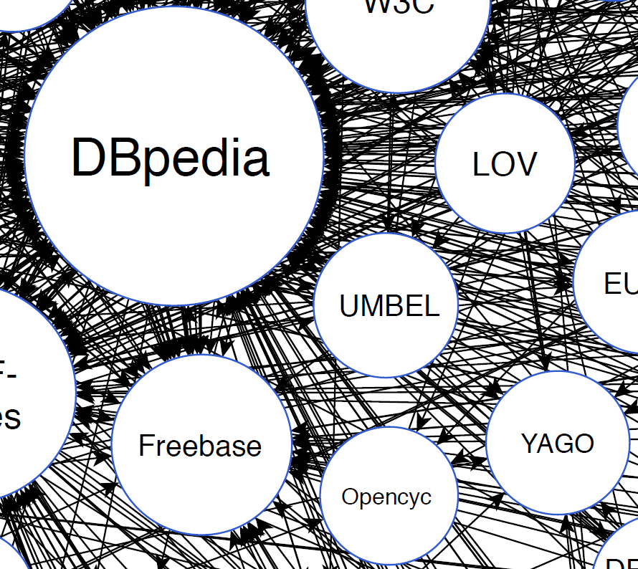
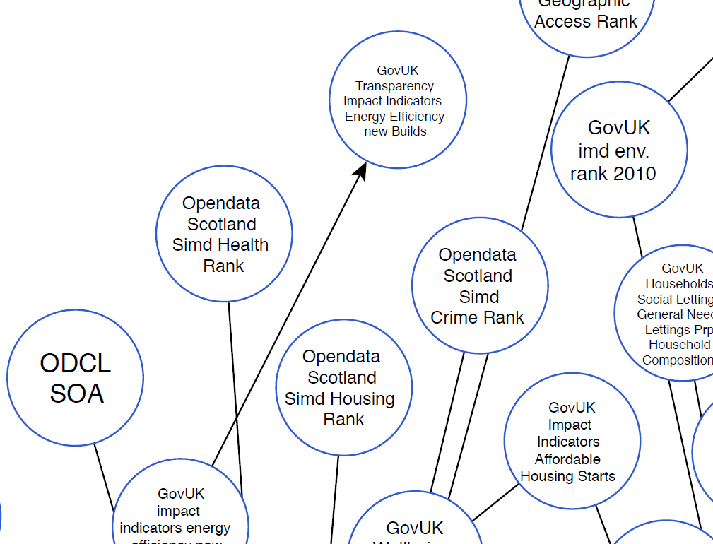
Central vs. Peripheral KBs
Notes:
Zooming into the center of the LOD cloud, we can find KBs, such as DBpedia, YAGO and Freebase, each containing millions of entity descriptions of thousands of different types, that are heavily interlinked.
On the other hand, peripheral KBs are sparsely interlinked and they typically describe entities of vey specific types.

Slide 4
In Search of Similarity Evidence in KBs [Efthymiou et al. 2016, 2015]
Attribute-based comparisons
  unique attributes (e.g., rdfs:label) provide strong evidence
    >90% of matching pairs have >80% overlap similarity in the values of rdfs:label
Content-based comparisons
  central KBs: 3-4 common tokens in entity values
  peripheral KBs: 1-2 common tokens in entity values
    blocking algorithms miss up to 30% matches in peripheral KBs
Relationships-based comparisons
  matching neighbors provide positive evidence
    >92% of pairs with at least one matching neighbor, are matches in most KBs
  some types of relationships provide strong negative evidence
    dissimilar values for wasBornIn indicate a non-matching pair
Notes:
V. Efthymiou, K. Stefanidis, V. Christophides: Minoan ER: Progressive Entity Resolution in the Web of Data. EDBT 2016
V. Efthymiou, K. Stefanidis, V. Christophides: Big data entity resolution: From highly to somehow similar entity descriptions in the Web. Big Data 2015

Slide 5

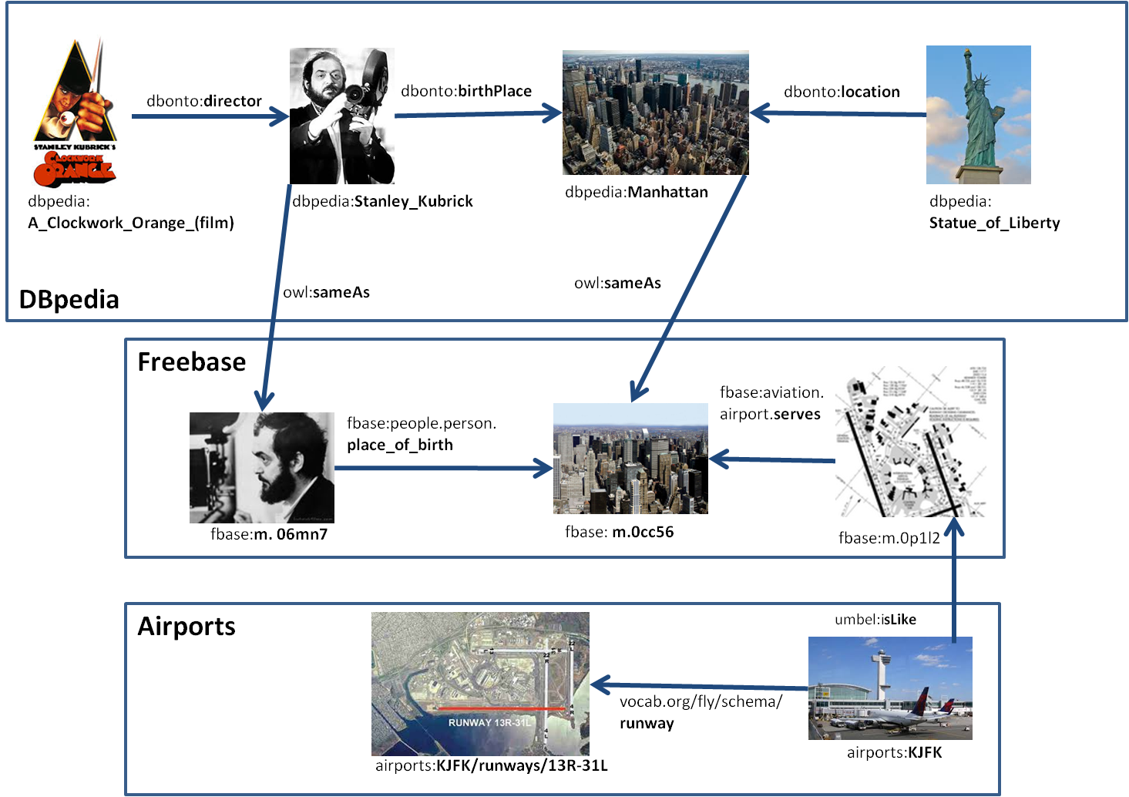





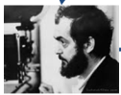
Types of Missed Matches (FNs)
Type A: a third, matching description (transitivity)
Type B: matches of their neighbors
applicable to identify matches within a KB
directs
can identify matches both within a KB and across different KBs
isdirected

Slide 6

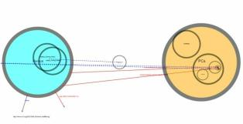
Iterative ER
Increase the number of matching entities
Blocking
Matching
Iterative ER: identify new matches based on partial results either of matches or of merges
Good for high Variety
Notes:
generate new candidate pairs of descriptions not considered in a previous step.
Clearly several passes increase the number of comparisons and reduce the Reduction Ratio

Slide 7
Iterative ER Approaches
Merging-based: new matches can be found by exploiting merged (more complete) descriptions of previously identified matches
  Idea: ER resembles a database self-join operation (of the initial set of descriptions with itself)
    But: No knowledge about which descriptions may match, so all pairs of descriptions need to be compared
Matching-based: If descriptions related to entity e_{i} are matching to descriptions related to e_{j}, then e_{i} and e_{j} are likely to match
  Idea: ER resembles to a graph traversal problem in which similarity is propagated until a fixed point is reached
    Use positive or negative evidence for prioritize similarity re-computation

Slide 8
Matching and Resolving Entities (II): Merging-based Iterative Resolution
Notes:
In merging-based iterative entity resolution (mainly of relational records), the matching decision between two descriptions triggers a merge operation, which transforms the initial entity collection by adding the new, merged description and potentially removing the two initial descriptions. This change also triggers more updates in the matching decisions, since the new, merged description needs to be compared to the other descriptions of the collection. Intuitively, the final result of merging-based iterative entity resolution is a new set of descriptions which are the results of merging all the matches found in the initial entity collection. In other words, each real-world entity described in the input entity collection is represented by a single description in the resolution results and each description in the resolution results represents a distinct real-world entity from the input entity collection.

Slide 9
Merging-based ER– Formal Definition
Let E = {e₁, ..., e_{m}} a set of entity descriptions and
  M : E ×E → {true, false} is a match function
  μ : E ×E → E is a partial merge function
The merging-based (generic) resolution of entities in E is a set of descriptions E’, such that:
    ∀e_{i}, e_{j} ∈ E : M(e_{i}, e_{j}) = true, ∃e_{k} ∈ E’: μ (e_{i}, e_{j}) ≤ e_{k}
    ∀e_{k} ∈ E’, ∀e_{l} ∈ E, e_{l} ≤ e_{k}
    no strict subset of E‘ satisfies conditions 1 and 2
  where e_{l} ≤ e_{k} means that e_{k} is at least as informative than e_{l}, regarding the same real-world entity
Note: E’ ⊆ E (the merge closure)
  Condition 1: E’ cannot produce more than E
  Condition 2: E’ produce at least all information of E
  Condition 3: Minimal solution
∧
∧
∧
Notes:
The merge closure exists and it is unique.

Slide 10
Match and Merge Functions: ICAR Properties [Benjelloun et al., 2009]
Idempotence: a description always matches itself, and merging it with itself still yields the same description
  ∀e_{i} ∈ E if M(e_{i},e_{i}) = true then μ (e_{i},e_{i}) = e_{i}
    Commutativity: direction of match and merge is irrelevant
  ∀e_{i},e_{j} ∈ E if M(e_{i},e_{j}) = M(e_{j},e_{i}) = true then μ(e_{i},e_{j}) = μ(e_{j},e_{i})
  Associativity: order of merge is irrelevant
  ∀e_{i},e_{j},e_{k} ∈ E if μ(μ(e_{i},e_{j}),e_{k}) and μ(e_{i},μ(e_{j},e_{k}) exist then μ(μ(e_{i},e_{j}),e_{k}) = μ(e_{i},μ(e_{j},e_{k})
  Representativity: merging does not lose matches; no “negative evidence”
  if e_{k}=μ(e_{i},e_{j}) then ∀e_{l} ∈ E such that M(e_{i},e_{l}) = true also M(e_{k},e_{l}) = true
Transitivity is not assumed!
Notes:
O. Benjelloun, H. Garcia-Molina, D. Menestrina, Q. Su, S. E. Whang, and J. Widom. Swoosh: a generic approach to entity resolution. VLDB J., 18(1):255–276, 2009

Slide 11
Merge Domination & Monotonicity
When the match and merge functions satisfy the ICAR properties, there is a natural domination (partial) order of descriptions
Given two descriptions, e₁ and e₂, we say that e₁ is merge domi-nated by e₂, denoted e₁≤e₂, if M(e₁,e₂) = true and μ(e₁,e₂) = e₂
  e₁ does not add information
  Merged descriptions always dominates the ones they have derived from
  ∀e₁, e₂ ∈ E such that M(e₁,e₂) = true, it holds that e₁ ≤ μ(e₁,e₂) and e₂ ≤ μ(e₁,e₂)
Match function is monotonic
  ∀e₁, e_{2,} e₃ ∈ E If e₁ ≤ e₂ and M(e₁,e₃)=true, then M(e₂,e₃)=true
Merge function is monotonic
  ∀e₁, e_{2,} e₃ ∈ E If e₁ ≤ e₂ and M(e₁,e₃) , then μ(e₁,e₃) ≤ μ(e₂,e₃)
∀e₁, e_{2,} e₃ ∈ E If e₁≤e₃, e₂≤e₃ and M(e₁,e₂)=true, then μ(e₁,e₂) ≤ e₃
Generic Entity Resolution with Swoosh F. Naumann 20.6.2013
Notes:
Description e1 is dominated by e2 if M(e₁,e₂) = true and e2 holds more information: e1 ≼ e2
Any partial order on records
◊ Reflexive, transitive
◊ Antisymmetric: if e1 ≼ e2 and e2 ≼ e1, then e1= e2

Slide 12
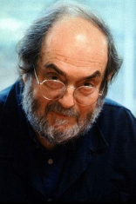
What is Best Sequence of Match, Merge Calls that Give us Right Answer?
e₁
KB1:Stanley_Kubrick
KB1:birthPlace | KB1:Manhattan
KB1:bornIn | 1928-7-26
KB1:parents | KB1:Gertrude Kubrick
KB1:parents | KB1:Jacques Leonard Kubrick
rdf:type | yago:AmericanFilmDirectors
e₂
KB1:SKBRK
KB1:name | “S. Kubrick”
KB1:birthPlace | KB1:Manhattan
KB1:deathPlace | KB1:UnitedKingdom
KB1:diedIn | 1999
KB2:SKubrick
foaf:name | “Stanley Kubrick”
KB2:place_of_birth | KB2:MNHT
rdf:type | foaf:Person
KB2:activeYearsEndYear | 7/3/1999
KB2:directed | KB2:A_Clockwork_Orange
e₃
M(e₂,e₃)=true
e_{2,3}=μ(e₂,e₃)
KB12:Stanley_Kubrick
birthPlace | Manhattan
bornIn | 1928-7-26
parents | Gertrude Kubrick
parents | Jacques Leonard Kubrick
rdf:type | AmericanFilmDirectors
activeYearsEndYear | 7/3/1999
directed | A_Clockwork_Orange
M(e₁,e_{2,3})=true

Slide 13
R-Swoosh [Benjelloun et al., 2009]
Assumes ICAR and merge domination
Idea 1: if M(e₁,e₂) = true we can remove e₁ and e₂
  Whatever would match e₁ or e₂ now also matches μ(e₁,e₂)
  Representativity and associativity
Idea 2: Removal of dominated descriptions is not necessary as a last step in the algorithm
  Assume e₁ and e₂ appear in final answer where e₁ ≤ e₂
    Then M(e₁,e₂) = true and μ(e₁,e₂) = e₂
  Thus comparison of e₁ and e₂ should have generated merged description e₂, and e₁ should have been eliminated
Generic Entity Resolution with Swoosh F. Naumann 20.6.2013

Slide 14
R-Swoosh Example
E
E'
E
E'
E
E'
e₁
e₂
e₃
e₂
e₃
e₁
e₃
e₁
e₂
(a)
(b)
(c)
E
E'
E
E'
E
E'
e₂₃
e₁
e₁₂₃
e₁₂₃
(d)
(e)
(f)
Notes:
One of the algorithms exploiting the ICAR properties is R-Swoosh, which operates as follows. A set E of entity descriptions is initialized to contain all the input descriptions. Then, at each iteration, a description e is removed from E and compared to each description e’ of the, initially empty, set E’. If e and e’ are found to match, then they are removed from E and E’, respectively, and the result of their merging is placed into E (exploiting representatively). If there is no description e’ matching with e, then e is placed in E’. This process continues until E becomes empty, i.e., there are no more matches to be found.

Slide 15
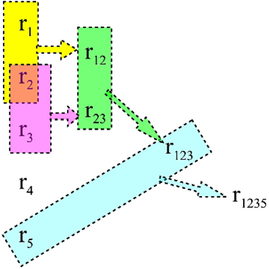
ER with ICAR properties
General ER process is guaranteed to be finite
Entity descriptions can be matched and merged in any order
e₁
Dominated entity descriptions can be discarded anytime
Union class of match and merge
  Union-merge: All values are kept in merged descriptions
  Union-match: At least one of the values in common
e
e₂
e
e
e
e
e
e
Commutativity of match and merge functions for highly heterogeneous descriptions does not always hold
Notes:
Keeps data lineage, ensures that we do not miss future matches
Presentation to user or app to do the actual fusion
Alternative for numbers: Keep range
The key idea is that each record maintains all the values seen in its base records. For example, if a record with name {John Doe} is merged with a record with name {J. Doe}, the result would have the name {John Doe, J. Doe}. Unioning values is convenient in practice since we record all the variants seen for a person’s name, a hotel’s name, a company’s phone number, and so on. Keeping the “lineage” of our records is important in many applications, and furthermore ensures we do not miss future potential matches. Notice that the actual presentation of this merged record to the user does not have to be a set, but can be any string operation result on the possible values (e.g., {John Doe}). Such a strategy is perfectly fine as long as the records only use the “underlying” set values for matching and merging. Two records match if there exists a pair of values from the records that match. In our example, say the match function compares a third record with name {Johnny Doe} to the merged record obtained earlier. If the function compares names, then it would declare a match if Johnny Doe matches either one of the two names.

Slide 16
Matching and Resolving Entities (II): Matching-based Iterative Resolution
Notes:
Graph-based Iterative Algorithms

Slide 17
Positive and Negative Match Evidence
Evaluated on individual entities
Evaluated on interrelated entities
 | Hard Constraints | Soft Constraints
Positive Evidence | FD: if M(e_{i}, e_{j}) = true then M(e_{k}, e_{l}) = true Example: if two movies match then their director also match | FD: if M(e_{i}, e_{j}) = true then most likely M(e_{k}, e_{l}) = true Example: if two movies match then their actors are most likely to match
Negative Evidence | FD: if M(e_{i}, e_{j}) = false then M(e_{k}, e_{l}) = false Example: if two directors don’t match then movies directed by them don’t also match | FD: if M(e_{i}, e_{j}) = false then most likely M(e_{k}, e_{l}) = false Example: if two movies don’t match then their actors are less likely to match
Negative constraints are usually
stated by domain experts
Constrains can be recursive
L. Getoor, A. Machanavajjhala Entity Resolution for Big Data KDD’13 Tutorial
Notes:
Hard constraints are those which we definitely want to be true. These might relate to the successful assembly of a mechanism. Soft constraint are those we would like to be true - but not at the expense of the others. These might say that a mechanism must follow a given path. There is not point in trying to match every point exactly if this can only be done by breaking the assembly of the links.
Global constraint: if two movie festivals match then their venue also match
Can be applied to all instances of venues e.g., all occurrences of ‘Cannes International Film Festival’ (named until 2002) can be matched to ‘Cannes Festival’
Local constraint: if two movies match then their actors also match
Don’t match all occurrences of ‘Victorina Mérida Rojas’ with ‘Victoria Abril’, only in the context of the Almodovar’s films

Slide 18
Additional Constraints [Shen et al, 2005]
Type | Example
Aggregate | No director has produced more than four movies per year
Subsumption | If a movie X from Yago matches a movie Y from IMBD then each studio cited by in Y matches some studio cited by in X
Neighborhood | If actors X and Y share similar names and some co-­actors in a movie, they are likely to match
Incompatible | No director has filmed a movie in studios both in Africa and Japan
Layout | If two movies with similar names are mentioned by the same review they are likely to match
Key/Uniqueness | Actors of the same movie must refer to distinct persons
Ordering | If two paper citations match, then their authors will be matched in order
Individual | ‘Victorina Mérida Rojas’ matches with ‘Victoria Abril’
Notes:
W. Shen et al., “Constraint-­based Entity Matching”, AAAI 2005

Slide 19
Matching-based Iterative ER
Pair-wise ER: matching decisions are made independently
  Deduplication, Linkage
Collective ER: matching decisions depend on other matching decisions according to positive and negative evidence (general constraints)
  Similarity propagation approaches (more scalable)
    Dependency graphs of matching decisions
    Collective relational clustering
  Probabilistic approaches (scalability is an open issue)
    Generative Models (for acyclic dependencies between match decisions)
    Undirected Models based on Markov Networks (sometimes with a first-­order logic syntax)
  Hybrids of constraints and probabilistic models
Notes:
LDA, CRFs, Markov Logic Networks, Probabilistic Relational Models
Constraint‐based Entity Matching,
Dedupalog
The approach presented by Dong et al relies on existence of a dependency graph whose nodes represent similarities between record pairs, and edges represent dependencies between matching decisions. In general, the records and their relationships themselves can be represented as a graph. The graph indicates that, for example, if two publications match (maybe based on the fact that all their authors match) then their venues must match as well.
Bhattacharya and Getoor propose another method called relational clustering for entity resolution (RC-ER), which iteratively creates clusters of matched records. In each iteration, clusters that are deemed most similar are merged. The similarity between two clusters is measured based on matching (strings) of the cluster labels, in addition to matching attributes of their related records. What makes this measure different from other measures is that its value can change after each iteration, since the cluster labels and their set of related records can change.
I. Bhattacharya and L. Getoor. Collective Entity Resolution in Relational Data. IEEE Data Engineering Bulletin, 29(2):4–12, 2006.
I. Bhattacharya and L. Getoor. Collective Entity Resolution in Relational Data. ACM Transactions on Knowledge Discovery from Data (TKDD), 1(1), 2007.
Another known problem is the existence of inconsistent matching results, e.g., a record a matches with two records b and c but b and c do not match. To resolve such inconsistencies we can partition the graph of records. Consider the graph G(N,E) where each node n in N represents a record and each edge (n, m) in E connects two nodes n and m only if their corresponding records match. We call this graph the linkage graph. The goal of the clustering algorithm is then to cluster the linkage graph in a way that the number of intra-cluster edges are maximized while minimizing edges between clusters. This problem is proven to be NP-complete

Slide 20
Similarity Propagation Approaches
A graph structure for encoding the similarity between entity descriptions and matching decisions, and iteratively assess matching of entities by propagating similarity values
  Details of how the graph is constructed and traversed and how (content and context) similarity is computed vary
Similarity-propagation ER: the match function is re-computed at each iteration step by considering previous matching decisions:
  M^{n}(e_{i},e_{j}) = true, if sim^{n-1}(e_{i},e_{j}) ≥ ϑ
  M^{n}(e_{i},e_{j}) = false, if sim^{n-1}(e_{i},e_{j}) ≤ ϑ’
  M^{n}(e_{i},e_{j})= undecided, otherwise
Total similarity:
sim(e_{i},e_{j})= a*sim_{nbr}(e_{i},e_{j})+(1-a)*sim_{nbr}(nbr(e_{i}),nbr(e_{j}))
where nbr(e) denotes the neighborhood (in, out) nodes of e
Notes:
While probabilities may be encoded in various ways in the algorithms, no global probabilistic model is defined
Based on an entity graph: 1 node = 1 entity, 1 edge = relationship between 2 entities
Based on dependency graph: 1 node = 2 entities, 1 edge = relationship to another entity pair
Similarity function can be defined by applying domain knowledge, learning from training data, resorting to global knowledge, etc.

Slide 21
Maintaining the Order of Comparisons
In similarity-propagation approaches the order of comparisons is dynamic
Graph traversal usually supported by a priority queue (PQ) on the similarity score of nodes
  As entities are resolved, the PQ is updated for maximizing effectiveness & reducing re-comparisons
Different strategies of order maintenance:
  Based on heuristics
    type of nodes and edge direction [Dong et al. 2005]
    degree of nodes [Weis & Naumann 2006]
    edge weights [Kalashnikov & Mehrotra 2006]
  Triggered by recent matches [Böhm et al. 2012, Lacoste-Julien et al. 2013]
  Lazy maintenance [Herschel et al. 2012, Altowim et al. 2014]
Notes:
Dong, X., Halevy, A.Y., Madhavan, J.: Reference reconciliation in complex information spaces. In: SIGMOD, pp. 85–96 (2005)
Dmitri V. Kalashnikov and Sharad Mehrotra Domain-independent data cleaning via analysis of entity-relationship graph. ACM TODS Journal, Vol. 31(2), June 2006
Weis, M., Naumann, F.: Detecting duplicates in complex xml data. In: ICDE, p. 109 (2006)
M. Herschel, F. Naumann, S. Szott, M.Taubert. Scalable iterative graph duplicate detection. IEEE Trans. Knowl. Data Eng. 24(11), 2094–2108 (2012)
M. Herschel and F. Naumann. Scaling Up Duplicate Detection in Graph Data. In Proc. of the ACM Conf. on Information and Knowledge Management (CIKM), pages 1325–1326, 2008.
Bohm, C., de Melo, G., Naumann, F., Weikum, G.: Linda: distributed web-of-data-scale entity matching. In: CIKM, pp. 2104–2108 (2012)
S. Lacoste-Julien, K. Palla, A. Davies, G. Kasneci, T. Graepel and Z. Ghahramani SiGMa: Simple Greedy Matching for Aligning Large Knowledge Bases,19th ACM SIGKDD International Conference on Knowledge Discovery and Data Mining (KDD 2013), Chicago, USA, August 2013.
Naumann and Herschel refer to the record linkage algorithms that take advantage of such graphs as graph algorithms, and present efficient algorithms to minimize re-comparison of the records by updating the order of comparison each time a matching decision is made. This is based on the observation that, for example, if the publications are compared first, then their venues (that do not match solely based on string similarity) can be matched in the first comparison, otherwise they need to be compared again after their publications match.

Slide 22
Dependency Graph [Dong et al., 2005]
Works on an entity graph constructed from the relational records
  nodes represent similarity comparisons between pairs of records and/or their attribute values (real-­valued)
  edges represent match decisions based on the matching of associated nodes (boolean-­valued)
A matching decision is taken when the real-valued similarity score (between 0 and 1) of a node is above a threshold θ
  If it exceeds the threshold, it is marked as match, otherwise as undecided,
  if no more neighbors are undecided, it is marked as non-match
Idea 1: consider richer matching evidence
Idea 2: propagate similarity between matching decisions
Idea 3: Gradually enrich references by merging attribute values (Swoosh-style)
Notes:
Enrichment: After reconciling two person entities fusion their information: “mike” and “Stonebraker, M.” share first name initial, and contact the same person by email correspondence or co-authoring. This enables us to resolve other dependent entities

Slide 23



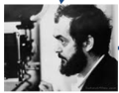




Dependency Graph: Example
Let E be a set of entity descriptions
  A node v = {e_{i},e_{j}}, where e_{i},e_{j} ∈ E, i ≠ j
  An edge e = (v_{a},v_{b}) from v_{a}={e_{ai},e_{aj}} to v_{b} = {e_{bi}, e_{bj}} implies e_{bi} , e_{bj} ∈ values(e_{ai}) ∪ values(e_{aj})
Directed edge when dependency is only in one direction
  can be stated by domain experts
  inferred by the data semantics (e.g., keys/forein keys, rdf properties)
Include only nodes whose two entities have the potential to be similar
v₁
v₂
v₃
v₄
Notes:
Definition
For every pair of references A and B: For each pair of entity descriptions e1,e2 (of the same type) create a node m=(e1,e2)
A node representing their similarity
For every attribute of A and attribute of B: For each pair of attribute values a1 of e1 and a2 of e2 (attributes may be of different types), there is a node n = (a1, a2) and an edge between m and n
A node representing attribute similarity
Each node is associated with a similarity score between 0 and 1
An edge between attr-sim node and ref-sim node, representing the dependency between the similarities

Slide 24
Consider Richer Matching Evidence [Dong et al., 2005]
Positive evidence (i.e., constraints for match nodes) is captured by the Boolean similarity of neighborhood nodes
  Strong-boolean: Resolution implies resolution of neighbour
    E.g., if two movies are matched then director must also be matched
  Weak-boolean: No direct implication
    E.g., similarity of two movies increases as their rdf:labels are highly similar
Negative evidence (i.e., constraints for non‐match nodes) is verified after similarity propagation is performed, and inconsistencies are fixed
Notes:
Non-merge node: the two entities are guaranteed to be different and should never be merged

Slide 25
Similarity Propagation [Dong et al., 2005]
Similarity function for node u: sim(u) = S_{rv} + S_{sb} + S_{wb}
  S_{rv}: from real-valued neighbors (decision-tree shape)
  S_{sb}: from strong-boolean-valued neighbors
  S_{wb}: from weak-boolean-valued neighbors
When a node is matched, the similarity score of its neighbors is re-computed
Process converges if
  Similarity score is monotone in the similarity values of neighbors
  Compute neighbor similarities only if similarity increase is not too small
Notes:
Normalized between 0 and 1
S_{rv} = Σ_{i∈[1,n]}λ_{i}x_{i} , where x_{i} is the similarity score of in-neighbor i∈[1,n], and λ_{i} is the weight of the corresponding weight (one for each – semantic - type of neighbors)
| β |N_{sb}|, if S_{rv} >= thresh,
S_{sb} = |
| 0, otherwise
where |N_{sb}| is the number of matched strong-boolean neighbors and β is a constant
| γ |N_{wb}|, if S_{rv} >= thresh,
S_{wb} = |
| 0, otherwise
where |N_{wb}| is the number of matched weak-boolean neighbors and γ is a constant

Slide 26









Traversing the ER Graph
e
a
b
c
PQ
f
a
b
c
h
d
e
g
h
d
g
Initially all nodes are active and placed in the PQ
A node is processed before its out-neigbors
f
Notes:
no weights in the edges, we are focusing only on reference nodes.
It can cope with cyclic graphs and not only DAGs. When there are no cycles nodes are resolved in any order, as long as the constraint is satisfied. In the presence of cycles the constraint is violated and one node in the cycle is picked up for comparison. A nodes can be active, merged or inactive. Initially all nodes are active and are placed in the PQ. At each iteration step the node in the head of the PQ is processed and its similarity is assessed (i.e., update its similarity). If the similarly is above the threshold then it becomes merged otherwise inactive. In both cases they are removed from the PQ. If the updated similarity increase its similarity then all its inactive out-neibords become active and inserted at the end of the PQ (by respecting the processing order constraint).

Slide 27

Traversing the ER Graph
e
a
b
c
PQ
b
c
h
d
e
g
h
d
g
merged node
f
inactive node

Slide 28
Traversing the ER Graph
e
a
b
c
PQ
c
h
d
e
g
h
d
g
f

Slide 29
Traversing the ER Graph
e
a
b
c
PQ
h
d
e
g
h
d
g
f

Slide 30
Traversing the ER Graph
e
a
b
c
PQ
d
e
g
h
d
g
f

Slide 31
Traversing the ER Graph
e
a
b
c
PQ
g
b
e
h
d
g
f

Slide 32
Traversing the ER Graph
e
a
b
c
PQ
b
e
h
d
g
f

Slide 33

Traversing the ER Graph
e
a
b
c
PQ
e
c
h
d
g
f

Slide 34
Traversing the ER Graph
e
a
b
c
PQ
c
h
d
g
f

Slide 35
Traversing the ER Graph
e
a
b
c
PQ
h
d
g
f

Slide 36
Linda [Böhm et al. 2012]
Works on an entity graph constructed from the RDF descriptions
  exploits the unique mapping constraint between two KBs
Key Idea: the more matching neighbors via similar relationships two descriptions have, the more likely it is that they match
  String similarity of the literal values of entities: checked once
  Contextual similarity of the graph neighbors:checked iteratively
Two square matrices (|E| × |E|) are used:
  X captures the identified matches (binary values)
  Y captures the pair-wise similarities (real values)
    Initialization: common neighbors & string similarity of literals
    Updates: Use the new identified matches of X
Until the priority queue (extracted from Y) becomes empty:
  Get the pair (e_{i}, e_{j}) with the highest similarity: match by default!
    Update X: matches of e_{i} are also matches of e_{j}
  Update the similarity of nodes influenced by the new matches
Notes:
clean to clean
Y is only used for the priority queue
The head of the priority queue (highest similarity) is a match by default.
actual termination conditions: (a) certain # iterations, (b) certain # entries in X computed, (c) specific fraction of the queue processed

Slide 37
Linda Algorithm Example
Matches | e1 | e2 | e3 | e4 | e5
e1 | 1 | 0 | 0 | 0 | 0
e2 |  | 1 | 0 | 0 | 0
e3 |  |  | 1 | 0 | 0
e4 |  |  |  | 1 | 0
e5 |  |  |  |  | 1
PQ
e1 – e4
e2 – e4
e1 – e3
e5 – e3
e2 – e3
…
A priority queue, derived by an initial similarity compu-tation between all pairs, based on their attribute values
e3
e4
e2
e1
e5
Notes:
Only a matching phase (no blocking)

Slide 38
Linda Algorithm Example
Matches | e1 | e2 | e3 | e4 | e5
e1 | 1 | 0 | 0 | 1 | 0
e2 |  | 1 | 0 | 0 | 0
e3 |  |  | 1 | 0 | 0
e4 |  |  |  | 1 | 0
e5 |  |  |  |  | 1
PQ
e1 – e4
e2 – e4
e1 – e3
e5 – e3
e2 – e3
…
the head of PQ is a match by default
e3
e4
e2
e1
e5

Slide 39
Linda Algorithm Example
Matches | e1 | e2 | e3 | e4 | e5
e1 | 1 | 0 | 0 | 1 | 0
e2 |  | 1 | 0 | 0 | 0
e3 |  |  | 1 | 0 | 0
e4 |  |  |  | 1 | 0
e5 |  |  |  |  | 1
PQ
e2 – e4
e1 – e3
e2 – e3
e5 – e3
…
unique mapping constraint (1-1 Assumption)
similarity re-computation, based on the matching neighbors and the names of the links to them
directs
e3
e4
e2
e1
directs
e5
Notes:
all neighbor nodes are re-compared by privileging nodes with the same type of link

Slide 40
Linda Algorithm Example
Matches | e1 | e2 | e3 | e4 | e5
e1 | 1 | 0 | 0 | 1 | 0
e2 |  | 1 | 1 | 0 | 0
e3 |  |  | 1 | 0 | 0
e4 |  |  |  | 1 | 0
e5 |  |  |  |  | 1
PQ
e2 – e3
e5 – e3
…
directs
e3
e4
e2
e1
directs
e5
Notes:
That is, the context of n includes in- and out-neighbor nodes
context_sim(n, m) =
The context C(n) of n is a set of tuples (p_{i}, z_{i}, w_{i}), where z_{i} is a neighboring node of n p_{i} is the predicate associated with an edge connecting n with z_{i},w_{i} is a numeric weight (how discriminative this information is) sim(p_{i}, p_{j}) is an edit distance-based similarity score of the predicates p_{i}, p_{j}

Slide 41
Linda Algorithm Example
Matches | e1 | e2 | e3 | e4 | e5
e1 | 1 | 0 | 0 | 1 | 0
e2 |  | 1 | 1 | 0 | 0
e3 |  |  | 1 | 0 | 0
e4 |  |  |  | 1 | 0
e5 |  |  |  |  | 1
PQ
e5 – e3
…
unique mapping constraint (1-1 Assumption)
directs
e3
e4
e2
e1
directs
stops when PQ is empty
e5

Slide 42
Linda Distributed Version
Matches | e1 | e2 | e3 | e4 | e5
e1 | 1 | 0 | 0 | 0 | 0
e2 |  | 1 | 0 | 0 | 0
e3 |  |  | 1 | 0 | 0
e4 |  |  |  | 1 | 0
e5 |  |  |  |  | 1
PQ
e1 – e4
e2 – e4
e1 – e3
e2 – e3
…
PQ
e5 – e3
e5 – e4
…
Node 2
Node 1
knows
e3
e4
e5
Node 2
The node to hold the PQ entry (a,b) and the respective vertex neighbors is determined by a modulo operation of the first component (a)
e2
e1
Node 1
knows
Notes:
The distributed version is not guaranteed to return the same results as the centralized one!

Slide 43
Matching and Resolving Entities (II): Progressive Resolution Techniques
Notes:
ER traditionally seen as a pre-processing step prior to data analysis. Such an offline strategy is not suitable for many emerging applications that require (near) real-time analysis, especially if it involves big, fast, or streaming data

Slide 44



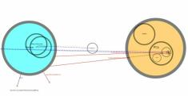

Progressive ER
Optimization: maximize benefit (number or type of matches) for a given cost (number of comparisons, disk/cloud access)
Blocking
Planning
Matching
Update
Progressive ER: estimates which part of the data to resolve next and adapts this decision in a pay as you go fashion
Good for high Velocity
Notes:
They essentially extend the typical ER workflow with a planning phase, which is responsible for selecting which pairs of descriptions, that have resulted from blocking, will be compared in the entity matching phase and in what order. The goal of this new phase is to favour more promising comparisons, i.e., those that are more likely to result in matches. This way, those comparisons are executed before less promising ones and thus, more matches are identified early on in the process. Moreover, the optional update phase propagates the results of matching, such that a new scheduling phase will promote the comparison of pairs that were influenced by the previous matches. This iterative process continues until the pre-defined computing budget is consumed.

Slide 45
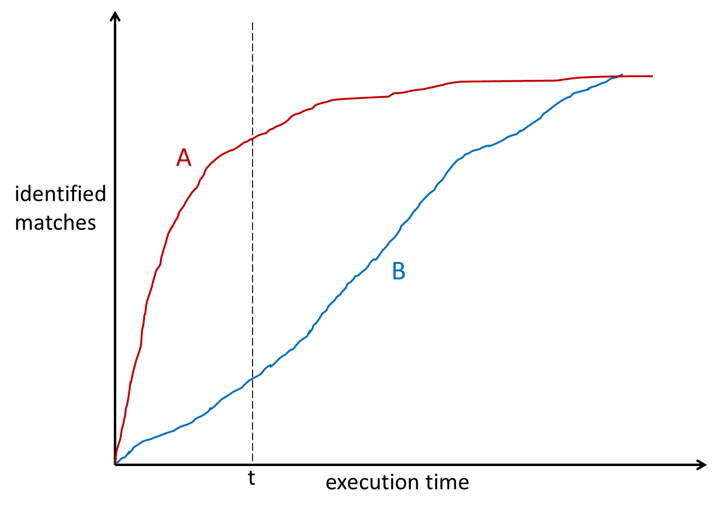
Progressive Approach to Relational Entity Resolution [Altowim et al. 2014]
Key Idea: divides the ER process into several windows and generates a resolution plan for each window
Lazy resolution strategy to resolve pairs with the smallest cost
  Unlike single entity type resolution a block based prioritization is significantly more important when resolving multiple types
  specifies which blocks and entity pairs within these blocks will be resolved during the plan execution phase of a window
  associates with each identified pair the order in which to apply the similarity functions on the attributes of the two entities
Notes:
Yasser Altowim, Dmitri V. Kalashnikov, and Sharad Mehrotra. 2014. Progressive approach to relational entity resolution. Proc. VLDB Endow. 7, 11 (July 2014), 999-1010.
Unlike single entity-set resolution where there may not be a strong reason to prefer one block over another to match first,

Slide 46
Relational Progressive ER: Example
Actors
Movies
Directors
v₁
v₅
v₁
v₅
v₉
v₂
v₂
v₆
v₁₀
v₆
v₃
v₇
v₃
v₇
v₁₁
Blocks with entities of the same type
A₁ M₁
D₁
A₁ M₁
v₄
v₈
v₁₂
M₂
A₂ D₂
Altowim et al. Progressive Approach to Relational ER VLDB 2014
Notes:
To capture decision propagation, it is often convenient to model the problem as a graph:
Nodes: Pairs of entity descriptions of the same type (relation)
Edges: Dependency between pairs (foreign keys)
The set of candidate nodes to be resolved next is determined by the tradeoff between the benefit and the cost of resolving these nodes. Developing an optimal progressive approach is infeasible in practice as it would require an “oracle" that knows in advance the set of pairs that, when resolved, will have the highest influence on the quality of the result. Thus, a pragmatic approach consists in finding a good strategy that best utilizes the given budget by saving cost at two different levels. First, resolve only the parts of the dataset that have higher benefit on the quality of the result. Second, it should resolve those identified pairs with the least amount of cost.

Slide 47
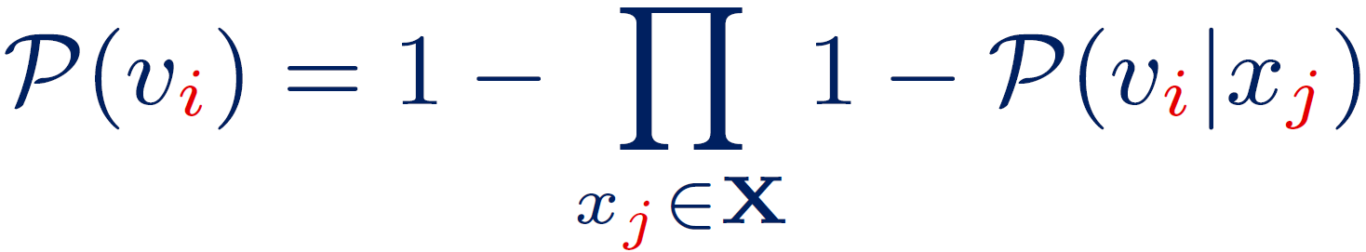
Matching Probability Estimation
Noisy-OR Model
The nodes in the ER graph influencing a pair of entities are interpreted as common causes to the same effect
The probability that a node is processed at each round depends on the number of cause nodes that are matches and/or on the percentage of matching nodes in the block of the effect node
Cause
Cause
…
Cause
Effect
not required to know all the causes
Effect: Node considered for matching
Causes: (a) Influencing matching nodes
(b) Fraction of matching pairs in the block of
v_{i}
x_{j}
v_{i}
Altowim et al. Progressive Approach to Relational ER VLDB 2014
Notes:
We should stress that leak value represents the probability that vi is duplicate in the absence of all explicitly modeled causes of yi, and it can be different for different entity-sets (actors, movies, directors).
Computing the exact benefit of a node vi is infeasible in practice for two reasons. First, computing the probability value of a node given a state requires the graph G to be fully instantiated to infer the dependency between the nodes (in contrast, G is progressively constructed), and is also equivalent to the belief update problem in Bayesian Networks, which is known to NP-hard. Second, identifying each of the set Top (set of unresolved nodes that can be resolved within the remaining cost of our budget BG such that the summation of their probability values given S is maximized) and set Topvi (set of unresolved nodes that can be resolved within the remaining cost of our budget minus the resolution cost of vi such that the summation of their probability values given Svi is maximized) can be easily proved to be NP-hard as it contains the traditional knapsack problem as a special case. Therefore, we use heuristics to compute Benefit(vi).

Slide 48



Heuristics for Estimating Node Benefit
v₁
v₅
v₉
match
non-match
v₂
v₆
v₁₀
v₃
v₇
v₁₁
A₁ M₁
D₁
v₄
v₈
v₁₂
M₂
A₂ D₂
Direct Benefit
Indirect
Benefit
A
M
The Impact is estimated for k nodes of the same entity type, as the average number of their direct dependent unresolved nodes
v₁
v₂
M₁
Fraction of matching pairs in the block
Altowim et al. Progressive Approach to Relational ER VLDB 2014
Notes:
Therefore, we use heuristics to compute Benefit(vi) and the values of P(vi) and Imp(vi) are estimated as below.
the probability value of vi is estimated based on the present influencing nodes that are detected as matches and the known percentage of duplicate nodes in block in which vi belongs
the impact value of vi is computed per relation (all the actors have the same impact)
The value P(A -> M) refers to the probability that a node vl in V(M) is duplicate given that exists a duplicate node vm in V(A) that influences vl via L A->M. Such a probability value can be specified by a domain expert or learned from a training data set.
Since computing even the most influencing nodes is in general an NP-hard problem, we instead compute a single estimated impact value Imp(R) for every entity-set R and we use that single value as the impact value of every candidate node vi in V(R). This value is computed based on statistics that we collect prior to and throughout the execution of the algorithm.
this function estimates the number of the direct dependent nodes via L A -> M that will be impacted by the resolution of the k nodes.

Slide 49
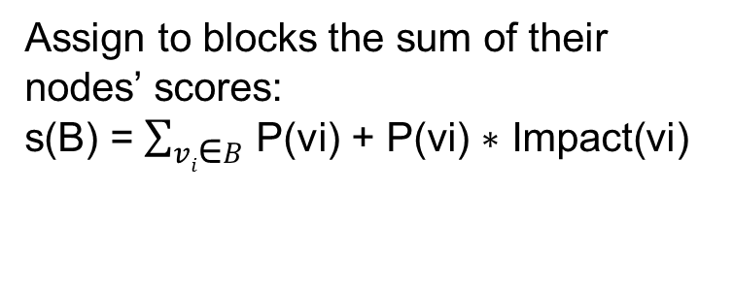
Traversing the ER Graph (in Blocks)
F1
M1
D1
0.3
a
0.1
b
e
0.3
d
s(F1)=s(e)= 0.1+0.1*1=0.2
0.1
0.1
s(M1)=s(a)+s(d)= (δ+δ*1)*2=4δ
A1
M2
c
0.2
0.2
0.3
f
D2
h
g
Assign to blocks the sum of their nodes’ scores:
s(B) = $\sum_{vi\text{∈}B}{\text{P}\text{(}\text{vi}\text{) + }\text{P}\text{(}\text{vi}\text{) ∗ }\text{Impact}\text{(}\text{vi}\text{)}}$
s(Α1)=s(c)+s(h)=(0.1+0.1*2)*2=0.6
Impact(directors) = 3,
Impact(actors) = 2,
Impact(movies) = 1
Impact(family) = 1
Initial P(v_{i}) = δ
Initially, a block of the entity type with the highest out-degree (impact) is selected (in random), since P(v_{i}) is the same for all nodes (of the same type)
Notes:
In this example P(v_{i}) = δ for those nodes with no matching in-neibords

Slide 50
Traversing the ER Graph (in Blocks)
F1
M1
D1
0.3
a
0.1
b
e
0.3
d
s(F1)=s(e)= 0.1+0.1*1=0.2
0.1
0.1
s(M1)=s(a)+s(d)= (δ+δ*1)*2=4δ
A1
M2
c
0.2
0.2
0.3
f
D2
h
g
Assign to blocks the sum of their nodes’ scores:
s(B) = $\sum_{vi\text{∈}B}{\text{P}\text{(}\text{vi}\text{) + }\text{P}\text{(}\text{vi}\text{) ∗ }\text{Impact}\text{(}\text{vi}\text{)}}$
s(Α1)=s(c)+s(h)=(0.1+0.1*2)*2=0.6
Impact(directors) = 3,
Impact(actors) = 2,
Impact(movies) = 1
Impact(family) = 1
Initial P(v_{i}) = δ
Then, update the scores, load the block with the highest score and resolve its nodes
Notes:
Note that the similarity score of nodes do not change.

Slide 51
Traversing the ER Graph (in Blocks)
F1
M1
D1
0.3
a
0.1
b
e
0.3
d
s(F1)=s(e)= 0.1+0.1*1=0.2
0.1
0.1
s(M1)=s(a)+s(d)= (δ+δ*1)+ (0.2+0.2*1)=2δ+0.4
A1
M2
c
0.2
0.2
0.3
f
D2
h
g
Assign to blocks the sum of their nodes’ scores:
s(B) = $\sum_{vi\text{∈}B}{\text{P}\text{(}\text{vi}\text{) + }\text{P}\text{(}\text{vi}\text{) ∗ }\text{Impact}\text{(}\text{vi}\text{)}}$
Impact(directors) = 3,
Impact(actors) = 2,
Impact(movies) = 1
Impact(family) = 1
Initial P(v_{i}) = δ
Then, update the scores, load the block with the highest score and resolve its nodes

Slide 52
Traversing the ER Graph (in Blocks)
F1
M1
D1
0.3
a
0.1
b
e
0.3
d
s(F1)=s(e)= 0.1+0.1*1=0.2
0.1
0.1
A1
M2
c
0.2
0.2
0.3
f
D2
h
g
s(M2)=s(f)= δ+δ*1=2δ
Assign to blocks the sum of their nodes’ scores:
s(B) = $\sum_{vi\text{∈}B}{\text{P}\text{(}\text{vi}\text{) + }\text{P}\text{(}\text{vi}\text{) ∗ }\text{Impact}\text{(}\text{vi}\text{)}}$
s(D2)=s(g)= δ+δ*3=4δ
Impact(directors) = 3,
Impact(actors) = 2,
Impact(movies) = 1
Impact(family) = 1
Initial P(v_{i}) = δ
Then, update the scores, load the block with the highest score and resolve its nodes

Slide 53


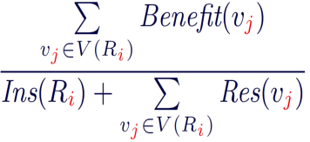
ER Planning
Instantiated
Unresolved Nodes
Step#1
v₁
v₂
v₄
v₁
v₂
v₆
v₆
v₇
v₁₀
v₁₃
v₁₀
v₁₆
v₁₅
v₁₆
v₂₁
Sort
Uninstantiated Blocks
Step#2
R₁
R₂
R₄
R₅
R₆
R₈
R₉
Altowim et al. Progressive Approach to Relational ER VLDB 2014

Slide 54









ER Planning
R₁
…
R₈
R₆
R₂
Step#3
v₃₀
v₃₂
v₃₄
v₁
v₂
v₄₀
v₄₂
v₄₅
v₃₆
v₃₈
v₁₀
v₃₀
v₄₇
v₄₈
v₁
v₂
v₆
  If >
  else
  return and
v₁₀
v₁₆
Altowim et al. Progressive Approach to Relational ER VLDB 2014

Slide 55
Comparison of ER Graph Traversals
Property | [Dong et al. 2005] | [Böhm et al. 2012] | [Altowim et al. 2014]
Seed node selection | any node with no in-edges | the node with the highest content_sim | any node of the entity type with the highest out-degree
Matching condition | similarity is above a threshold value | the highest score (head of PQ) | a (black-box) resolve function returns true
Similarity/Evidence Update (PQ) | weighted sum of in-neighbors similarities | weighted sum of matching in-/out-neighbors similarities | leaky noisy-or of matching in-neighbors
Backtracking
Traversal policy | topological sort | advance in the PQ the neighbors (with most similar relationships) of the recent match | sort PQ based on #in-matches and #out-neighbors

Slide 56
Web-scale Progressive ER: Ongoing Work
Relational progressive ER algorithms assume that the more entity pairs are correctly identified, the higher the quality of the result is expected to be
We are interested in characterizing the quality of resolved pairs
  # of real-world entities resolved (shallow strategy)
    entity-centric search (entity coverage)
  # of real-world entity graphs resolved (deep strategy)
    entity-centric recommendation (relationship completeness)
  # descriptions resolved for the same real-world entity
  (tail strategy)
    web-scale knowledge curation (attribute completeness)
Notes:
From Big Data to Big Knowledge

Slide 57
Matching and Resolving Entities (II): Challenges and Open Issues

Slide 58
Challenges and Open Issues
Tight coupling of Blocking with Iterative Matching/Merging
  Better control of block characteristics w.r.t. the entity similarity subsequently used (see [J. Fisher et al. 2015]
Progressive ER with Quality Guarantees
  guarantees (e.g., coverage) regarding the quality of matches/ merges w.r.t. subsequent entity-centric services and data analysis tasks
ER for Big Data
  Algorithms for high Velocity (see [D. Firmani et al. 2016]), Variety, and Volume entity descriptions (see [Q. Wang et al. 2015] [L. Kolb et al. 2012])
Large-Scale ER Testbeds
  Real-world ground truth datasets for different match types and open source ER platforms (see [Efthymiou et al. 2015, 2016])
Notes:
J. Fisher, P. Christen, Q. Wang, and E. Rahm. A Clustering-Based Framework to Control Block Sizes for Entity Resolution. In Proceedings of the 21th ACM SIGKDD International Conference on Knowledge Discovery and Data Mining (KDD '15). ACM, New York, NY, USA, 279-288.
D. Firmani, B. Saha, & D. Srivastava. 2016. Online entity resolution using an Oracle. Proc. VLDB Endow. 9, 5 (January 2016), 384-395.
Q. Wang, M. Cui, & H. Liang. Semantic-Aware Blocking for Entity Resolution. Transactions on Knowledge and Data Engineering (TKDE). December 2015
L. Kolb, A. Thor, & E. Rahm. Load Balancing for MapReduce-based Entity Resolution. In Proceedings of the 2012 IEEE 28th International Conference on Data Engineering (ICDE '12). IEEE Computer Society, Washington, DC, USA, 618-629.
V. Efthymiou, K. Stefanidis, V. Christophides: Minoan ER: Progressive Entity Resolution in the Web of Data. EDBT 2016
V. Efthymiou, K. Stefanidis, V. Christophides: Big data entity resolution: From highly to somehow similar entity descriptions in the Web. Big Data 2015

Slide 59
Challenges and Open Issues
Crowdsourced ER:
  reduce the crowdsourcing cost for obtaining ground truth (see [Chai et al. 2016] [Gokhale et al. 2014] [Wang et al. 2012])
Temporal ER:
  resolve evolving entity descriptions and analyse the history of descriptions (see [Dong & Tan 2015])
Uncertain ER:
  consider confidence scores when resolving certain & uncertain entity descriptions (see [Gal 2014] [Demartini et al. 2013])
Privacy-aware ER:
  Trade-off between entity obfuscation techniques and ER results quality (see [Whang & Garcia-Molina 2013])
Notes:
X. L. Dong & W. C. Tan: A Time Machine for Information: Looking Back to Look Forward. Tutorial in VLDB, 2015
C. Chai, G. Li, J. Li, D. Deng, & J. Feng. 2016. Cost-Effective Crowdsourced Entity Resolution: A Partial-Order Approach. In SIGMOD '16
C. Gokhale, S. Das, A. Doan, J. F. Naughton, N. Rampalli, J. W. Shavlik, & X. Zhu. Corleone: hands-off crowdsourcing for entity matching. In SIGMOD, pages 601–612, 2014.
J. Wang, T. Kraska, M. J. Franklin, & Jianhua Feng. CrowdER: crowdsourcing entity resolution. Proc. VLDB Endow. 5, 11 (July 2012), 1483-1494.
Avigdor Gal. 2014. Uncertain entity resolution: re-evaluating entity resolution in the big data era: tutorial. Proc. VLDB Endow. 7, 13 (August 2014), 1711-1712.
G. Demartini, D. E. Difallah, and P. Cudré-Mauroux. Large-scale linked data integration using probabilistic reasoning and crowdsourcing. VLDB J., 22(5):665–687, 2013.
S. E. Whang & H. Garcia-Molina. Disinformation techniques for entity resolution. In CIKM, pages 715–720, 2013.

Slide 60
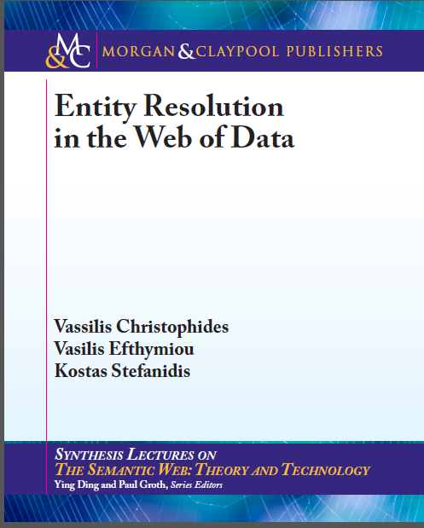
http://www.morganclaypoolpublishers.com/catalog_Orig/product_info.php?products_id=823

Slide 61
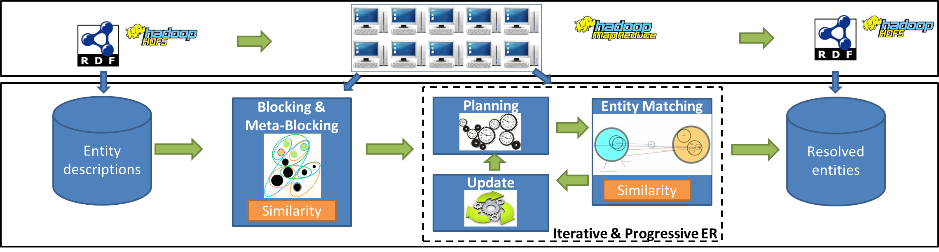
The Minoan ER Framework
http://csd.uoc.gr/~vefthym/minoanER
Notes:
V. Efthymiou, K. Stefanidis, V. Christophides: Minoan ER: Progressive Entity Resolution in the Web of Data. EDBT 2016
V. Efthymiou, K. Stefanidis, V. Christophides: Big data entity resolution: From highly to somehow similar entity descriptions in the Web. Big Data 2015
V. Efthymiou, G. Papadakis, G. Papastefanatos, K. Stefanidis, T. Palpanas: Parallel meta-blocking: Realizing scalable entity resolution over large, heterogeneous data. Big Data 2015
V. Efthymiou, K. Stefanidis, V. Christophides: Benchmarking Blocking Algorithms for Web Entities. IEEE Transactions on Big Data

Slide 62

Questions ?

Slide 63

Acknowledgements
EU FP7-PEOPLE-2013-IRSES
Big Geospatial Data Quality and User Privacy Défi Mastodons CNRS 2016

Slide 64

License
These slides are made available under a Creative Commons Attribution-ShareAlike license (CC BY-SA 3.0): http://creativecommons.org/licenses/by-sa/3.0/
You can share and remix this work, provided that you keep the attribution to the original authors intact, and that, if you alter, transform, or build upon this work, you may distribute the resulting work only under the same or similar license to this one

