Slide 1
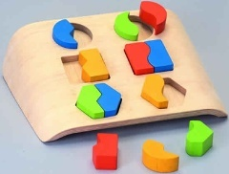
Entity Resolution in the Web of Data
Vassilis Christophides
INRIA Paris-Roquencourt (MUSE team,France)
Joint work with Vasilis Efthymiou (UoC-CSD, Greece)
& Kostas Stefanidis (Tampere University, Finland)

Slide 2
Matching and Resolving Entities (I): Entity Similarity
Notes:
Entity Similarity Functions
Content-based
Context-based
Blocking Frameworks for Web-scale ER
Token-based
Attribute-based
URL-based
Block Post-processing
Critical Assessment of Blocking Techniques
Meta-Blocking

Slide 3
Similar or Dissimilar?

Slide 4
Similarity is Domain Specific
Shape
Color
Size
Pattern

Slide 5
Entity Resolution - Match
Matches: Sets of entity descriptions that refer to the same real-world entity, intuitively:
  Matching descriptions are placed in the same partition
  All the descriptions of the same partition match
A match function M() maps each pair of entity descriptions (e_{i}, e_{j}) to {true, false}
  M(e_{i}, e_{j}) = true => e_{i}, e_{j} are matches
  M(e_{i}, e_{j}) = false => e_{i}, e_{j} are non-matches
Notes:
Finding matches vs non-­matches is a classification problem
•Imbalanced: typically O(E) matches, O(E^2) non-­matches
• Instances are pairs of descriptions. Pairs are not independent and identically distributed (i.i.d.)

Slide 6
Match Function: Formal Properties
The match function M() introduce an equivalence relation (owl:sameAs) among entity descriptions
  Reflexivity: ∀e_{i} ∈ E if M(e_{i}, e_{i}) = true
  Symmetry: ∀e_{i}, e_{j} ∈ E M(e_{i}, e_{j}) = M(e_{j} ,e_{i})
  Transitivity: ∀e_{i}, e_{j}, e_{k} ∈ E if M(e_{i}, e_{j}) = true and M(e_{j}, e_{k}) = true then M(e_{i}, e_{k}) = true
Additional properties are useful when linking & repairing entities
  Exclusivity (1-1 Assumption): ∀e_{i} , e_{k} ∈ E and ∀e_{j} ∈ E’ if M(e_{i}, e_{j}) = true then M(e_{k}, e_{j}) = false
  Functional Dependency: ∀e_{i}, e_{j}, e_{k}, e_{l} ∈ E where e_{i} ⇒ e_{k} and e_{j} ⇒ e_{l} if M(e_{i}, e_{j}) = true then M(e_{k}, e_{l}) = true
Notes:
Unique Mapping Assumption, Clean – Clean

Slide 7
Entity Resolution - Similarity
In practice, the match function is defined via a similarity function sim(), measuring how similar two entity descriptions are to each other, according to certain comparison criteria
Given a similarity threshold t:
  M(e_{i}, e_{j}) = true, if sim(e_{i}, e_{j}) ≥ ϑ
  M(e_{i}, e_{j}) = false, otherwise
ML techniques for automatically learning similarity measures are challenged by a Web-scale entity resolution [Köpcke et al. 2010]
  adaptive learning techniques require training data for each domain [Tejada et al. 2002] [Bilenko et al. 2003]
  active learning techniques (threshold-based Boolean functions or linear classifiers) work well with highly similar descriptions [Arasu et al. 2010]
Notes:
H. Köpcke, A. Thor, & E. Rahm. Evaluation of entity resolution approaches on real-world match problems. PVLDB, 3(1):484–493, 2010.
S. Tejada, C. A. Knoblock, & S. Minton. Learning domain-independent string transformation weights for high accuracy object identification. In Proceedings of the eighth ACM SIGKDD international conference on Knowledge discovery and data mining (KDD -2002). ACM, New York, NY, USA, 350-359.
M. Bilenko & R. J. Mooney. Adaptive Duplicate Detection Using Learnable String Similarity Measures. In Proceedings of the 9th ACM SIGKDD International Conference on Knowledge Discovery and Data Mining (KDD-2003), pp.39-48, Washington, DC, August 2003.
A. Arasu, M. Götz, & R. Kaushik. On active learning of record matching packages. In Proceedings of the ACM SIGMOD 2010, New York, NY, USA, 783-794.
Computing entities from descriptions can be seen as a clustering problem
• In typical clustering algorithms (k-­means, LDA, etc.) number of clusters is a constant or sub linear in E.
• In ER the number of clusters is linear in E, and average cluster size is a constant. Significant fraction of clusters are singletons.

Slide 8
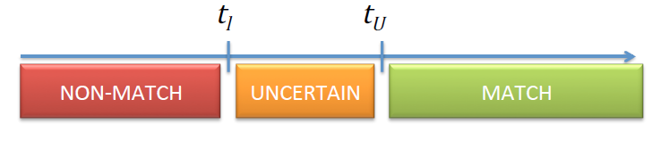
Fellegi & Sunter Model [Science‘69]
Assuming an entity pair ζ = (e₁, e₂) and a comparison vector γ (for simplicity binary) of descriptions, M a set of matching pairs, U a set of non-­matching pairs, the resolution decisions are based on :
  R(ζ) = M(γ)/U(γ) = P(γ | ζ∈M) / P(γ | ζ∈U)
Resolution Rule: R(tl,tu)
For high dimensional γ computing M(γ), U(γ) becomes inefficient
Computing P(γ | ζ∈M) requires some knowledge of matches
Notes:
I. Fellegi & A. Sunter, “A Theory for Record Linkage”, JASA 1969

Slide 9



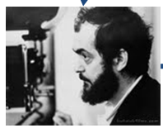
Entity Similarity: Example
dbpedia: A_Clockwork_Orange_(film)
dbo:director | dbpedia:Stanley_Kubrick
dbo:Work/ runtime | “136”
foaf:name | “A Clockwork Orange”
fbase:m.05ldxl
fbase:film.directedBy | lmdb:director/8476
fbase:film_cut/runtime | “136”
foaf:name | “A Clockwork Orange”
e2
e4
although not identical e₂ and e₄ are highly similar
dbpedia:Stanley_Kubrick
dbo:birthPlace | dbpedia:Manhattan
rdf:type | foaf:Person
rdf:type | yago:AmericanFilmDirectors
rdf:type | yago:Amateur ChessPlayers
lmdb:director/8476
lmdb:director_name | “Stanley Kubrick”
rdf:type | foaf:Person
foaf:made | lmdb:film/1894
foaf:made | lmdb:film/2014
foaf:made | lmdb:film/2685
e3
e1
e₁ and e₃ are at best somehow similar
Notes:
Entity Matching: Relies on a similarity function, the higher the similarity of two descriptions, the more likely it is that they match
-Content : standalone comparisons between entities based on the values of their attributes
-Context: graph-based comparisons between entities based on their relationships

Slide 10
The Role of Similarity Functions: Ideal Case
Matching pairs of entity descriptions
Pairs of entity descriptions satisfying an ideal similarity function
Set of all pairs of entity descriptions
Notes:
The underlying intuition for this definition is that the higher the similarity of two descriptions, the more likely it is that they match, i.e., the similarity of two descriptions is used as a hint for their matching. There is no general way of determining which attributes should count as salient in determining matching entity descriptions [de Melo, 2013]
G. de Melo. Not quite the same: Identity constraints for the web of linked data. In AAAI, 2013

Slide 11
The Role of Similarity Functions: A Pragmatic Case
Matching pairs of entity descriptions
Pairs of entity descriptions satisfying a pragmatic similarity function
Set of all pairs of entity descriptions
Missed matching pairs of entity descriptions
True matching pairs of entity descriptions
Notes:
As studied in [Hogan et al., 2010], a pair of descriptions is more likely to be matching if they share several common attribute-value pairs, while certain attributes are more appropriate to determine matches and certain values of these attributes are more discriminant than others.
A. Hogan, A. Polleres, J. Umbrich, and A. Zimmermann. Some entities are more equal than others: statistical methods to consolidate linked data. In 4th International Workshop on New Forms of Reasoning for the Semantic Web: Scalable and Dynamic (NeFoRS2010), 2010.

Slide 12
Entity Similarity: Formal Description
A similarity function sim(): Ε × Ε → R is a metric, if for any e_{i},e_{j},e_{l}∈E for a given set E, it satisfies the following conditions:
  sim(e_{i},e_{i}) ≥ 0 (positive),
  sim(e_{i},e_{i}) ≥ sim(e_{i},e_{j}),
  sim(e_{i},e_{j}) = sim(e_{j},e_{i}) (reflexive),
  sim(e_{i},e_{i}) = sim(e_{j},e_{j}) = sim(e_{j},e_{i}) ⇒ e_{j}=e_{i}
  sim(e_{i},e_{j})+sim(e_{j},e_{l}) ≤ sim(e_{i},e_{l})+sim(e_{j},e_{j}) (triangle inequality)
Normalized similarity: sim(e_{i},e_{i})∈[0,1]
  sim(e_{i},e_{i}) = 1 for exact match
  sim(e_{i},e_{j}) = 0 for “completely” different e_{i} and e_{i}
  0 < sim(e_{i},e_{j}) < 1 for some approximate similarity
Any similarity metric can be transformed to a distance metric and vice versa
  sim(e_{i},e_{j})= 1 – dist(e_{i},e_{j})
Notes:
S. Araújo, D. Tran, A. DeVries, J. Hidders, and D. Schwabe. SERIMI: class-based disambiguation for effective instance matching over heterogeneous web data. In WebDB, pages 25–30, 2012.
C. Böhm, G. de Melo, F. Naumann, and G. Weikum. LINDA: distributed web-of-data-scale entity matching. In CIKM, pages 2104–2108, 2012.
Distance metric properties:
d ( x , y ) ≥ 0 non-negativity or separation axiom
d ( x , y ) = 0 ⇔ x = y identity of indiscernibles
d ( x , y ) = d ( y , x ) symmetry
d ( x , z ) ≤ d ( x , y ) + d ( y , z ) subadditivity or triangle inequality

Slide 13
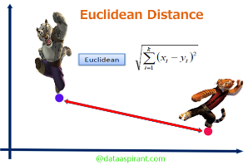
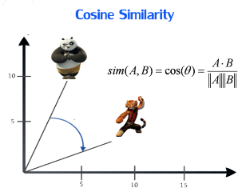
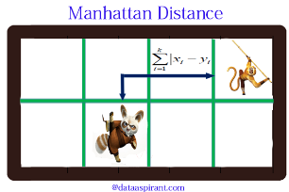
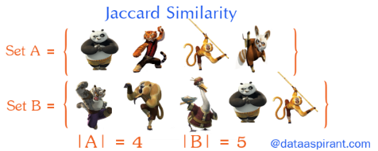
Euclidian vs Non-Euclidian Distances
A Euclidean space: has some number of real-valued dimensions and dense points
  There is notion of average of two points
  A Euclidian distance is based on the locations of points in such space (L₂-norm, L₁-norm)
A Non-Euclidian distance is based on properties of points, but not on their “location” in space
  Jaccard, Cosine, Edit, Hamming distance
http://dataconomy.com/implementing-the-five-most-popular-similarity-measures-in-python/
Notes:
http://www.it1me.com/learn?s=Euclidean_distance http://slideplayer.com/slide/6412385/
Euclid geometry: distance between two points is a line
Non-Euclid geometry: distance between two points is a curly path along the object surface
The Manhattan distance (or city block) is a non-Euclidian distance metric which is defined as the sum of the absolute distance between the coordinates of each point. It measures the route one might have to travel between two points in Manhattan where the streets and avenues are arranged at right angles to one another. It is known as Hamming distance when applied to binary data.

Slide 14
Matching and Resolving Entities (I): Content-based Entity Similarity

Slide 15
In Search of Entity Similarity Measures
Defining similarity functions that satisfy the formal properties of metric spaces is, in practice, too restrictive for non-geometric models
Two main families of similarity measures for resolving entity descriptions in the Web of data
  Content-based: mostly for measuring string similarity of attribute values in pairs of entity descriptions
    character-based, token-based
  Context-based: exploit similarity of neighbor descriptions via different entity relationships
    tree-based, graph-based
Notes:
Defining similarity functions that satisfy the formal properties of metric spaces is, in practice, too restrictive for non-geometric models [Jacobs et al., 2000, Mu and Yan, 2010, Santini and Jain, 1999, Skopal, 2006, Tversky, 1977]. For example, the triangle inequality assumes that the notion of similarity is transitive. A well-known counter-example is that a man is similar to a centaur and the centaur is similar to a horse; however, the man is completely dissimilar to the horse [Mu and Yan, 2010, Skopal, 2006]. Content-based similarity measures usually satisfy the properties of metric spaces.
A. Tversky. Features of similarity. Psychological Review, 84:327–352, 1977.
D. W. Jacobs, D. Weinshall, and Y. Gdalyahu. Classification with nonmetric distances: Image retrieval and class representation. IEEE Trans. Pattern Anal. Mach. Intell., 22(6):583–600, 2000.
T. Skopal. On fast non-metric similarity search by metric access methods. In EDBT, pages 718–736, 2006.
Y. Mu and S. Yan. Non-metric locality-sensitive hashing. In AAAI, 2010

Slide 16
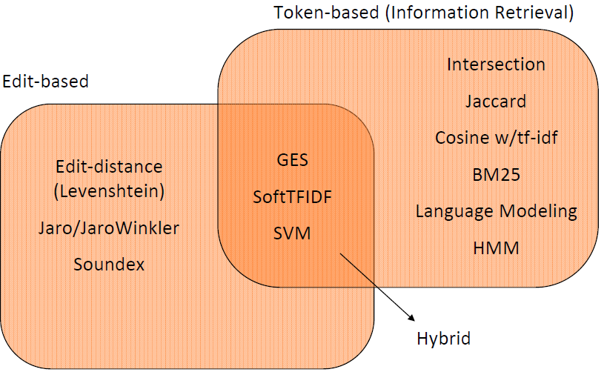

String Similarity Measures
Good for Text-intensive
descriptions
Good for Names
Dice
Good for
abbreviations,
nick names
Phonetic
Domain dependent (Rules, DataTypes)
Record Linkage: Similarity Measures and Algorithms N. Koudas S. Sarawagi D. Srivastava SIGMOD'06 Tutorial
Notes:
Character-based functions manage to account for typographical errors (character swaps, typos, etc.). In general, these functions allow edit operations in order to transform one string into another, for example, by inserting, deleting, or substituting characters. Can handle Typographical errors
Token-based functions take as input the set of tokens of two descriptions, or alternatively, the set of n-grams of these descriptions, i.e., substrings of length n. Intuitively, Jaccard similarity expresses the number of tokens two sets have in common divided by the total number of unique tokens. Similarly dice similarity is equal to the number of tokens or n-grams in common to both sets, relative to the average size of the total number of tokens present. It is essentially the harmonic mean of precision and recall.
The Levenshtein distance satisfies the formal properties of a metric, but Jaro and Jaro-Winkler similarity functions are not symmetric, and consequently, cannot be considered as metrics [Euzenat
and Shvaiko, 2013]
Note that symmetry and triangle inequality are not required for token-based similarity functions to be labelled as strong or weak. Note also that only Jaccard can be considered as a metric, since the rest of the token-based similarity functions do not satisfy the triangle inequality [Charikar, 2002].
M. S. Charikar. Similarity estimation techniques from rounding algorithms. In STOC, pages 380–388, 2002.
W. Cohen, P. Ravikumar, S. Fienberg, (2003-08-01). A Comparison of String Distance Metrics for Name-Matching Tasks. 73–78.
A hybrid similarity measure combines several single similarity measures with a combination method to achieve better extraction results.
Global Evidence of Similarity (GES) : Using a statistical (generative) model for composing one signal from another, we derive information-theoretic measures for local and global similarities induced by shared regions. The local similarities of shared regions (“local evidence scores”) are accumulated into a global similarity score (“global evidence score”) of the entire query signal relative to the reference signal.
softTFIDF: a “soft” version of TFIDF, in which similar tokens are considered as well as tokens in S intersection T
Zhu, X., Gong, P., Zhao, Z., & Zhang, C. (2012). Learning similarity metric with SVM. In Proceedings of the International Joint Conference on Neural Networks.

Slide 17
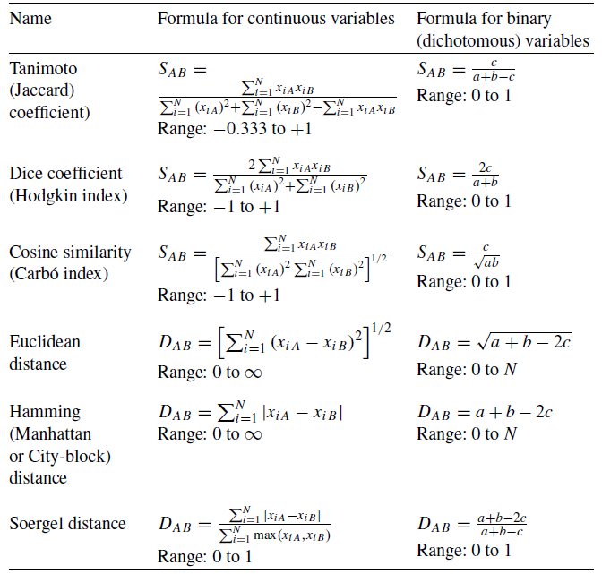

Slide 18
Tokenizing Strings: Separators
Forming words from sequence of characters:
  Surprisingly complex in English, can be harder in other languages
General idea: Separate string into tokens using some separator
  Space, hyphen, punctuation, special characters
  Usually also convert to lower-case
Problems:
  Sometimes hyphens should be considered either as part of the word or a word separator: e.g., spanish-speaking
  Apostrophes can be a part of a word, a part of a possessive, or just a mistake: e.g., master's degree
  Periods can occur in numbers, abbreviations, URLs, ends of sentences, and other situations: e.g., F.M.I
Similarity measures Felix Naumann 11.6.2013

Slide 19
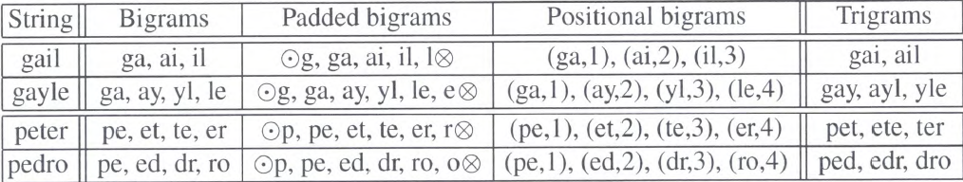
Tokenizing Strings: n-grams
Split string into short substrings of length n
Sliding window over string
  n=2: Bigrams
  n=3: Trigrams
Variation: Pad with n – 1 special characters
  Emphasizes beginning and end of string
Variation: Include positional information to weight similarities
  Number of n-grams = |x| – n + 1
  Count how many n-grams are common in both strings
Similarity measures Felix Naumann 11.6.2013
Notes:
Q-grams: A Foundation for Approximate String Processing

Slide 20
Token-based Entity Similarity
name | Eiffel Tower
architect | Sauvestre
year | 1889
location | Paris
name | Statue of Liberty
architect | Bartholdi Eiffel
year | 1886
located | NY
about | Lady liberty
architect | Eiffel
location | NY
e3
e1
e2
name | White Tower
location | Thessaloniki
year-constructed | 1450
about | Eiffel Tower
architect | Sauvestre
year | 1889
located | Paris
e5
e4
Jaccard( tokens(e_{i}), tokens(e_{j}) ) = | tokens(e_{i}) ∩ tokens(e_{j}) |
| tokens(e_{i}) ∪ tokens(e_{j}) |
Jaccard(e₁,e₃) = 1/8
Jaccard(e₁,e₄) = 1
Jaccard(e₁,e₅)= 1/8
Jaccard(e₂,e₃) = 3/7
Jaccard(e₂,e₄) = 1/11
Jaccard(e₂,e₅) = 0/11

Slide 21
Matching and Resolving Entities (I): Context-based Entity Similarity

Slide 22
Similarity of Hierarchical Data
Relational star / snowflake schema [Ananthakrishna et al. 2002]
Hierarchical XML data [Calado et al.2010]
Casting
Movie
ID | Actor | Film
S1 | Al Pacino | F1
S2 | Al Pacino | F2
S3 | Marlon Brando | F2
ID | Name | Year | Rating
F1 | The Godfather | 1972 | 9.2
F2 | Gottvatter, The | 72
single branch
m1,movie
m2,movie
t1,title
y1,year
s1,set
t2,title
y2,year
s2,set
Troy
2004
a11,actor
a12,actor
Troja
04
a21,actor
a22,actor
a23,actor
Brad Pitt
Eric Bana
Brad Pit
Erik Bana
Brian Cox
multiple branch
Notes:
R. Ananthakrishna, S. Chaudhuri, and V. Ganti. Eliminating fuzzy duplicates in data warehouses. In VLDB, pages 586–597, 2002.
P. Calado,, M Herschel, L. Leitão: An Overview of XML Duplicate Detection Algorithms. Soft Computing in XML Data Management 2010: 193-224
[Weis and Naumann, 2005] adapts DELPHI has been extended to work not only for a single branch of hierarchy, but also for cases in which one table may have several children tables.
M. Weis and F. Naumann. Dogmatix tracks down duplicates in XML. In SIGMOD, pages 431–442, 2005.

Slide 23
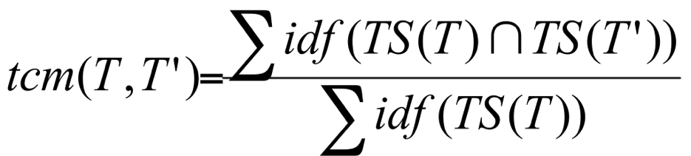

DELPHI Containment Metric [Ananthakrishna et al. 2002]
Hybrid measure considering both similarity of attribute values (tcm) and similarity of children sets reached by foreign keys (fkcm)
Similarity of attribute values
  Divide tuples into tokens → token sets TS
  Compute the edit distance between the tokens of different sets
  Determine weight of each token via inverse document frequency
    Thus the idf of a rare term is high, whereas the idf of a frequent term is likely to be low
  The token similarity metric tcm measures which fraction of one tuple T is covered by the other tuple T’ in a relation of interest R_{i}
Notes:
Summation is performed over the total number of tuples of a relation of interest Ri.
Let G={v1, ..., vn} be a set of tuples from Ri. Let TS(v) denote the set of tokens in a tuple v. Let Bt (G) be the bag (multi-set) of all tokens that occur in any tuple in G. Let tf(t)
denote the frequency of a token t in Bt (G). The token containment metric tcm(v, v’) with respect to G between tuples v and v’ in G is given by the containment metric cm(TS(v), TS(v’)) with respect to G between their token sets. For example, if all tokens have equal IDF values then tcm([“MO”, “United States”], [“MO”, “United States of America”]) is 1.0; And, tcm([“MO”, “United States of America”], [“MO”, “United States”]) is 0.6. Observe that when two tokens differ slightly due to a typographical error, token containment metric still treats
them as two distinct tokens. To address this shortcoming, we treat two very similar tokens—with edit distance 3 less than a small value (say, 0.15)—in Bt (G) to be synonyms.

Slide 24
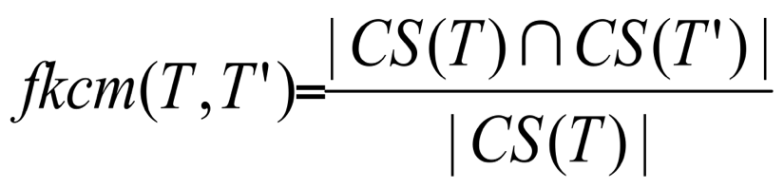
DELPHI Containment Metric [Ananthakrishna et al. 2002]
Similarity of children sets
  The children set CS of a tuple T includes all tuples of a relation R_{j} referencing T from a relation R_{i} by means of a foreign key
  Foreign-key containment metric (fkcm) measures at what extent the children set of a tuple T is covered by the children set of a tuple T’
Notes:
If i > 1, we say that two tuples v1 and v2 in Ri co-occur through a tuple v in Ri-1 if they both join with v. In general, two distinct tuples v1 and v2 in Ri join with two sets S1 and S2 (usually with little overlap) of tuples in Ri-1. We call S1 the children set CS(v1) of v1, and S2 the children set CS(v2) of v2. Let G={v1, ..., vn} be a set of tuples from Ri. Let Bc(G) be the bag (multi-set) of all children tuples in Ri-1 with any tuple in G as parent. The child frequency cf(c) of a child tuple c with respect to G is the number of times c occurs in Bc(G). The FK-containment metric fkcm(v, v’) with respect to G between v and v’ in G is the containment metric cm(CS(v), CS(v’)) with respect to Bc(G) between the children sets CS(v) and CS(v’). For example, the FK-containment metric between values “Missouri” (whose State.Id is S4) and “MO” (whose State.Id is S3) in the State relation is 1.0 because their children sets are identical ({Joplin}).
If a has as child b and c has also as child b, then for the following hierarchy
Level 2: a c
\ /
Level : b
the frequency of b in *multi-set* (children of level 2) is 2

Slide 25
DELPHI Containment Metric [Ananthakrishna et al. 2002]
  Combining tcm and fkcm
    Both tcm and fkcm are assigned an IDF weight
    Use of a classification function:
    pos(x) = 1 if x > 0,
    -1 otherwise
    Threshold for tcm: s1
    Threshold for fkcm: s2
    Classification of pairwise comparison between T and T‘ using
      If final result equals 1, then match, otherwise non-match
Notes:
The IDF values of the token and children sets capture the concept of amount of information because sets containing more distinguishing tokens or children tuples have higher IDF values. For a tuple v in Ri (i >1) let wt=IDF(TS(v)), and wc=IDF(CS(v)).
Essentially, the combination function returns the prediction, 1 (duplicate) or -1 (not a duplicate), of the similarity function that has a higher weight. Suppose that “UK” is considered a duplicate of “USA” according to a textual similarity function. Because they do not co-occur with any state tuple, fkcm contradicts this prediction. Since the children set of UK has a higher IDF value than its token set, UK is not a duplicate of USA.

Slide 26
DELPHI Containment Metric: Example
ID | Actor | Film
S1 | Al Pacino | F1
S2 | Al Pacino | F2
S3 | Marlon Brando | F2
ID | Name | Year | Rating
F1 | The Godfather | 1972 | 9.2
F2 | Gottvatter, The | 72
1. Token sets:
TS(F1) = {The, Godfather, 1972, 9.2}
TS(F2) = {Gottvatter, The, 72}
5. Children co-occurrence
fkcm(F1,F2) = 1, fkcm(F2,F1) = ½
2. Attribute value similarities
The = The, Godfather = Gottvatter,
1972 = 72.
3. Weights
For simplification, we assume all tokens have equal weight
6. Combination of both metrics
(s1 = s2 = 0.5, weights = 1)
pos( pos(3/4 - 0.5) + pos(1 - 0.5) = 1
→ F1 and F2 match
4. Token containment metric
tcm(F1,F2) = ¾, tcm(F2,F1) = 1
Notes:
Assume S1 and S2 matching

Slide 27



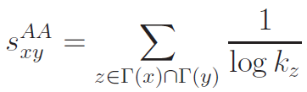


Graph-Context Similarity
Assign a score s_{x y} to each pair of entities x and y
  two descriptions are similar if their structural neighborhood is similar (hide attribute values)
Local similarity Indices
  Common neighbors (CN)
    where is the set of neighbors
  Jaccard: Normalized common neighbors (NCN)
    where is the set of neighbors
  Adamic-Adar (AA):
    where is the degree of node z
    and counts the uniqueness
    of z, which is inversely proportional to its number of neighbors
N
Notes:
Entity relationships are often set-­based
– Set of co-actors for a movie
– Set of cities in a country
– Set of films directed by a director
The Adamic/Adar index is reported to attain the best performance in predicting new links in a social network.
L. A. Adamic and E. Adar. Friends and neighbors on the web. Social Networks, 25(3):211–230, 2003.
Common Neighbors index, also known as Friend of a Friend algorithm (FOAF), is adopted by many popular OSNs, such as facebook.com and hi5.com for the friend recommendation task.
https://wadsashika.wordpress.com/2014/09/19/measuring-graph-similarity-using-neighbor-matching/

Slide 28
Content & Context Similarity:
Linda [Böhm et al. 2012]
Works on an entity graph constructed from RDF triples having URIs as subject, predicate and object
  Literals are stored for each entity e as L(e)
Matches are identified using a hybrid similarity:
  String similarity (token-based) of their literal values L(e)
  Contextual similarity (based on in and out neighbors in the entity graph)
The context C(n) of e is a set of tuples (p_{i},e_{i},w_{i}), where
    e_{i} is a neighboring node of e
    p_{i} is the label of the relationship between e and e_{i}
    w_{i} is a numeric weight selected to be higher for less frequent and thus the most discriminative context information
Notes:
Böhm, C., de Melo, G., Naumann, F., Weikum, G.: Linda: distributed web-of-data-scale entity matching. In: CIKM, pp. 2104–2108 (2012)
Weights are selected to be higher for less frequent and thus more discriminative context tuples.

Slide 29
Contextual Similarity
The contextual similarity of nodes n and m is:
context_sim(n, m) =
where
x_{n,m} is 1, if n, m are identified as matches, and 0 else and sim(p_{i}, p_{j}) is the string similarity of the predicates of n, m (edit-distance based)
It counts the number of common or matching neighbors of two descriptions, which are linked to them in a similar way, i.e., using a relationship with a similar name
Notes:
w = 1/log(freq(p,z)), where freq(p,z) is the total number of occurrences of relation p with entity z (bornIn,ParisFrance,w1) is less discriminative than (bornIn,ParisTexas,w2) actually (work, Bartholdi, w2) is stored in LINDA as (inv:work, Bartholdi, w2) – “is work of” is a dbpedia-like representation

Slide 30
LINDA Hybrid Similarity
The similarity score for descriptions e and e’ is:
sim^{LINDA}(e,e’)= content_sim(e,e’)+
β*context_sim(C(e),C(e’))−θ
where
β controls the contextual influence
θ is used for re-normalization to values around 0
content_
sim^{LINDA} is not a normalized measure as it serves to rank pairs of descriptions based on the evidence that they are matching
  positive scores reflect likely mappings
  negative scores imply dissimilarities
Notes:
more common tokens and common neighbors that two descriptions have, the more likely they are to match, experiments have shown β = 1 to perform well
It is an extension of the overlap similarity, that takes the set size difference into account. Unlike Jaccard similarity, Lprior’s normalization is biased toward the size of the smaller set and, hence, better accounts for data heterogeneity. The reason for this bias is that, in the Web of data, the sizes of the two sets can vary significantly,

Slide 31


Content & Structure Similarity:
SiGMa [Lacoste-Julien et all 2013]
Even though entities i and j have no tokens in common, the fact that several of their respective neighbors are matched together is a strong evidence that i and j should be matched together
  Use neighbors for scoring and suggesting candidate pairs
Notes:
SiGMa: Simple Greedy Matching for Aligning Large Knowledge Bases, S. Lacoste-Julien, K. Palla, A. Davies, G. Kasneci, T. Graepel and Z. Ghahramani, 19th ACM SIGKDD International Conference on Knowledge Discovery and Data Mining (KDD 2013), Chicago, USA, August 2013.
SiGMa: is a scalable greedy iterative algorithm which is able to exploit previous matching decisions as well as the relationship graph information between entities.

Slide 32
SiGMa Neighbors Similarity
Compatible-neighbors N_{ij}: a neighbor k of i being matched to a compatible neighbor l of j should encourage i to be matched to j
  N_{ij} = {(k, l): (i, r, k)∈KB1 and (j, s, l)∈KB2 and relationship r is matched to s}
Notes:
Note that a property of this neighborhood is that (k, l) in Nij iff (I, j) in Nkl, as we have that the relationship r is matched to s iff r-1 is matched to s-1 as well.
For the string similarity measure, we primarily consider the number of words that two strings have in common, albeit weighted by their information content. In order to handle the varying lengths of strings, we use the Jaccard similarity coefficient between the sets of words, with a smoothing term. To capture the
information that some words are more informative than others, we use the IDF (inverse-document-frequency) weight for each word in a weighted Jaccard measure, a commonly used feature in information retrieval. While this measure is robust to word re-ordering, it is not robust to variations of spelling for words.
User provided partial matching between properties of both databases are used in a property similarity measure. In order to elegantly handle missing values of properties, varying number of property values present, etc., we also use a smoothed weighted Jaccard similarity measure between the sets of properties. It can make use of a similarity measure between literals such a normalized distance on numbers (for dates, years etc.) or a string-edit distance on strings.

Slide 33

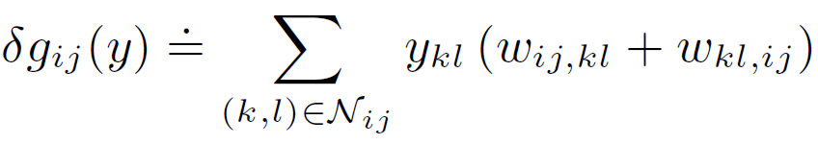
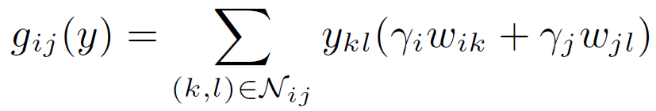
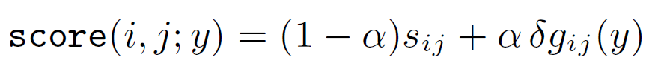
SiGMa Similarity Measures
Content similarity: static score of both the string representation of entities (rdfs:label) and their other property values
Context-dependent similarity: dynamic score where the weight w_{ij,kl} is the contribution of a neighboring matched pair (k,l) to the score of the candidate pair (i,j)
  count the number of compatible neighbors currently matched together for a pair of candidates
Global Score:
Notes:
The matching m : KB1 -> KB2 is encoded by a matrix y with entries indexed by each KB, with yij = 1 if m(i) = j and yij = 0 otherwise
gij(y) is basically counting in a weighted fashion the number of matched pairs (k,l) which are in the neighborhood of I and j.
Note that a property of this neighborhood is that (k, l) in Nij iff (I, j) in Nkl, as we have that the relationship r is matched to s iff r⁻¹ is matched to s⁻¹ as well.
We would like to normalize this count by dividing by the number of possible neighbors, and we would possibly want to weight each neighbor differently. We again use a smoothed weighted Jaccard measure to summarize this information, averaging the contribution from each KB. This can be obtained by defining wij,kl = gi wik + gj wjl, where gi and gj are normalization factors specific to i and j in each database and wik is the weight of the contribution of k to i in KB1 (and similarly for wjl in KB2).

Slide 34
In Search of Entity Similarity Measures
For highly similar entities content similarity (i.e., their attribute values) is sufficient
For somehow similar entities we need to also consider the similarity of the structured context of entities in an iterative way
  Identifying most discriminating attributes and relationships is helpful
An orthogonal issue is the schematic discrepancy of attributes and relationships employed in the entity descriptions whose hybrid similarity is assessed
  Simple: either ontological commitments exist or schematic mappings are provided by the users
  Complex: assess similarity of attributes and relationships based on the similarity of their names or values
Notes:
Defining ideal similarity measures is difficult, calls for more pragmatic approaches

Slide 35
Matching and Resolving Entities (I): Blocking Techniques
Notes:
Token-based
Attribute-based
URL-based
Block Post-processing
Critical Assessment of Blocking Techniques

Slide 36
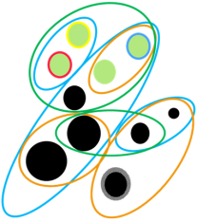
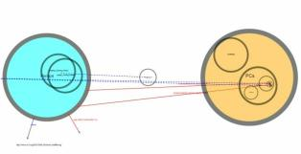
Typical ER Workflow
Reduce comparisons leading to non-matching entities
O(b∙d²)
b blocks of d descriptions (avg)
O(n)
if hash-based
O(n²)
n entity descriptions
Blocking
Matching
Preliminary experiment over 9M entity descriptions in a cluster of 15 VMs:
ER workflow without blocking: >200 hrs
ER workflow with blocking: 11 hrs
Group similar enough
entity descriptions
Recognize pairs of similar entity descriptions
Good for high Volumes
Notes:
Entity Blocking: Enables to perform comparisons only between descriptions of the same block
True Positives: a suggested comparison between matching descriptions
False Positives: a suggested comparison between non-matching descriptions
False Negatives: a pair of matching descriptions, not placed in any common block
Main Blocking Concern: no missed matches (FNs)

Slide 37

Blocking: Formal Definition
Let
  E = {e₁, ..., e_{m}} is a set of entity descriptions
A blocking collection is a set of blocks, B = {b₁, …, b_{m}}, containing entity descriptions such that, $∪bi∈B$ = E

Slide 38
Token Blocking [Papadakis et al. 2011]
Assume two clean sets KB₁, KB₂ of entity descriptions free of intra-overlapping (Clean-Clean ER)
Each distinct token t_{i} of values of entity descriptions in KB₁ ∪ KB₂ corresponds to a block
  Each block contains all entity descriptions sharing the corresponding token
  Pairs originating from the same (clean) KB are not compared
Token blocking offers a brute-force method for comparing descriptions even if they are highly heterogeneous
  The same pair of descriptions is contained in many blocks (redundant comparisons)
  Many dissimilar pairs are put in the same block (unnecessary comparisons)
Notes:
To reduce the number of comparisons required by ER, token blocking relies on the minimal assumption that matching descriptions should at least share a common token.

Slide 39
Token Blocking Example
name | Eiffel Tower
architect | Sauvestre
year | 1889
location | Paris
name | Statue of Liberty
architect | Bartholdi Eiffel
year | 1886
located | NY
about | Lady liberty
architect | Eiffel
location | NY
e3
e1
e2
name | White Tower
location | Thessaloniki
year-constructed | 1450
about | Eiffel Tower
architect | Sauvestre
year | 1889
located | Paris
Actually, an inverted index
e5
e4
Eiffel
e₁, e₂, e₃, e₄
Tower
e₁, e₄, e₅
Statue
e₂
Liberty
e₂, e₃
White
e₅
1889
e₁, e₄
Bartholdi
e₂
Generated
Blocks
NY
e₂, e₃
Paris
e₁, e₄
1886
e₂
1450
e₅
Lady
e₃
Sauvestre
e₁, e₄
Thessaloniki
e₅
Redundant comparisons for (e₁, e₄) contained in 5 different blocks!
Notes:
singular blocks do not suggest comparisons -> they can be ignored
e2, e5 are not placed in any common block
(e1, e4) suggest that we may need to post-processing blocks and prioritize comparisons between descriptions sharing several tokens.

Slide 40
Token Blocking Example
name | Eiffel Tower
architect | Sauvestre
year | 1889
location | Paris
name | Statue of Liberty
architect | Bartholdi Eiffel
year | 1886
located | NY
about | Lady liberty
architect | Eiffel
location | NY
e3
e1
e2
name | White Tower
location | Thessaloniki
year-constructed | 1450
about | Eiffel Tower
architect | Sauvestre
year | 1889
located | Paris
Actually, an inverted index
e5
e4
Eiffel
e₁, e₂, e₃, e₄
Tower
e₁, e₄, e₅
Liberty
e₂, e₃
1889
e₁, e₄
Generated
Blocks
NY
e₂, e₃
Paris
e₁, e₄
Sauvestre
e₁, e₄
Unnecessary comparisons between (e₁, e₃), (e₂, e₄), (e₁, e₅)
Notes:
(e1, e3) (e2, e4) suggest that we may need to distinguish the tokens for different clusters of attributes (place names vs person names).
(e1, e5) suggest that we may need to post-processing blocks and filter out pairs featuring very low common tokens.

Slide 41
Attribute Clustering Blocking [Papadakis et al. 2013]
Token blocking totally ignores the semantics of attributes
  When attribute mappings are not known, attribute clustering considers similarity of attributes
  Attribute similarity is computed w.r.t. the string similarities of their values
Two main steps:
  Similar attributes are placed together in non-overlapping clusters
  Token blocking is performed on the descriptions of each cluster
Notes:
The goal again is to identify matches between two KBs, each containing no duplicates – Clean-Clean Entity Resolution
Next, we present two extensions: attribute clustering blocking, in which candidate matches should at least share a common token for similar attributes known globally and prefix-infix(-suffix) blocking, in which candidate matches should additionally share a common URI infix.

Slide 42
Attribute Clustering Blocking [Papadakis et al. 2013]
For each attribute of KB₁:
  Find the most similar attribute of KB₂
For each attribute of dataset KB₂:
  Find the most similar attribute of dataset KB₁
Compute the transitive closure of the generated pairs of attributes
Connected attributes form clusters
All single-member clusters are merged into a common cluster

Slide 43
Attribute Clustering Blocking: Example
about | Eiffel Tower
architect | Sauvestre
year | 1889
located | Paris
about | Statue of Liberty
architect | Bartholdi Eiffel
year | 1886
located | NY
about | Auguste Bartholdi
born | 1834
about | Joan Tower
born | 1938
e13
e14
e11
work | Eiffel Tower
year-constructed | 1889
location | Paris
work | Bartholdi Fountain
year-constructed | 1876
location | Washington D.C.
work | Lady Liberty
artist | Bartholdi
location | NY
e12
e15
e16
e17
  Finding the attribute of KB₂ that is the most similar to “about” of KB₁: values {Eiffel, Tower, Statue, Liberty, Auguste, Bartholdi, Joan}
compared to (with Jaccard similarity) :
values of work: {Lady,Liberty,Eiffel,Tower,Bartholdi,Fountain} → Jaccard = 4/9
values of artist: {Bartholdi} → Jaccard = 1/8
values of location: {NY, Paris, Washington, D.C.} → Jaccard = 0
values of year-constructed: {1889, 1876} → Jaccard = 0
Notes:
Dataset 1 contains data of many types (buildings, architects, musicians, …)
Joan Tower (born September 6 1938) is a Grammy-winning contemporary American composer, concert pianist and conductor.
Dataset 2 contains only buildings and sculptures.
e₁ = {(about, Eiffel Tower), (architect, Sauvestre), (year, 1889), (located, Paris)}
e₂ = {(about, Statue of Liberty), (architect, Bartholdi Eiffel), (year, 1886), (located, NY)}
e₃ = {(about, Auguste Bartholdi), (born, 1834)}
e₄ = {(about, Joan Tower), (born, 1938)}
e₅ = {(work, Lady Liberty), (artist, Bartholdi), (location, NY)}
e₆ = {(work, Eiffel Tower), (year-constructed, 1889), (location, Paris)}
e₇ = {(work, Bartholdi Fountain), (year-constructed,1876), (location, Washington D.C.)}

Slide 44
Attribute Clustering Blocking: Example
about | Eiffel Tower
architect | Sauvestre
year | 1889
located | Paris
about | Statue of Liberty
architect | Bartholdi Eiffel
year | 1886
located | NY
about | Auguste Bartholdi
born | 1834
about | Joan Tower
born | 1938
e13
e14
e11
work | Eiffel Tower
year-constructed | 1889
location | Paris
work | Bartholdi Fountain
year-constructed | 1876
location | Washington D.C.
work | Lady Liberty
artist | Bartholdi
location | NY
e12
e15
e16
e17
KB1
KB2
about
architect
year
born
located
work
artist
year-constructed
location
Notes:
most similar of architect is work (based on values again).

Slide 45
Attribute Clustering Blocking: Example
Compute the transitive closure of the generated attribute pairs
  Connected attributes form clusters
Example: Pairs (about, work), (work, about), (artist, architect), (architect, work)
KB1
KB2
about
architect
year
born
located
work
artist
year-constructed
location
C1
about
work
architect
artist
C2
C3
year
year-constructed
born
location
located
Notes:
Transitive closure: ignores direction and adds all connected pairs to the same cluster

Slide 46
Token Blocking in Each Attribute Cluster
about | Eiffel Tower
architect | Sauvestre
year | 1889
located | Paris
about | Statue of Liberty
architect | Bartholdi Eiffel
year | 1886
located | NY
about | Auguste Bartholdi
born | 1834
about | Joan Tower
born | 1938
e13
e14
e11
work | Eiffel Tower
year-constructed | 1889
location | Paris
work | Bartholdi Fountain
year-constructed | 1876
location | Washington D.C.
work | Lady Liberty
artist | Bartholdi
location | NY
e12
e15
e16
e17
C1
about
work
architect
artist
C2
C3
year
year-constructed
born
location
located
C3.NY
e₁₂, e₁₅
C1.Tower
e₁₁, e₁₄, e₁₆
C1.Bartholdi
e₁₂, e₁₃, e₁₅, e₁₇
→ compare Lady Liberty to Auguste Bartholdi

Slide 47
Prefix-Infix(-Suffix) [Papadakis et al.12]
Not only the content but also the identity (URI) of descriptions reveal valuable semantics regarding similarity of entities
  E.g., 66% of the 182 million URIs of BTC09 follow the scheme: Prefix-Infix(-Suffix)
Example: http://en.wikipedia.org/wiki/Linked_data#Principles.html
    Prefix describes the source, i.e. domain, of the URI
    Infix is a local identifier or a named anchor
    The optional Suffix contains details about the format, e.g. .html, .rdf .nt, etc.
Infix blocking
  The blocking key is the URI infix of the entity description
Infix profile blocking
  The blocking keys are the URI infixes of attribute values in entity descriptions
Notes:
http://km.aifb.kit.edu/pro jects/btc-2009/

Slide 48
Infix Blocking
yago:Statue_of_Liberty
dbpedia:Statue_of_Liberty
fb:m.072p8
geonames:5139572
skos:prefLabel | Statue of Liberty
yago:isLocatedIn | yago:Liberty_Island
rdfs:label | Statue of Liberty
dbprop:location | dbpedia:Liberty_Island
fb:official_name | Statue of Liberty
fb:contained_by | fb:m.026kp2
ex:location | ex:Liberty_Island
geonames:name | Statue of Liberty
geonames:nearby | geonames:5124330
e1
e2
e4
yago:Tina_Brown
skos:prefLabel | Tina Brown
yago:linksTo | yago:Liberty_Island
e3
e5
Statue_of_Liberty
e₁, e₂
m.072p8
e₃
5139572
e₄
Tina_Brown
e₅
Notes:
e1= {(skos:prefLabel,Statue of Liberty),(yago:isLocatedIn, yago:Liberty_Island)}
e2= {(rdfs:label, Statue of Liberty), (dbpprop:location, dbpedia:Liberty_Island)}
e3= {(freeb:official_name, Statue of Liberty), (freeb:containedby, freeb:m.026kp2), (example:location, example:Liberty_Island}
e4= {(geonames:name, Statue of Liberty), (geonames:nearby, geonames:5124330)}

Slide 49
Infix Profile Blocking
yago:Statue_of_Liberty
dbpedia:Statue_of_Liberty
fb:m.072p8
geonames:5139572
skos:prefLabel | Statue of Liberty
yago:isLocatedIn | yago:Liberty_Island
rdfs:label | Statue of Liberty
dbprop:location | dbpedia:Liberty_Island
fb:official_name | Statue of Liberty
fb:contained_by | fb:m.026kp2
ex:location | ex:Liberty_Island
geonames:name | Statue of Liberty
geonames:nearby | geonames:5124330
e1
e2
e4
yago:Tina_Brown
skos:prefLabel | Tina Brown
yago:linksTo | yago:Liberty_Island
e3
e5
(e₁, e₃) true positive
(e₁, e₅) false positive
Liberty_Island
e₁, e₂, e₃, e₅
m.026kp2
e₃
5124330
e₄
The effectiveness of these approaches relies on the good naming practices of the KBs publishing entity descriptions
Notes:
Tina Brown’s August 1999 party to introduce Talk magazine, like many of her fetes over the years, was a triumph of glitz. After sparring with the famously difficult New York mayor Rudy Giuliani, and failing to land the Brooklyn Navy Yard, a dramatic stretch of urban waterfront, she’d audaciously rented Liberty Island.

Slide 50

Other Blocking Techniques
Similarity Join algorithms: relies on an inverted index from the most discriminating (non-frequent) tokens of the descriptions and the prefix filtering principle [Chaudhuri et al., 2006]
  prefix filtering is effective only when the similarity threshold is extremely high
Frequent itemsets blocking: build blocks for sets of tokens that frequently co-occur in entity descriptions
  may significantly reduce the number of candidate pairs
  may also significantly increase missed matches, especially between descriptions with few common tokens
Multidimensional blocking: constructs a collection of blocks for each similarity function used to resolve entities and aggregates them into a single multidimensional collection, by taking into account the similarities of descriptions that share blocks
Notes:
S. Chaudhuri, V. Ganti, and R. Kaushik. A primitive operator for similarity joins in data cleaning. In ICDE 2006.
two token sets x and y with an intersection size |x ∪ y|>= t should at least share a common token in the (|x| –t+1) prefix of x and the (|y| –t+1) prefix of y. We thus need to index only prefix of length |x| - ⎡t * |x| ⎤ -1 1, for every token set x, to ensure the prefix filtering-based method does not miss any similar pair, i.e., any pair of token sets with Jaccard similarity t or greater.
The ppjoin+ algorithm [Xiao et al., 2008, 2011] additionally exploits a positional filtering, i.e., the position in the ordered set of tokens, in which a token appears, to further reduce the number of candidate pairs. Specifically, it estimates the maximum possible intersection size of two token sets x, y, by considering that if the first common token of x and y is the first token of x and the second token of y, then the maximum intersection that these sets can have is 1 + min(|x| -1, |y| - 2). For a complete survey and experimental evaluation of string-similarity join algorithms, we refer the reader to [Augsten and Böhlen, 2013, Jiang et al., 2014].
C. Xiao, W. Wang, X. Lin, and J. X. Yu. Efficient similarity joins for near duplicate detection. In WWW, pages 131–140, 2008.
N. Augsten and M. H. Böhlen. Similarity Joins in Relational Database Systems. Synthesis Lectures on Data Management. Morgan & Claypool Publishers, 2013.
Y. Jiang, G. Li, J. Feng, and W. Li. String similarity joins: An experimental evaluation. PVLDB, 7(8):625–636, 2014.
A. Metwally and C. Faloutsos. V-smart-join: A scalable mapreduce framework for all-pair similarity joins of multisets and vectors. PVLDB, 5(8):704–715, 2012.
Abstractly, each maximal frequent itemset defines a block, and descriptions containing the tokens of a frequent itemset are placed in the block that the itemset defines [Kenig and Gal, 2013].
B. Kenig and A. Gal. MFIBlocks: An effective blocking algorithm for entity resolution. Inf. Syst., 38(6):908–926, 2013.
R. Isele, A. Jentzsch, and C. Bizer. Efficient multidimensional blocking for link discovery without losing recall. In WebDB, 2011.
Complex Blocking Predicates
Conjunction of predicates [Michelson et al AAAI’06, Bilenko et al ICDM’06]
Chain-­trees [Das Sarma et al CIKM‘12]
BlkTrees [Das Sarma et al CIKM‘12]
M. Michelson & C. Knoblock, “Learning Blocking Schemes for Record Linkage”, AAAI 2006
A. Das Sarma et al, “An Automatic Blocking Mechanism for Large-Scale De-­duplication Tasks”, CIKM 2012

Slide 51
Placing Entities in the Same Block
Method | Criterion
Token Blocking [Papadakis et al., 2011] | The descriptions have a common token in their values
Attribute Clustering Blocking [Papadakis et al., 2013] | The descriptions have a common token in the values of attributes that have similar values in overall
Prefix-Infix(-Suffix) [Papadakis et al., 2012] | The descriptions have a common token in their literal values, or a common URI infix
ppjoin+ [Vernica et al., 2010] | The descriptions have a common token in their p first tokens (sorted in ascending frequency order)
Frequent itemsets [Kenig and Gal, 2013] | The descriptions have frequently co-occurring tokens in their values

Slide 52
Blocking Algorithms Comparison
Method (suffix) | Partitioning | Overlapping |  |  | Algorithm
 |  | positive | negative | neutral | Hash-based | Sort-Based
Canopy Clustering[McCallum et al. 00] |  |  | • |  |  | •
Standard blocking [Fellegi& Sunter 69, Kolb et al.,12b] | • |  |  |  | •
Q-grams [Gravano et al., 01] |  | • |  |  | •
Suffixes [Aizawa & Oyama, 05] |  | • |  |  | •
Sorted neighborhood [Hernàndez & Stolfo 95, Kolb et al.,12a] |  |  |  | • |  | •
Adaptive sorted neighborhood [Yan et al., 07] | • |  |  |  |  | •
Token blocking [Papadakis et al.,11] |  | • |  |  | •
Attribute clustering [Papadakis et al.,13] |  | • |  |  | •
Prefix-infix (suffix) [Papadakis et al. 12] |  | • |  |  | •
ppjoin+ [Vernica et al., 10] |  | • |  |  | •
Frequent itemsets [Kenig&Gal,13] |  | • |  |  | •
Schema Agnostic
Notes:
Clearly, blocking techniques proposed for traditional data warehouses cannot be applied to resolve entities in the Web of data. First, they consider that two descriptions commit to the same relational schema (in most of the cases, they are seen as rows of the same table) and second, because their similarity is computed using known blocking keys. Given the high heterogeneity, loose structuring and varying quality of entity descriptions in the Web of data, we need blocking techniques that rely on a minimal number of assumptions about how descriptions match within or across KBs. Table 3.1 summarizes, simplified, the criteria employed by blocking techniques proposed for Web data in order to place two descriptions into the same block. The categorization of the blocking techniques presented in this lecture with respect to the characteristics of the produced blocks (i.e., partitioning vs. overlapping blocks) and the algorithmic approach (hash-based vs. sort-based) used are presented in Table 3.2. Partitioning approaches are sensitive to errors, since misplaced entity descriptions potentially result in missed matches. Therefore, due to the varying data quality, they are not suited for entity resolution in the Web of data. Data heterogeneity makes sort-based approaches not easily applicable as well, since the missing knowledge of the schema of the data incommodes the sorting process.
[McCallum et. al., KDD 2000] A. McCallum, K. Nigam, L. Ungar, “Efficient clustering of high-dimensional data sets with application to reference matching”, in KDD, 2000.

Slide 53
Discussion on Blocking Methods
Blocking methods can be distinguished between:
  Partitioning: Each description is placed in exactly one block
    Fewer comparisons
  Overlapping: Each description is placed in more than one block
    More identified matches
In overlapping approaches, the number of common blocks between two descriptions can provide evidence regarding their similarity
  Overlap-positive: many common blocks → high similarity evidence
  Overlap-negative: few common blocks → high similarity evidence
  Overlap-neutral: number of common blocks is irrelevant
Trade-off between the number and the size of overlapping blocks:
  Few, large blocks vs. many, small blocks
    More comparisons vs. more missed matches
Overlap-positive: lower misclassification cost
    Seem more appropriate for the Web of data

Slide 54
Matching and Resolving Entities (I): Block Post-Processing
Notes:
Meta-Blocking

Slide 55
Meta-blocking:
Improving the Efficiency of Blocking
Eliminate redundant comparisons &
reduce unnecessary comparisons
Blocking
Matching
Meta Blocking

Slide 56
Meta-blocking – The Blocking Graph
Blocking graph (Nodes: entity descriptions, Edges: common block)
Pruned blocking graph (discard edges with weight below avg.: 1.75)
Blocks (ToB):
Eiffel
e₁, e₄, e₂, e₃
Tower
e₁, e₄, e₅
Liberty
e₂, e₃
1
e2
e2
e1
e1
3
1
1
5
e3
e3
e5
1
e5
NY
e₂, e₃
1889
e₁, e₄
Paris
e₁, e₄
1
1
e4
e4
Sauvestre
e₁, e₄
edge weights = #common blocks
2 comparisons
to identify 2 matches
14 comparisons to identify 2 matches e₁-e₄ and e₂-e₃
Prune edges to discard unnecessary comparisons between non-matches based on positive overlapping evidence
Notes:
improves precision without using any particular sim function, approaches jaccard-like sim
redundant comparisons are performed just once

Slide 57
Edge Weighting and Pruning
Weighting Schemes (how to weight the edges)
  Common Blocks (CBS): w_{i,j} =|B_{i,j}|
  Jaccard (JS): w_{i,j} = |B_{i,j}|/(|B_{i}|+|B_{j}|-|B_{i,j}|)
  Enhanced CBS (ECBS): w_{i,j} = CBS • log(|B|/|Bi|) • log (|B|/|Bj|)
Pruning Methods (which edges to prune)
  WEP: Keep edges with weight above average
  CEP: Keep top-K edges overall
  WNP: Keep, for each node, the edges with weight above a local average
  CNP: Keep, for each node, its top-K edges
Notes:
Different weighting schemes for edges have been proposed. More precisely, the weight of an edge connecting two descriptions can be the number of common blocks shared by these descriptions, or the Jaccard similarity of the sets of blocks that contain these descriptions, or the inverse of the sum of candidate pairs contained in the common blocks of these descriptions. These weighting schemes estimate the likelihood that two descriptions are potentially matching based on the number of their common tokens eventually normalized by their frequency (reflected in the size and number of common blocks they appear). Finally, different pruning strategies exploit the information provided by a blocking graph. Two pruning criteria can be used, namely, the minimum weight of the retained edges and the maximum number of retained edges. With respect to its application scope, the pruning criterion can be either global, applying to the entire blocking graph, or local, covering only a node neighborhood.

Slide 58

Questions?
Notes:
Data Janitor
For Big-Data Scientists, ‘Janitor Work’ Is Key Hurdle to Insights
http://www.nytimes.com/2014/08/18/technology/for-big-data-scientists-hurdle-to-insights-is-janitor-work.html
Big Data's Dirty Problem
http://fortune.com/2014/06/30/big-data-dirty-problem/

Slide 59
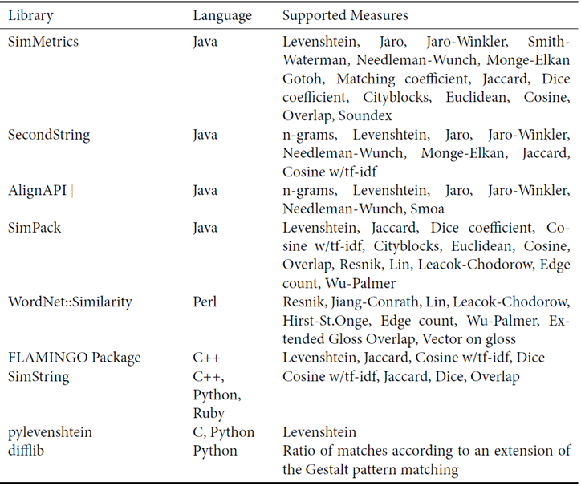
String Matching Software Libraries
Record Linkage for Web Data Oktie Hassanzadeh Ph.D. Univ. Toronto
Notes:
SimMetrics: http://sourceforge.net/projects/simmetrics
SecondString: http://sourceforge.net/projects/secondstring
Geographiclib for geographic similarity: http://geographiclib.sourceforge.net

