Slide 1
Introduction to
Communication-Avoiding Algorithms www.cs.berkeley.edu/~demmel
Jim Demmel, and many, many others …

Slide 2
Why avoid communication? (1/2)
Algorithms have two costs (measured in time or energy):
Arithmetic (FLOPS)
Communication: moving data between
  levels of a memory hierarchy (sequential case)
  processors over a network (parallel case).
CPU
Cache
CPU
DRAM
CPU
DRAM
DRAM
CPU
DRAM
CPU
DRAM

Slide 3
Why avoid communication? (2/3)
Running time of an algorithm is sum of 3 terms:
  # flops * time_per_flop
  # words moved / bandwidth
  # messages * latency
communication
Time_per_flop << 1/ bandwidth << latency
  Gaps growing exponentially with time [FOSC]
Avoid communication to save time
Annual improvements
Time_per_flop |  | Bandwidth | Latency
 | Network | 26% | 15%
 | DRAM | 23% | 5%
59%
Goal : reorganize algorithms to avoid communication
  Between all memory hierarchy levels
    L1 L2 DRAM network, etc
  Very large speedups possible
  Energy savings too!
Notes:
2008 DARPA Exascale report has similar prediction:
Gap between DRAM access time and flops will increase
100x over coming decade to balance power usage between
processors, DRAM
2011 NRC Report: “The Future of Computing Performance: Game Over or Next Level?”
Millett and Fuller

Slide 4
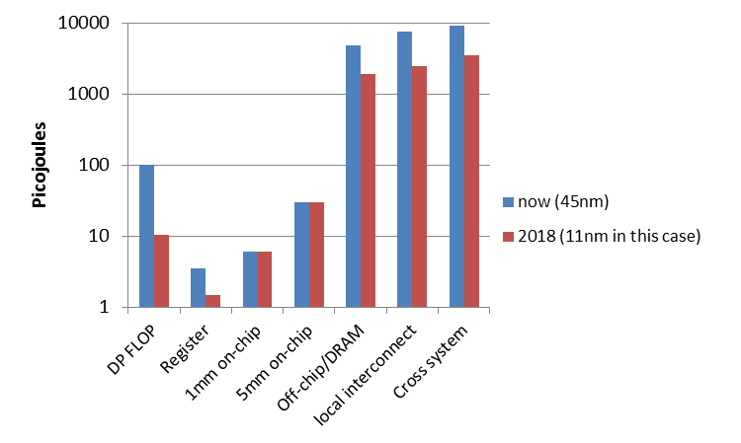
Why Minimize Communication? (2/2)
Source: John Shalf, LBL

Slide 5
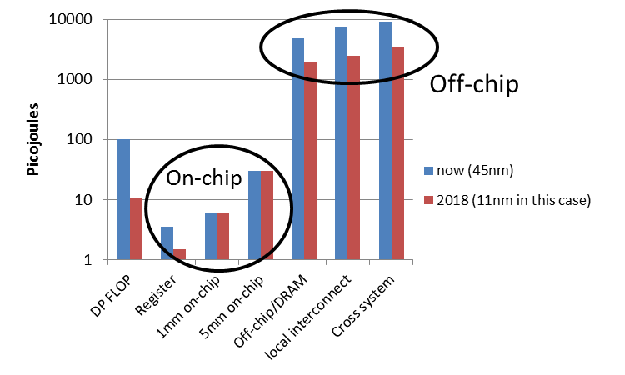
Why Minimize Communication? (2/2)
Minimize communication to save energy
Source: John Shalf, LBL

Slide 6
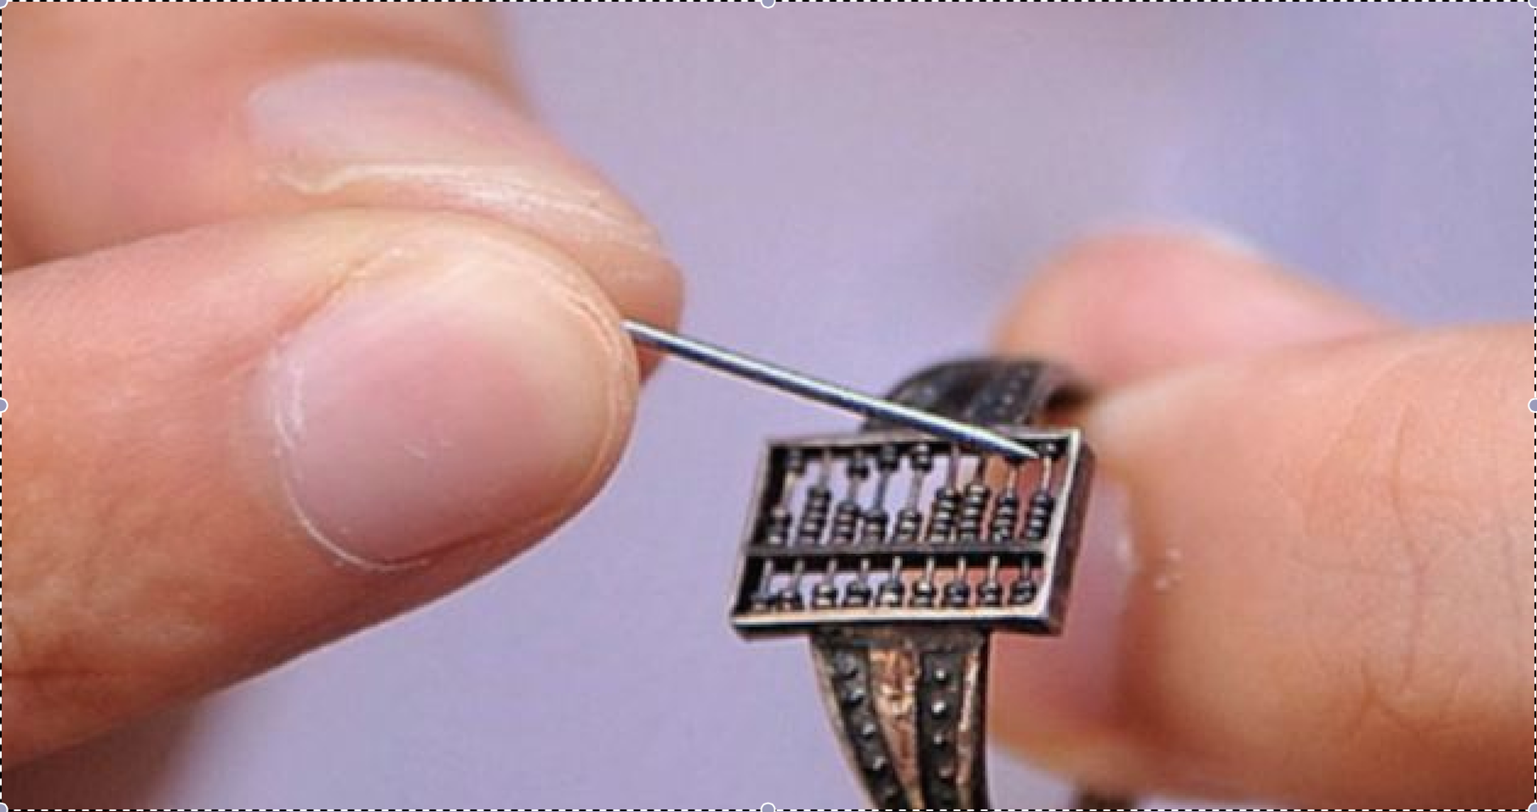
Alternative Cost Model for Algorithms?
Total distance moved by beads on an abacus
Notes:
Still measures “communication”, just old fashioned kind
300 year old ring from Qing dynasty in China used by traders
First wearable computer?

Slide 7
Goals
Redesign algorithms to avoid communication
  Between all memory hierarchy levels
    L1 L2 DRAM network, etc
Attain lower bounds if possible
  Current algorithms often far from lower bounds
  Large speedups and energy savings possible
Lots of open problems / potential class projects
Notes:
2008 DARPA Exascale report has similar prediction:
Gap between DRAM access time and flops will increase
100x over coming decade to balance power usage between
processors, DRAM

Slide 8
Sample Speedups
Up to 12x faster for 2.5D matmul on 64K core IBM BG/P
Up to 3x faster for tensor contractions on 2K core Cray XE/6
Up to 6.2x faster for All-Pairs-Shortest-Path on 24K core Cray CE6
Up to 2.1x faster for 2.5D LU on 64K core IBM BG/P
Up to 11.8x faster for direct N-body on 32K core IBM BG/P
Up to 13x faster for Tall Skinny QR on Tesla C2050 Fermi NVIDIA GPU
Up to 6.7x faster for symeig(band A) on 10 core Intel Westmere
Up to 2x faster for 2.5D Strassen on 38K core Cray XT4
Up to 4.2x faster for MiniGMG benchmark bottom solver, using CA-BiCGStab (2.5x for overall solve)
  2.5x / 1.5x for combustion simulation code

Slide 9
President Obama cites Communication-Avoiding Algorithms in the FY 2012 Department of Energy Budget Request to Congress:
“New Algorithm Improves Performance and Accuracy on Extreme-Scale Computing Systems. On modern computer architectures, communication between processors takes longer than the performance of a floating point arithmetic operation by a given processor. ASCR researchers have developed a new method, derived from commonly used linear algebra methods, to minimize communications between processors and the memory hierarchy, by reformulating the communication patterns specified within the algorithm. This method has been implemented in the TRILINOS framework, a highly-regarded suite of software, which provides functionality for researchers around the world to solve large scale, complex multi-physics problems.”
FY 2010 Congressional Budget, Volume 4, FY2010 Accomplishments, Advanced Scientific Computing Research (ASCR), pages 65-67.
CA-GMRES (Hoemmen, Mohiyuddin, Yelick, JD)
“Tall-Skinny” QR (Grigori, Hoemmen, Langou, JD)

Slide 10
Summary of CA Algorithms
“Direct” Linear Algebra
  Lower bounds on communication for linear algebra problems like Ax=b, least squares, Ax = λx, SVD, etc
  New algorithms that attain these lower bounds
    Being added to libraries: Sca/LAPACK, PLASMA, MAGMA
    Large speed-ups possible
  Autotuning to find optimal implementation
Ditto for programs accessing arrays (eg n-body)
Ditto for “Iterative” Linear Algebra

Slide 11
Outline
“Direct” Linear Algebra
  Lower bounds on communication
  New algorithms that attain these lower bounds
Ditto for programs accessing arrays (eg n-body)
Ditto for “Iterative” Linear Algebra
Related work

Slide 12
Outline
“Direct” Linear Algebra
  Lower bounds on communication
  New algorithms that attain these lower bounds
Ditto for programs accessing arrays (eg n-body)
Ditto for “Iterative” Linear Algebra
Related work

Slide 13
Lower bound for all “direct” linear algebra
  Let M = “fast” memory size (per processor)
  #words_moved (per processor) = Ω(#flops (per processor) / M^{1/2} )
  #messages_sent (per processor) = Ω(#flops (per processor) / M^{3/2} )
  Parallel case: assume either load or memory balanced
Holds for
  Matmul, BLAS, LU, QR, eig, SVD, tensor contractions, …
  Some whole programs (sequences of these operations, no matter how individual ops are interleaved, eg A^{k})
  Dense and sparse matrices (where #flops << n³ )
  Sequential and parallel algorithms
  Some graph-theoretic algorithms (eg Floyd-Warshall)

Slide 14
Lower bound for all “direct” linear algebra
  Let M = “fast” memory size (per processor)
  #words_moved (per processor) = Ω(#flops (per processor) / M^{1/2} )
  #messages_sent ≥ #words_moved / largest_message_size
  Parallel case: assume either load or memory balanced
Holds for
  Matmul, BLAS, LU, QR, eig, SVD, tensor contractions, …
  Some whole programs (sequences of these operations, no matter how individual ops are interleaved, eg A^{k})
  Dense and sparse matrices (where #flops << n³ )
  Sequential and parallel algorithms
  Some graph-theoretic algorithms (eg Floyd-Warshall)

Slide 15
Lower bound for all “direct” linear algebra
  Let M = “fast” memory size (per processor)
  #words_moved (per processor) = Ω(#flops (per processor) / M^{1/2} )
  #messages_sent (per processor) = Ω(#flops (per processor) / M^{3/2} )
  Parallel case: assume either load or memory balanced
Holds for
  Matmul, BLAS, LU, QR, eig, SVD, tensor contractions, …
  Some whole programs (sequences of these operations, no matter how individual ops are interleaved, eg A^{k})
  Dense and sparse matrices (where #flops << n³ )
  Sequential and parallel algorithms
  Some graph-theoretic algorithms (eg Floyd-Warshall)
SIAM SIAG/Linear Algebra Prize, 2012
Ballard, D., Holtz, Schwartz
Notes:
QR etc: under certain technical conditions

Slide 16
Can we attain these lower bounds?
Do conventional dense algorithms as implemented in LAPACK and ScaLAPACK attain these bounds?
  Often not
If not, are there other algorithms that do?
  Yes, for much of dense linear algebra
  New algorithms, with new numerical properties, new ways to encode answers, new data structures
  Not just loop transformations
Only a few sparse algorithms so far
Lots of work in progress / possible projects
Case study: Matrix Multiply

Slide 17
Naïve Matrix Multiply
{implements C = C + A*B}
for i = 1 to n
for j = 1 to n
for k = 1 to n
C(i,j) = C(i,j) + A(i,k) * B(k,j)
C(i,j)
C(i,j)
A(i,:)
=
+
*
B(:,j)

Slide 18
Naïve Matrix Multiply
{implements C = C + A*B}
for i = 1 to n
{read row i of A into fast memory}
for j = 1 to n
{read C(i,j) into fast memory}
{read column j of B into fast memory}
for k = 1 to n
C(i,j) = C(i,j) + A(i,k) * B(k,j)
{write C(i,j) back to slow memory}
C(i,j)
C(i,j)
A(i,:)
=
+
*
B(:,j)

Slide 19
Naïve Matrix Multiply
{implements C = C + A*B}
for i = 1 to n
{read row i of A into fast memory} … n² reads altogether
for j = 1 to n
{read C(i,j) into fast memory} … n² reads altogether
{read column j of B into fast memory} … n³ reads altogether
for k = 1 to n
C(i,j) = C(i,j) + A(i,k) * B(k,j)
{write C(i,j) back to slow memory} … n² writes altogether
C(i,j)
C(i,j)
A(i,:)
=
+
*
B(:,j)
n³ + 3n² reads/writes altogether – dominates 2n³ arithmetic

Slide 20
Blocked (Tiled) Matrix Multiply
Consider A,B,C to be n/b-by-n/b matrices of b-by-b subblocks where b is called the block size; assume 3 b-by-b blocks fit in fast memory
for i = 1 to n/b
for j = 1 to n/b
{read block C(i,j) into fast memory}
for k = 1 to n/b
{read block A(i,k) into fast memory}
{read block B(k,j) into fast memory}
C(i,j) = C(i,j) + A(i,k) * B(k,j) {do a matrix multiply on blocks}
{write block C(i,j) back to slow memory}
C(i,j)
C(i,j)
A(i,k)
b-by-b
block
=
+
*
B(k,j)

Slide 21
Blocked (Tiled) Matrix Multiply
Consider A,B,C to be n/b-by-n/b matrices of b-by-b subblocks where b is called the block size; assume 3 b-by-b blocks fit in fast memory
for i = 1 to n/b
for j = 1 to n/b
{read block C(i,j) into fast memory} … b² × (n/b)² = n² reads
for k = 1 to n/b
{read block A(i,k) into fast memory} … b² × (n/b)³ = n³/b reads
{read block B(k,j) into fast memory} … b² × (n/b)³ = n³/b reads
C(i,j) = C(i,j) + A(i,k) * B(k,j) {do a matrix multiply on blocks}
{write block C(i,j) back to slow memory} … b² × (n/b)² = n² writes
C(i,j)
C(i,j)
A(i,k)
b-by-b
block
=
+
*
B(k,j)
2n³/b + 2n² reads/writes << 2n³ arithmetic - Faster!

Slide 22
Does blocked matmul attain lower bound?
Recall: if 3 b-by-b blocks fit in fast memory of size M, then #reads/writes = 2n³/b + 2n²
Make b as large as possible: 3b² ≤ M, so #reads/writes ≥ 2n³/(M/3)^{1/2} + 2n²
Attains lower bound = Ω (#flops / M^{1/2} )
But what if we don’t know M?
Or if there are multiple levels of fast memory?
How do we write the algorithm?

Slide 23
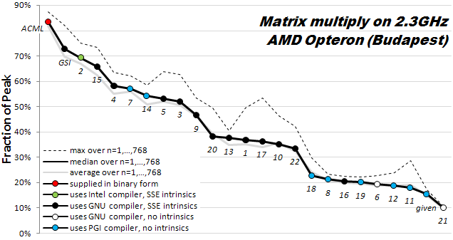
How hard is hand-tuning matmul, anyway?
Results of 22 student teams trying to tune matrix-multiply, in CS267 Spr09
Students given “blocked” code to start with (7x faster than naïve)
  Still hard to get close to vendor tuned performance (ACML) (another 6x)
For more discussion, see www.cs.berkeley.edu/~volkov/cs267.sp09/hw1/results/

Slide 24
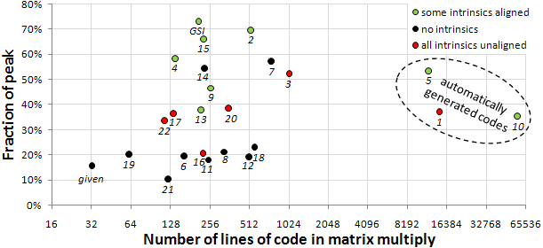
How hard is hand-tuning matmul, anyway?

Slide 25
Recursive Matrix Multiplication (RMM) (1/2)
For simplicity: square matrices with n = 2^{m}
C = = A · B = · ·
=
True when each A_{ij} etc 1x1 or n/2 x n/2
C₁₁ C₁₂ C₂₁ C₂₂
A₁₁ A₁₂ A₂₁ A₂₂
B₁₁ B₁₂ B₂₁ B₂₂
A₁₁·B₁₁ + A₁₂·B₂₁ A₁₁·B₁₂ + A₁₂·B₂₂ A₂₁·B₁₁ + A₂₂·B₂₁ A₂₁·B₁₂ + A₂₂·B₂₂
func C = RMM (A, B, n)
if n = 1, C = A * B, else
{ C₁₁ = RMM (A₁₁ , B₁₁ , n/2) + RMM (A₁₂ , B₂₁ , n/2)
C₁₂ = RMM (A₁₁ , B₁₂ , n/2) + RMM (A₁₂ , B₂₂ , n/2)
C₂₁ = RMM (A₂₁ , B₁₁ , n/2) + RMM (A₂₂ , B₂₁ , n/2)
C₂₂ = RMM (A₂₁ , B₁₂ , n/2) + RMM (A₂₂ , B₂₂ , n/2) }
return

Slide 26
Recursive Matrix Multiplication (RMM) (2/2)
func C = RMM (A, B, n)
if n=1, C = A * B, else
{ C₁₁ = RMM (A₁₁ , B₁₁ , n/2) + RMM (A₁₂ , B₂₁ , n/2)
C₁₂ = RMM (A₁₁ , B₁₂ , n/2) + RMM (A₁₂ , B₂₂ , n/2)
C₂₁ = RMM (A₂₁ , B₁₁ , n/2) + RMM (A₂₂ , B₂₁ , n/2)
C₂₂ = RMM (A₂₁ , B₁₂ , n/2) + RMM (A₂₂ , B₂₂ , n/2) }
return
For big speedups, see SC12 poster on “Beating MKL and ScaLAPACK at Rectangular Matmul” 11/13 at 5:15-7pm
A(n) = # arithmetic operations in RMM( . , . , n)
= 8 · A(n/2) + 4(n/2)² if n > 1, else 1
= 2n³ … same operations as usual, in different order
W(n) = # words moved between fast, slow memory by RMM( . , . , n)
= 8 · W(n/2) + 12(n/2)² if 3n² > M , else 3n²
= O( n³ / M^{1/2} + n² ) … same as blocked matmul
“Cache oblivious”, works for memory hierarchies, but not panacea
Notes:
Speedups are for very rectangular matrices, not square

Slide 27
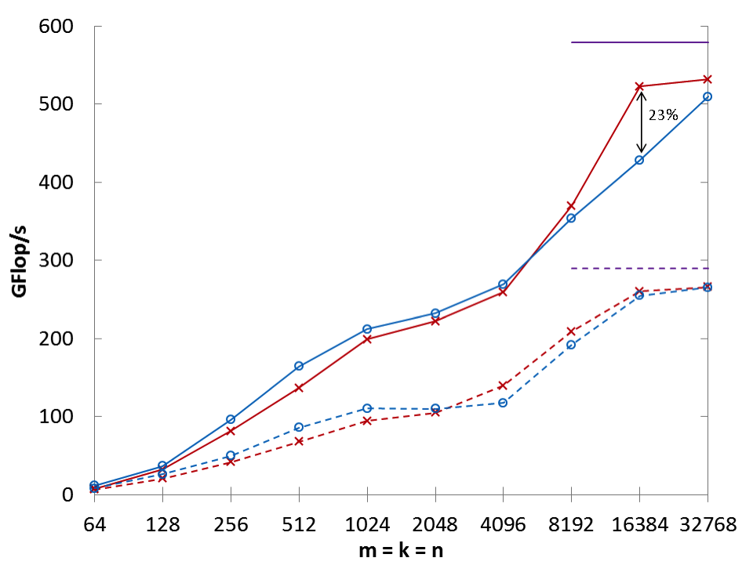
CARMA Performance: Shared Memory
Intel Emerald: 4 Intel Xeon X7560 x 8 cores, 4 x NUMA
Square: m = k = n
(linear)
Peak (single)
CARMA (single)
MKL (single)
Peak (double)
CARMA (double)
MKL (double)
(log)
Preliminaries Lower Bounds CARMA Benchmarking Future Work Conclusion 27

Slide 28
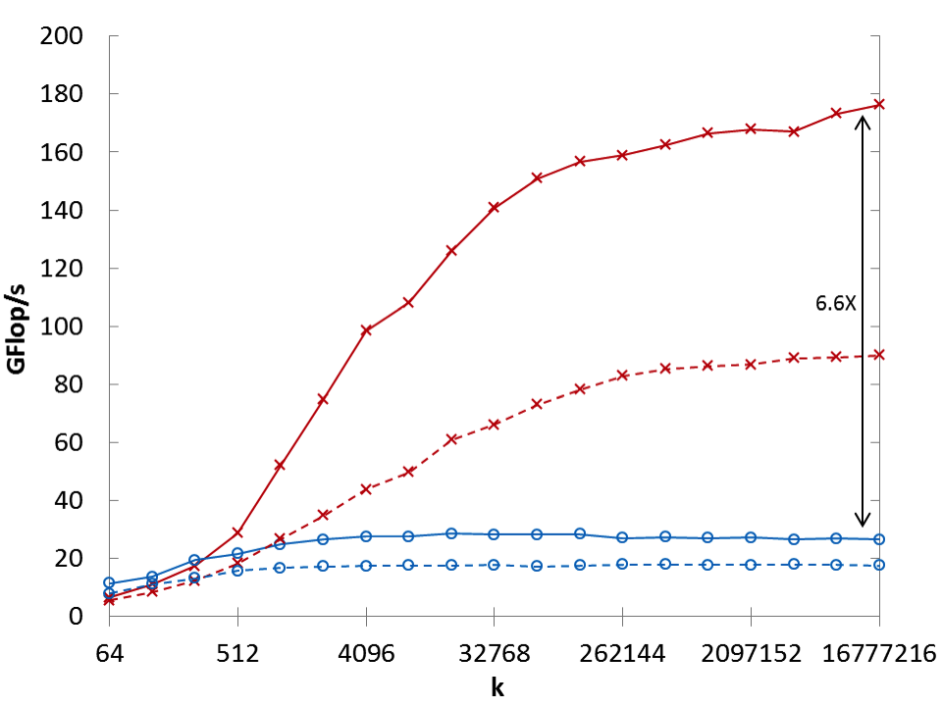
CARMA Performance: Shared Memory
Intel Emerald: 4 Intel Xeon X7560 x 8 cores, 4 x NUMA
Inner Product: m = n = 64
(linear)
CARMA (single)
CARMA (double)
MKL (single)
MKL (double)
(log)
Preliminaries Lower Bounds CARMA Benchmarking Future Work Conclusion 28
Notes:
32 cores altogether
Parallelism via Intel Cilk Plus
Intel MKL version 10.3.6
50 LOC

Slide 29
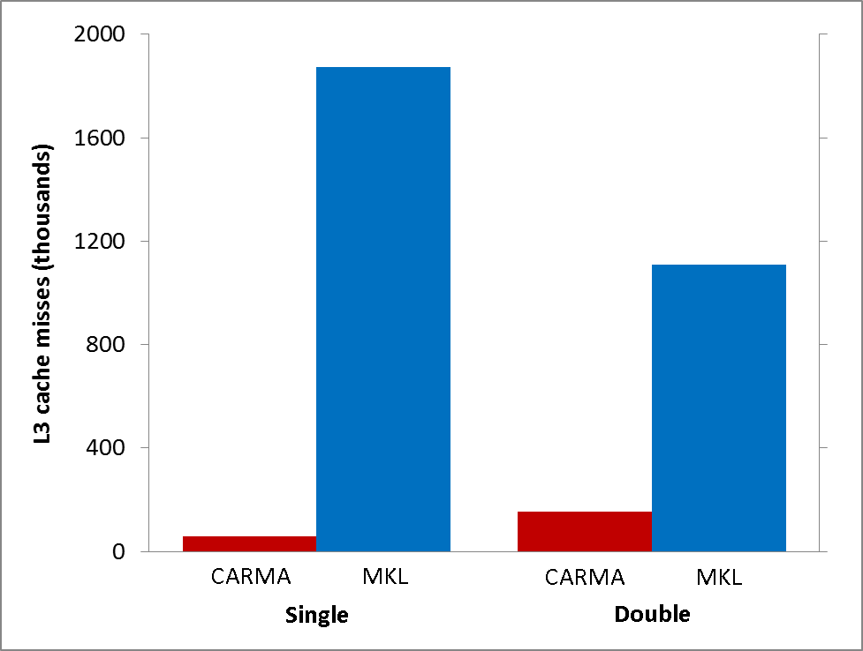
Why is CARMA Faster?
L3 Cache Misses
Shared Memory Inner Product (m = n = 64; k = 524,288)
(linear)
97% Fewer Misses
86% Fewer Misses
Preliminaries Lower Bounds CARMA Benchmarking Future Work Conclusion 29

Slide 30
Parallel MatMul with 2D Processor Layout
P processors in P^{1/2} x P^{1/2} grid
  Processors communicate along rows, columns
Each processor owns n/P^{1/2} x n/P^{1/2} submatrices of A,B,C
Example: P=16, processors numbered from P₀₀ to P₃₃
  Processor P_{ij} owns submatrices A_{ij}, B_{ij} and C_{ij}
C = A * B
P₀₀ P₀₁ P₀₂ P₀₃
P₀₀ P₀₁ P₀₂ P₀₃
P₀₀ P₀₁ P₀₂ P₀₃
P₁₀ P₁₁ P₁₂ P₁₃
P₁₀ P₁₁ P₁₂ P₁₃
P₁₀ P₁₁ P₁₂ P₁₃
P₂₀ P₂₁ P₂₂ P₂₃
P₂₀ P₂₁ P₂₂ P₂₃
P₂₀ P₂₁ P₂₂ P₂₃
P₃₀ P₃₁ P₃₂ P₃₃
P₃₀ P₃₁ P₃₂ P₃₃
P₃₀ P₃₁ P₃₂ P₃₃

Slide 31
SUMMA Algorithm
SUMMA = Scalable Universal Matrix Multiply
  Attains lower bounds:
    Assume fast memory size M = O(n²/P) per processor – 1 copy of data
    #words_moved = Ω( #flops / M^{1/2} ) = Ω( (n³/P) / (n²/P)^{1/2} ) = Ω( n² / P^{1/2} )
    #messages = Ω( #flops / M^{3/2} ) = Ω( (n³/P) / (n²/P)^{3/2} ) = Ω( P^{1/2} )
  Can accommodate any processor grid, matrix dimensions & layout
  Used in practice in PBLAS = Parallel BLAS
    www.netlib.org/lapack/lawns/lawn{96,100}.ps
Comparison to Cannon’s Algorithm
  Cannon attains lower bound
  But Cannon harder to generalize to other grids, dimensions, layouts, and Cannon may use more memory
Notes:
SUMMA with more complicated implementation can attain bandwidth lower bound

Slide 32
SUMMA – n x n matmul on P^{1/2} x P^{1/2} grid
k
j
B(k,j)
k
*
=
i
C(i,j)
A(i,k)
C(i, j) is n/P^{1/2} x n/P^{1/2} submatrix of C on processor P_{ij}
A(i,k) is n/P^{1/2} x b submatrix of A
B(k,j) is b x n/P^{1/2} submatrix of B
C(i,j) = C(i,j) + Σ_{k} A(i,k)*B(k,j)
  summation over submatrices
Need not be square processor grid

Slide 33
SUMMA– n x n matmul on P^{1/2} x P^{1/2} grid
k
j
B(k,j)
k
*
=
Brow
i
C(i,j)
A(i,k)
Acol
For k=0 to n-1 … or n/b-1 where b is the block size
… = # cols in A(i,k) and # rows in B(k,j)
for all i = 1 to p_{r} … in parallel
owner of A(i,k) broadcasts it to whole processor row
for all j = 1 to p_{c} … in parallel
owner of B(k,j) broadcasts it to whole processor column
Receive A(i,k) into Acol
Receive B(k,j) into Brow
C_myproc = C_myproc + Acol * Brow
For k=0 to n/b-1
for all i = 1 to P^{1/2}
owner of A(i,k) broadcasts it to whole processor row (using binary tree)
for all j = 1 to P^{1/2}
owner of B(k,j) broadcasts it to whole processor column (using bin. tree)
Receive A(i,k) into Acol
Receive B(k,j) into Brow
C_myproc = C_myproc + Acol * Brow
Attains bandwidth lower bound
Attains latency lower bound if
b near maximum n/P^{1/2}

Slide 34
Summary of dense parallel algorithms attaining communication lower bounds
Assume nxn matrices on P processors
Minimum Memory per processor = M = O(n² / P)
Recall lower bounds:
  #words_moved = Ω( (n³/ P) / M^{1/2} ) = Ω( n² / P^{1/2} )
  #messages = Ω( (n³/ P) / M^{3/2} ) = Ω( P^{1/2} )
Does ScaLAPACK attain these bounds?
  For #words_moved: mostly, except nonsym. Eigenproblem
  For #messages: asymptotically worse, except Cholesky
New algorithms attain all bounds, up to polylog(P) factors
  Cholesky, LU, QR, Sym. and Nonsym eigenproblems, SVD
    Needed to replace partial pivoting in LU
    Need randomization for Nonsym eigenproblem (so far)
Can we do Better?
Notes:
ScaLAPACK assumes best block size chosen
Many references, blue are ours
LU: uses tournament pivoting, different stability, speedup up to 29X predicted on exascale
QR uses TSQR, speedup up to 8x on Intel Clovertown, 13x on Tesla, up on cloud
Symeig uses variant of SBR, speedup up to 30x on AMD Magny-Cours, vs ACML 4.4
n=12000, b=500, 6 threads
Nonsymeig, uses randomization in two ways

Slide 35
Can we do better?
Aren’t we already optimal?
Why assume M = O(n²/P), i.e. minimal?
  Lower bound still true if more memory
  Can we attain it?
  Special case: “3D Matmul”: uses M = O(n²/P^{2/3})
    Dekel, Nassimi, Sahni [81], Bernsten [89], Agarwal, Chandra, Snir [90], Johnson [93], Agarwal, Balle, Gustavson, Joshi, Palkar [95]
    Processors arranged in P^{1/3} x P^{1/3} x P^{1/3} grid
  M = O(n²/P^{2/3}) is P^{1/3} times the minimum
    Not always that much memory available…

Slide 36
2.5D Matrix Multiplication
Assume can fit cn²/P data per processor, c>1
Processors form (P/c)^{1/2} x (P/c)^{1/2} x c grid
(P/c)^{1/2}
(P/c)^{1/2}
Example: P = 32, c = 2
c

Slide 37
2.5D Matrix Multiplication
Assume can fit cn²/P data per processor, c > 1
Processors form (P/c)^{1/2} x (P/c)^{1/2} x c grid
j
i
Initially P(i,j,0) owns A(i,j) and B(i,j)
each of size n(c/P)^{1/2} x n(c/P)^{1/2}
k
(1) P(i,j,0) broadcasts A(i,j) and B(i,j) to P(i,j,k)
(2) Processors at level k perform 1/c-th of SUMMA, i.e. 1/c-th of Σ_{m} A(i,m)*B(m,j)
(3) Sum-reduce partial sums Σ_{m} A(i,m)*B(m,j) along k-axis so P(i,j,0) owns C(i,j)

Slide 38
2.5D Matmul on BG/P, 16K nodes / 64K cores

Slide 39
2.5D Matmul on BG/P, 16K nodes / 64K cores
c = 16 copies
2.7x faster
12x faster
Distinguished Paper Award, EuroPar’11
SC’11 paper by Solomonik, Bhatele, D.
Notes:
SC’11 paper about need to fully utilize 3D torus network on BG/P to get this to work

Slide 40
Perfect Strong Scaling – in Time and Energy (1/2)
Every time you add a processor, you should use its memory M too
Start with minimal number of procs: PM = 3n²
Increase P by a factor of c ➔ total memory increases by a factor of c
Notation for timing model:
  γ_{T} , β_{T} , α_{T} = secs per flop, per word_moved, per message of size m
T(cP) = n³/(cP) [ γ_{T}+ β_{T}/M^{1/2} + α_{T}/(mM^{1/2}) ]
= T(P)/c
Notation for energy model:
  γ_{E} , β_{E} , α_{E} = joules for same operations
  δ_{E} = joules per word of memory used per sec
  ε_{E} = joules per sec for leakage, etc.
E(cP) = cP { n³/(cP) [ γ_{E}+ β_{E}/M^{1/2} + α_{E}/(mM^{1/2}) ] + δ_{E}MT(cP) + ε_{E}T(cP) }
= E(P)
Limit: c ≤ P^{1/3} (3D algorithm), if starting with 1 copy of inputs

Slide 41
Perfect Strong Scaling – in Time and Energy (2/2)
Perfect scaling extends to N-body, Strassen, …
Can prove lower bounds on network (eg 3D torus for matmul)
We can use these models to answer many questions, including:
What is the minimum energy required for a computation?
Given a maximum allowed runtime T , what is the minimum energy E needed to achieve it?
Given a maximum energy budget E , what is the minimum runtime T that we can attain?
The ratio P = E/T gives us the average power required to run the algorithm. Can we minimize the average power consumed?
Given an algorithm, problem size, number of processors and target energy efficiency (GFLOPS/W), can we determine a set of architectural parameters to describe a conforming computer architecture?
See Andrew Gearhart’s PhD thesis
Notes:
DARPA’s goal: 75 Gflops/Watt
DOE’s goal: 1 Exaflop/20 Mwatts = 1e18/2e7 = 5e10 = 50e9 = 50 Gflops/Watt

Slide 42
Handling Heterogeneity
Suppose each of P processors could differ
  γ_{i} = sec/flop, β_{i} = sec/word, α_{i} = sec/message, M_{i} = memory
What is optimal assignment of work F_{i} to minimize time?
  T_{i} = F_{i} γ_{i} + F_{i} β_{i} /M_{i}^{1/2} + F_{i} α_{i} /M_{i}^{3/2} = F_{i} [γ_{i} + β_{i} /M_{i}^{1/2} + α_{i} /M_{i}^{3/2}] = F_{i} ξ_{i}
  Choose F_{i} so Σ_{i} F_{i} = n³ and minimizing T = max_{i} T_{i}
  Answer: F_{i} = n³(1/ξ_{i})/Σ_{j}(1/ξ_{j}) and T = n³/Σ_{j}(1/ξ_{j})
Optimal Algorithm for nxn matmul
  Recursively divide into 8 half-sized subproblems
  Assign subproblems to processor i to add up to F_{i} flops
Works for Strassen, other algorithms…

Slide 43
Application to Tensor Contractions
Ex: C(i,j,k) = Σ_{mn} A(i,j,m,n)*B(m,n,k)
  Communication lower bounds apply
Complex symmetries possible
  Ex: B(m,n,k) = B(k,m,n) = …
  d-fold symmetry can save up to d!-fold flops/memory
Heavily used in electronic structure calculations
  Ex: NWChem
CTF: Cyclops Tensor Framework
  Exploits 2.5D algorithms, symmetries
  Solomonik, Hammond, Matthews

Slide 44
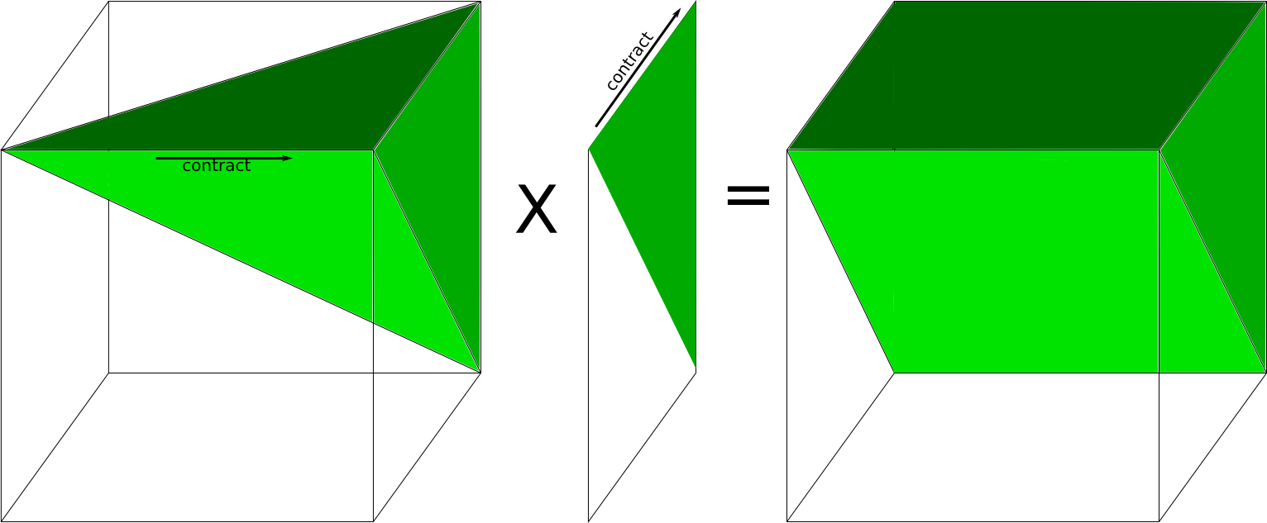
C(i,j,k) = Σ_{m} A(i,j,m)*B(m,k)
A
3-fold symm
B
2-fold symm
C
2-fold symm

Slide 45
Application to Tensor Contractions
Ex: C(i,j,k) = Σ_{mn} A(i,j,m,n)*B(m,n,k)
  Communication lower bounds apply
Complex symmetries possible
  Ex: B(m,n,k) = B(k,m,n) = …
  d-fold symmetry can save up to d!-fold flops/memory
Heavily used in electronic structure calculations
  Ex: NWChem, for coupled cluster (CC) approach to Schroedinger eqn.
CTF: Cyclops Tensor Framework
  Exploits 2.5D algorithms, symmetries
  Up to 3x faster running CC than NWChem on 3072 cores of Cray XE6
  Solomonik, Hammond, Matthews
Notes:
128 Nodes of Hopper, w9 = water simulation

Slide 46
TSQR: QR of a Tall, Skinny matrix
W₀
W₁
W₂
W₃
Q₀₀ R₀₀
Q₁₀ R₁₀
Q₂₀ R₂₀
Q₃₀ R₃₀
Q₀₀
Q₁₀
Q₂₀
Q₃₀
R₀₀
R₁₀
R₂₀
R₃₀
W =
=
=
.
R₀₀
R₁₀
R₂₀
R₃₀
Q₀₁ R₀₁
Q₁₁ R₁₁
Q₀₁
Q₁₁
R₀₁
R₁₁
=
=
.
R₀₁
R₁₁
=
Q₀₂ R₀₂

Slide 47
TSQR: QR of a Tall, Skinny matrix
W₀
W₁
W₂
W₃
Q₀₀ R₀₀
Q₁₀ R₁₀
Q₂₀ R₂₀
Q₃₀ R₃₀
Q₀₀
Q₁₀
Q₂₀
Q₃₀
R₀₀
R₁₀
R₂₀
R₃₀
W =
=
=
.
R₀₀
R₁₀
R₂₀
R₃₀
Q₀₁ R₀₁
Q₁₁ R₁₁
Q₀₁
Q₁₁
R₀₁
R₁₁
=
=
.
R₀₁
R₁₁
=
Q₀₂ R₀₂
Output = { Q₀₀, Q₁₀, Q₂₀, Q₃₀, Q₀₁, Q₁₁, Q₀₂, R₀₂ }

Slide 48
TSQR: An Architecture-Dependent Algorithm
W₀
W₁
W₂
W₃
R₀₀
R₁₀
R₂₀
R₃₀
R₀₁
Parallel:
W =
R₀₂
R₁₁
W₀
W₁
W₂
W₃
R₀₀
Sequential:
R₀₁
W =
R₀₂
R₀₃
W₀
W₁
W₂
W₃
R₀₀
R₀₁
Dual Core:
R₀₁
W =
R₀₂
R₁₁
R₀₃
R₁₁
Multicore / Multisocket / Multirack / Multisite / Out-of-core: ?
Can choose reduction tree dynamically
Notes:
Oldest reference for idea of tree: Golub/Plemmons/Sameh 1988,
But didn’t avoid communication

Slide 49
TSQR Performance Results
Parallel Speedups
  Up to 8x on 8 core Intel Clovertown
  Up to 6.7x on 16 processor Pentium cluster
  Up to 4x on 32 processor IBM Blue Gene
  Up to 13x on NVidia GPU
  Up to 4x on 4 cities vs 1 city (Dongarra, Langou et al)
  Only 1.6x slower on Cloud than just accessing data twice (Gleich and Benson)
Sequential Speedup
  “Infinite” for out-of-core on PowerPC laptop
SVD costs about the same
Joint work with Grigori, Hoemmen, Langou, Anderson, Ballard, Keutzer, others
Data from Grey Ballard, Mark Hoemmen, Laura Grigori, Julien Langou, Jack Dongarra, Michael Anderson
Notes:
Transition: TSQR -> CAQR
Cloud: Hadoop and Python based Dumbo MapReduce interface on 40-core mapreduce cluster at Stanford

Slide 50
Using similar idea for TSLU as TSQR:
Use reduction tree, to do “Tournament Pivoting”
W₁
W₂
W₃
W₄
P₁·L₁·U₁
P₂·L₂·U₂
P₃·L₃·U₃
P₄·L₄·U₄
Choose b pivot rows of W₁, call them W₁’
Choose b pivot rows of W₂, call them W₂’
Choose b pivot rows of W₃, call them W₃’
Choose b pivot rows of W₄, call them W₄’
W^{nxb} =
=
W₁’
W₂’
W₃’
W₄’
P₁₂·L₁₂·U₁₂
P₃₄·L₃₄·U₃₄
Choose b pivot rows, call them W₁₂’
Choose b pivot rows, call them W₃₄’
=
W₁₂’
W₃₄’
= P₁₂₃₄·L₁₂₃₄·U₁₂₃₄
Choose b pivot rows
Go back to W and use these b pivot rows
  Move them to top, do LU without pivoting
  Extra work, but lower order term
Thm: As numerically stable as Partial Pivoting on a larger matrix

Slide 51
LU Speedups from
Tournament Pivoting and 2.5D

Slide 52
2.5D vs 2D LU
With and Without Pivoting
Thm: Perfect Strong Scaling impossible, because Latency*Bandwidth = Ω(n²)

Slide 53
Other CA algorithms
Need for pivoting arises beyond LU, in QR
  Choose permutation P so that leading columns of A*P = Q*R span column space of A – Rank Revealing QR (RRQR)
  Usual approach like Partial Pivoting
    Put longest column first, update rest of matrix, repeat
    Hard to do using BLAS3 at all, let alone hit lower bound
  Use Tournament Pivoting
    Each round of tournament selects best b columns from two groups of b columns, either using usual approach or something better (Gu/Eisenstat)
    Thm: This approach ``reveals the rank’’ of A in the sense that the leading rxr submatrix of R has singular values “near” the largest r singular values of A; ditto for trailing submatrix
  Idea extends to other pivoting schemes
    Cholesky with diagonal pivoting
    LU with complete pivoting
    LDL^{T} with complete pivoting
Notes:
Grey Ballard, JD, Ben Lipshitz, Oded Schwartz, Sivan Toledo
“Communication efficient Gaussian elimination with Partial Pivoting using
a Shape Morphing Data Layout”
#Message = O(n^3/M) for columnwise-only format; recursive blocked too?

Slide 54
Communication Lower Bounds for Strassen-like matmul algorithms
Classical
O(n³) matmul:
#words_moved =
Ω (M(n/M^{1/2})³/P)
Strassen’s
O(n^{lg7}) matmul:
#words_moved =
Ω (M(n/M^{1/2})^{lg7}/P)
Strassen-like
O(n^{ω}) matmul:
#words_moved =
Ω (M(n/M^{1/2})^{ω}/P)
Proof: graph expansion (different from classical matmul)
  Strassen-like: DAG must be “regular” and connected
Extends up to M = n² / p^{2/ω}
Best Paper Prize (SPAA’11), Ballard, D., Holtz, Schwartz
appeared in JACM
Is the lower bound attainable?
Notes:
Jacob Scott’s thesis should remove assumptions

Slide 55
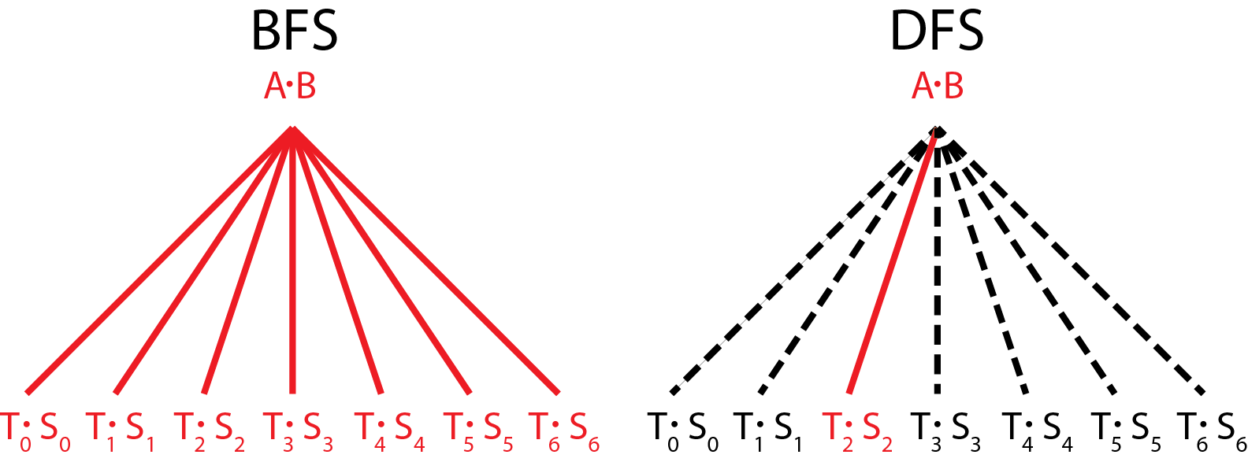
vs.
Communication Avoiding Parallel Strassen (CAPS)
Runs all 7 multiplies in parallel
Each on P/7 processors
Needs 7/4 as much memory
Runs all 7 multiplies sequentially
Each on all P processors
Needs 1/4 as much memory
CAPS
If EnoughMemory and P ≥ 7
then BFS step
else DFS step
end if
In practice, how to best interleave
BFS and DFS is
a “tuning parameter”
Notes:
Say what BFS and DFS are

Slide 56
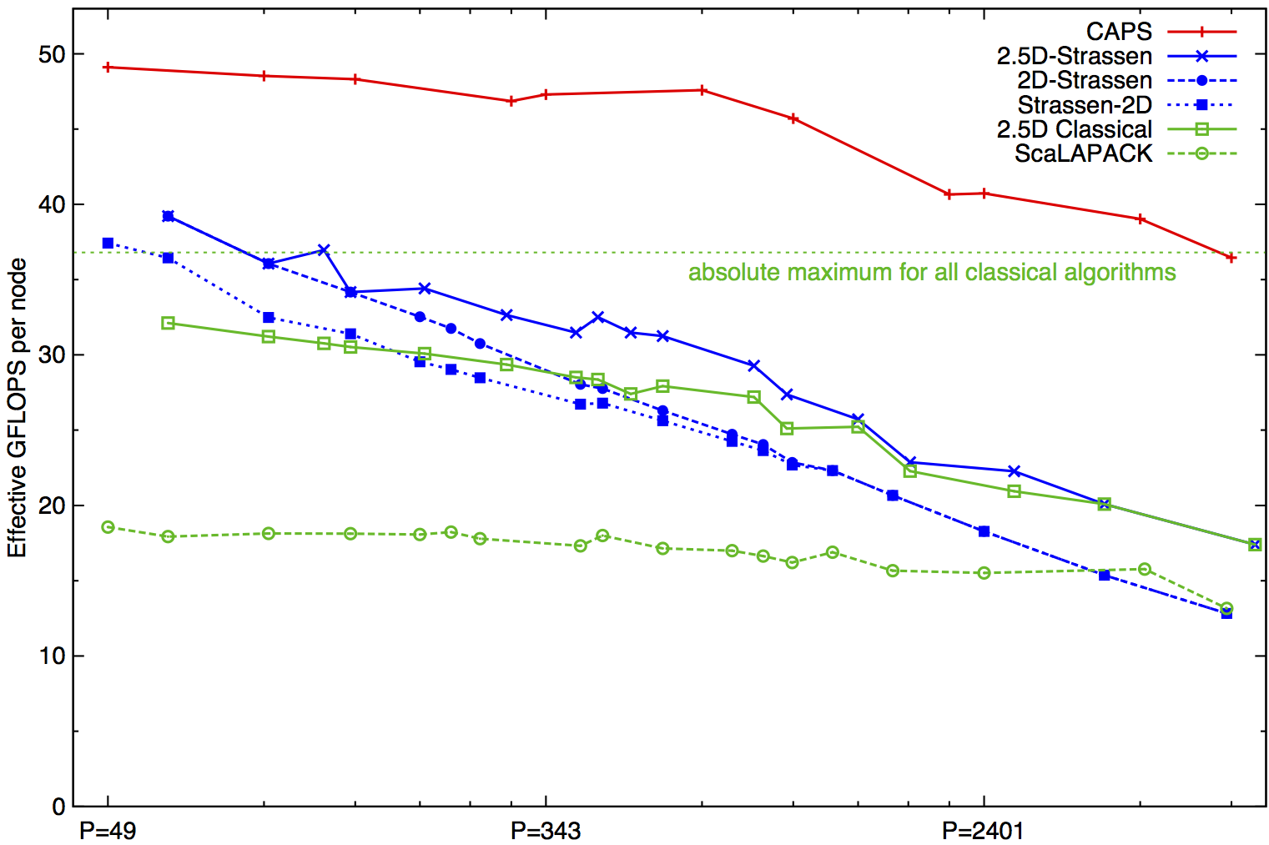
Performance Benchmarking, Strong Scaling Plot
Franklin (Cray XT4) n = 94080
Invited to appear as Research Highlight in CACM
Speedups: 24%-184%
(over previous Strassen-based algorithms)
Notes:
2n^3/time 184% is at 7203 ours 7056 theirs (per node).
Strong scaling range up to about p=1000
Top on this plot: p = 7200, recent data up to 20K
2(.5)D-Strassen means 2(.5)D-outer, and Strassen-inner, on the small local matrices
Strassen-2D means x DFS Strassen steps, followed by 2D classical for the 7^x subproblems
For details, see SC12 talk by Grey Ballard on CAPS
What about the rest of Linear Algebra:

Slide 57
What about fast algorithms for the rest of linear algebra?
“Fast Matrix Multiplication is Stable”
  JD, I. Dumitriu, O. Holtz, R. Kleinberg (2007)
“Fast Linear Algebra is Stable”
  JD, I. Dumitriu, O. Holtz (2007)
“Sequential Communication Bounds for Fast Linear Algebra”
  G. Ballard, JD, O. Holtz, O. Schwartz (EECS-2012-36)
Parallel communication bounds?
Implementations?

Slide 58
Symmetric Band Reduction
Grey Ballard and Nick Knight
A ⇒ QAQ^{T} = T, where
  A=A^{T} is banded
  T tridiagonal
  Similar idea for SVD of a band matrix
Use alone, or as second phase when A is dense:
  Dense ⇒ Banded ⇒ Tridiagonal
Implemented in LAPACK’s sytrd
Algorithm does not satisfy communication lower bound theorem for applying orthogonal transformations
  It can communicate even less!

Slide 59
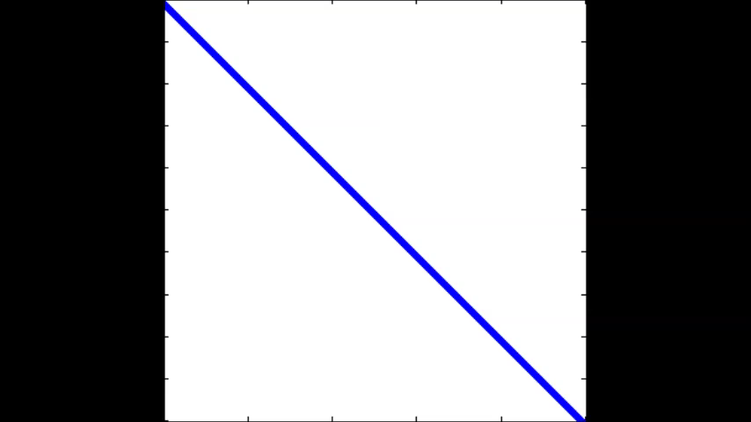
Conventional vs CA - SBR
Touch all data 4 times
Touch all data once
Conventional
Communication-Avoiding
Many tuning parameters
Right choices reduce #words_moved by factor M/bw, not just M^{1/2}
Many tuning parameters:
Number of “sweeps”, #diagonals cleared per sweep, sizes of parallelograms
#bulges chased at one time, how far to chase each bulge
Right choices reduce #words_moved by factor M/bw, not just M^{1/2}

Slide 60
Speedups of Sym. Band Reduction vs LAPACK’s DSBTRD
Up to 17x on Intel Gainestown, vs MKL 10.0
  n=12000, b=500, 8 threads
Up to 12x on Intel Westmere, vs MKL 10.3
  n=12000, b=200, 10 threads
Up to 25x on AMD Budapest, vs ACML 4.4
  n=9000, b=500, 4 threads
Up to 30x on AMD Magny-Cours, vs ACML 4.4
  n=12000, b=500, 6 threads
Neither MKL nor ACML benefits from multithreading in DSBTRD
  Best sequential speedup vs MKL: 1.9x
  Best sequential speedup vs ACML: 8.5x

Slide 61
What about sparse matrices? (1/3)
If matrix quickly becomes dense, use dense algorithm
Ex: All Pairs Shortest Path using Floyd-Warshall
Similar to matmul: Let D = A, then
But can’t reorder outer loop for 2.5D, need another idea
Abbreviate D(i,j) = min(D(i,j),min_{k}(A(i,k)+B(k,j)) by D = AB
  Dependencies ok, 2.5D works, just different semiring
Kleene’s Algorithm:
for k = 1:n, for i = 1:n, for j=1:n
D(i,j) = min(D(i,j), D(i,k) + D(k,j))
D = DC-APSP(A,n)
D = A, Partition D = [[D11,D12];[D21,D22]] into n/2 x n/2 blocks
D11 = DC-APSP(D11,n/2),
D12 = D11  D12, D21 = D21  D11, D22 = D21  D12,
D22 = DC-APSP(D22,n/2),
D21 = D22  D21, D12 = D12  D22, D11 = D12  D21,
Notes:
DC-APSP = Divide-and-conquer – All-Pairs-Shortest-Path

Slide 62
Performance of 2.5D APSP using Kleene
Strong Scaling on Hopper (Cray XE6 with 1024 nodes = 24576 cores)
2x
speedup
6.2x
speedup

Slide 63
What about sparse matrices? (2/3)
If parts of matrix becomes dense, optimize those
Ex: Cholesky on matrix A with good separators
Thm (Lipton,Rose,Tarjan,’79) If all balanced separators of G(A) have at least w vertices, then G(chol(A)) has clique of size w
  Need to do dense Cholesky on w x w submatrix
Thm: #Words_moved = Ω(w³/M^{1/2}) etc
Thm (George,’73) Nested dissection gives optimal ordering for 2D grid, 3D grid, similar matrices
  w = n for 2D n x n grid, w = n² for 3D n x n x n grid
Sequential multifrontal Cholesky attains bounds
PSPACES (Gupta, Karypis, Kumar) is a parallel sparse multifrontal Cholesky package
  Attains 2D and 2.5D lower bounds (using optimal dense Cholesky on separators)

Slide 64
What about sparse matrices? (3/3)
If matrix stays very sparse, lower bound unattainable, new one?
Ex: A*B, both diagonal: no communication in parallel case
Ex: A*B, both are Erdos-Renyi: Prob(A(i,j)≠0) = d/n, d << n^{1/2},iid
Assumption: Algorithm is sparsity-independent: assignment of data and work to processors is sparsity-pattern-independent (but zero entries need not be communicated or operated on)
Thm: A parallel algorithm that is sparsity-independent and load balanced for Erdos-Renyi matmul satisfies (in expectation)
#Words_moved = Ω(min( dn/P^{1/2} , d²n/P ) )
  Proof exploits fact that reuse of entries of C = A*B unlikely
Contrast general lower bound:
#Words_moved = Ω(d²n/(PM^{1/2})))
Attained by divide-and-conquer algorithm that splits matrices along dimensions most likely to minimize cost
Recent result (P. Koanantakool et al, IPDPS’16): Dense*Sparse
Notes:
Sparsity-independent means that you can’t see (for free) if there is a permutation that
makes both A and B block-diagonal, so no communication necessary.

Slide 65
Summary of Direct Linear Algebra (1/2)
New lower bounds, optimal algorithms, big speedups in theory and practice
Lots of ongoing work / possible projects on
  Algorithms:
    LDL^{T}, QR with pivoting, other pivoting schemes, low rank factorizations, eigenproblems…
    All-pairs-shortest-path, …
    Both 2D (c=1) and 2.5D (c>1)
    But only bandwidth may decrease with c>1, not latency
    Sparse matrices
  Platforms:
    Multicore, cluster, GPU, cloud, heterogeneous, low-energy, …
  Software:
    Integration into Sca/LAPACK, PLASMA, MAGMA,…
Integration of CTF into quantum chemistry/DFT applications
  Aquarius, with ANL, UT Austin on IBM BG/Q, Cray XC30
  Qbox, with LLNL, IBM, on IBM BG/Q
  Q-Chem, work in progress
Integration into big data analysis system based on Spark at AMPLab
Notes:
Qbox code – Francois Gygi @ UC Davis, also LLNL, first principle molecular dynamics,
uses Density Functional Theory to solve Kohn Sham equations, won Gordon Bell Prize in 2006
CTF – Cyclops Tensor Framework,
faster symmetric tensor contractions for “coupled cluster” electronic structure calculations

Slide 66
Summary of Direct Linear Algebra (2/2)
New lower bounds, optimal algorithms, big speedups in theory and practice
Lots of ongoing work / possible projects on
  Algorithms:
    LDL^{T}, QR with pivoting, other pivoting schemes, low rank factorizations, eigenproblems …
    Compare fast QR (
    All-pairs-shortest-path, …
    Both 2D (c=1) and 2.5D (c>1)
    But only bandwidth may decrease with c>1, not latency
    Sparse matrices
  Platforms:
    Multicore, cluster, GPU, cloud, heterogeneous, low-energy, …
  Software:
    Integration into Sca/LAPACK, PLASMA, MAGMA,…
Notes:
Qbox code – Francois Gygi @ UC Davis, also LLNL, first principle molecular dynamics,
uses Density Functional Theory to solve Kohn Sham equations, won Gordon Bell Prize in 2006
CTF – Cyclops Tensor Framework,
faster symmetric tensor contractions for “coupled cluster” electronic structure calculations

Slide 67
Outline
“Direct” Linear Algebra
  Lower bounds on communication
  New algorithms that attain these lower bounds
Ditto for programs accessing arrays (eg n-body)
Ditto for “Iterative” Linear Algebra
Related Work

Slide 68
Recall optimal sequential Matmul
Naïve code
for i=1:n, for j=1:n, for k=1:n,
C(i,j)+=A(i,k)*B(k,j)
“Blocked” code
for i = 1:n/b, for j = 1:n/b, for k = 1:n/b
C[i,j]+=A[i,k]*B[k,j] … b x b matmul
Thm: Picking b = M^{1/2} attains lower bound:
#words_moved = Ω(n³/M^{1/2})
Where does 1/2 come from?

Slide 69
New Thm applied to Matmul
for i=1:n, for j=1:n, for k=1:n, C(i,j) += A(i,k)*B(k,j)
Record array indices in matrix Δ
Solve LP for x = [xi,xj,xk]^{T}: max 1^{T}x s.t. Δ x ≤ 1
  Result: x = [1/2, 1/2, 1/2]^{T}, 1^{T}x = 3/2 = e
Thm: #words_moved = Ω(n³/M^{e-1})= Ω(n³/M^{1/2})
Attained by block sizes M^{xi},M^{xj},M^{xk} = M^{1/2},M^{1/2},M^{1/2}
 | i | j | k
 | 1 | 0 | 1 | A
Δ = | 0 | 1 | 1 | B
 | 1 | 1 | 0 | C

Slide 70
New Thm applied to Direct N-Body
for i=1:n, for j=1:n, F(i) += force( P(i) , P(j) )
Record array indices in matrix Δ
Solve LP for x = [xi,xj]^{T}: max 1^{T}x s.t. Δ x ≤ 1
  Result: x = [1,1], 1^{T}x = 2 = e
Thm: #words_moved = Ω(n²/M^{e-1})= Ω(n²/M¹)
Attained by block sizes M^{xi},M^{xj} = M¹,M¹
 | i | j
 | 1 | 0 | F
Δ = | 1 | 0 | P(i)
 | 0 | 1 | P(j)

Slide 71
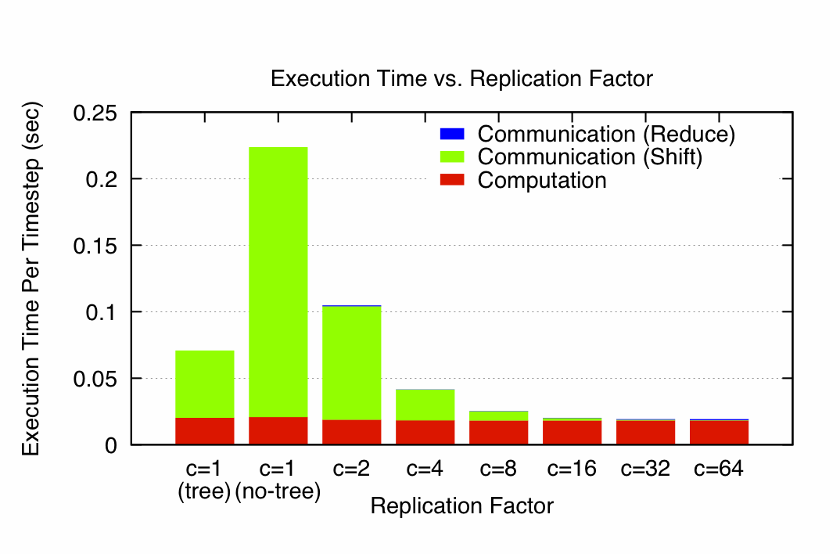
N-Body Speedups on IBM-BG/P (Intrepid)
8K cores, 32K particles
K. Yelick, E. Georganas, M. Driscoll, P. Koanantakool, E. Solomonik
11.8x speedup
Notes:
Intrepid: 163,480 core IBM BG/P at Argonne NL (ALCF)
Each node is one quad-core in a 3D torus
C=1(tree) uses special HW collective network, (no tree) just used regular network

Slide 72

Some Applications
Gravity, Turbulence, Molecular Dynamics, Plasma Simulation, …
Electron-Beam Lithography Device Simulation
Hair ...
  www.fxguide.com/featured/brave-new-hair/
  graphics.pixar.com/library/CurlyHairA/paper.pdf
Notes:
Gravity – astrophysical simulation (even if BH or FMM, direct method for nearby particles)(GB Prize 1992)
Vortex particular simulation of turbulence (GB 2009)
Molecular dynamics common in chemistry, biology
Plasmas in astrophysics
Electron-beam lithography: EE colleagues in Cory Hall
use it to simulation new ways of building chips
Hair, in graphics (Pixar) – use n-body now
(former CS267 GSI worked on improving their algorithm,
will appear in an upcoming movie, not FMM yet, mostly
nearest neighbor)
Princess Merida in Brave (Disney)
Email from Michael Driscoll (4/1/14)
Most everything about the simulator is public, except the code. It's described in detail in this paper:
http://graphics.pixar.com/library/CurlyHairA/paper.pdf
It was developed for Brave, and it's been used on most productions since. Merida, the protagonist in Brave, has about 44.5K hair-points, with about 40-200 points/hair (Table 2 in the paper). The number of point-point interactions changes over time but I'd guess there can be thousands or tens-of-thousands total, per timestep.

Slide 73
New Thm applied to Random Code
for i1=1:n, for i2=1:n, … , for i6=1:n
A1(i1,i3,i6) += func1(A2(i1,i2,i4),A3(i2,i3,i5),A4(i3,i4,i6))
A5(i2,i6) += func2(A6(i1,i4,i5),A3(i3,i4,i6))
Record array indices
in matrix Δ
Solve LP for x = [x1,…,x6]^{T}: max 1^{T}x s.t. Δ x ≤ 1
  Result: x = [2/7,3/7,1/7,2/7,3/7,4/7], 1^{T}x = 15/7 = e
Thm: #words_moved = Ω(n⁶/M^{e-1})= Ω(n⁶/M^{8/7})
Attained by block sizes M^{2/7},M^{3/7},M^{1/7},M^{2/7},M^{3/7},M^{4/7}
 | i1 | i2 | i3 | i4 | i5 | i6
 | 1 | 0 | 1 | 0 | 0 | 1 | A1
 | 1 | 1 | 0 | 1 | 0 | 0 | A2
Δ = | 0 | 1 | 1 | 0 | 1 | 0 | A3
 | 0 | 0 | 1 | 1 | 0 | 1 | A3,A4
 | 0 | 0 | 1 | 1 | 0 | 1 | A5
 | 1 | 0 | 0 | 1 | 1 | 0 | A6

Slide 74
Approach to generalizing lower bounds
Matmul
for i=1:n, for j=1:n, for k=1:n,
C(i,j)+=A(i,k)*B(k,j)
=> for (i,j,k) in S = subset of Z³
Access locations indexed by (i,j), (i,k), (k,j)
General case
for i1=1:n, for i2 = i1:m, … for ik = i3:i4
C(i1+2*i3-i7) = func(A(i2+3*i4,i1,i2,i1+i2,…),B(pnt(3*i4)),…)
D(something else) = func(something else), …
=> for (i1,i2,…,ik) in S = subset of Z^{k}
Access locations indexed by “projections”, eg
φ_{C} (i1,i2,…,ik) = (i1+2*i3-i7)
φ_{A} (i1,i2,…,ik) = (i2+3*i4,i1,i2,i1+i2,…), …
Goal: Communication lower bounds and optimal algorithms for any program that looks like this
Can we bound #loop_iterations / points in S
given bounds on #points in its images φ_{C} (S), φ_{A} (S), … ?

Slide 75
General Communication Bound
Thm: Given a program with array refs given by projections φ_{j}, then there is an e ≥ 1 such that
#words_moved = Ω (#iterations/M^{e-1})
where e is the the value of a linear program:
minimize e = Σ_{j} e_{j} subject to
rank(H) ≤ Σ_{j} e_{j}*rank(φ_{j}(H)) for all subgroups H < Z^{k}
Proof depends on recent result in pure mathematics by Christ/Tao/Carbery/Bennett
Given S subset of Z^{k}, group homomorphisms φ₁, φ₂, …, bound |S| in terms of |φ₁(S)|, |φ₂(S)|, … , |φ_{m}(S)|
Thm (Christ/Tao/Carbery/Bennett): Given s₁,…,s_{m}
|S| ≤ Π_{j} |φ_{j}(S)|^{sj}
Notes:
Note: there are infinitely many subgroups H, but only finitely many possible constraints
Michael Chris (UCB), Terry Tao (UCLA), Anthony Carbery (Edinburgh), Jonathan Bennett (Birmingham),
Published in Geometric Functional Analysis, 2008

Slide 76
Is this bound attainable (1/2)?
But first: Can we write it down?
  One inequality per subgroup H < Z^{d}, but still finitely many!
  Thm (bad news): Writing down all inequalities in LP reduces to Hilbert’s 10th problem over Q
    Could be undecidable: open question
  Thm (good news): Another LP has same solution, is decidable (but expensive so far)
  Thm: (better news) Easy to write LP down explicitly in many cases of interest:
    When at most 3 arrays
    When at most 4 loop indices
    When subscripts are subsets of indices
  Also easy to get upper/lower bounds on e
    Tarski-decidable to get superset of constraints (may get . s_{HBL} too large)
Notes:
Note: real “relaxation” is Tarski decidable.

Slide 77
Is this bound attainable (2/2)?
Depends on loop dependencies
Best case: none, or reductions (matmul)
Thm: When all subscripts are subsets of indices, the solution x of the dual LP gives optimal tile sizes: M^{x1}, M^{x2}, …
Ex: Linear algebra, n-body, “random code,” join, …
Conjecture: always attainable (modulo dependencies): work in progress / class project
Long term goal: incorporate in compilers

Slide 78
Ongoing Work
Automate generation of lower bounds
Extend “perfect scaling” results for time and energy by using extra memory
Have yet to find a case where we cannot attain lower bound (dependencies permitting) – can we prove this?
Incorporate into compilers
Notes:
Qbox code – Francois Gygi @ UC Davis, also LLNL, first principle molecular dynamics,
uses Density Functional Theory to solve Kohn Sham equations, won Gordon Bell Prize in 2006
CTF – Cyclops Tensor Framework,
faster symmetric tensor contractions for “coupled cluster” electronic structure calculations

Slide 79
Outline
“Direct” Linear Algebra
  Lower bounds on communication
  New algorithms that attain these lower bounds
Ditto for programs accessing arrays (eg n-body)
Ditto for “Iterative” Linear Algebra
Related work

Slide 80
Avoiding Communication in Iterative Linear Algebra
k-steps of iterative solver for sparse Ax=b or Ax=λx
  Does k SpMVs with A and starting vector
  Many such “Krylov Subspace Methods”
Goal: minimize communication
  Assume matrix “well-partitioned”
  Serial implementation
    Conventional: O(k) moves of data from slow to fast memory
    New: O(1) moves of data – optimal
  Parallel implementation on p processors
    Conventional: O(k log p) messages (k SpMV calls, dot prods)
    New: O(log p) messages - optimal
Lots of speed up possible (modeled and measured)
  Price: some redundant computation
80
Notes:
Well – partitioned = modest surface-to-volume ratio
See bebop.cs.berkeley.edu
CG: [van Rosendale, 83], [Chronopoulos and Gear, 89]
GMRES: [Walker, 88], [Joubert and Carey, 92], [Bai et al., 94]

Slide 81
Communication Avoiding Kernels:
The Matrix Powers Kernel : [Ax, A²x, …, A^{k}x]
Replace k iterations of y = A⋅x with [Ax, A²x, …, A^{k}x]
Example: A tridiagonal, n=32, k=3
Works for any “well-partitioned” A
A³·x
A²·x
A·x
x
1 2 3 4 …
… 32
Notes:
C. J. Pfeifer, Data flow and storage allocation for the PDQ-5 program
on the Philco-2000, Comm. ACM 6, No. 7 (1963), 365366.
Referred to in paper by Leiserson/Rao/Toledo/ in 1993 paper on blocking covers

Slide 82
Communication Avoiding Kernels:
The Matrix Powers Kernel : [Ax, A²x, …, A^{k}x]
Replace k iterations of y = A⋅x with [Ax, A²x, …, A^{k}x]
Example: A tridiagonal, n=32, k=3
A³·x
A²·x
A·x
x
1 2 3 4 …
… 32

Slide 83
Communication Avoiding Kernels:
The Matrix Powers Kernel : [Ax, A²x, …, A^{k}x]
Replace k iterations of y = A⋅x with [Ax, A²x, …, A^{k}x]
Example: A tridiagonal, n=32, k=3
A³·x
A²·x
A·x
x
1 2 3 4 …
… 32

Slide 84
Communication Avoiding Kernels:
The Matrix Powers Kernel : [Ax, A²x, …, A^{k}x]
Replace k iterations of y = A⋅x with [Ax, A²x, …, A^{k}x]
Example: A tridiagonal, n=32, k=3
A³·x
A²·x
A·x
x
1 2 3 4 …
… 32

Slide 85
Communication Avoiding Kernels:
The Matrix Powers Kernel : [Ax, A²x, …, A^{k}x]
Replace k iterations of y = A⋅x with [Ax, A²x, …, A^{k}x]
Example: A tridiagonal, n=32, k=3
A³·x
A²·x
A·x
x
1 2 3 4 …
… 32

Slide 86
Communication Avoiding Kernels:
The Matrix Powers Kernel : [Ax, A²x, …, A^{k}x]
Replace k iterations of y = A⋅x with [Ax, A²x, …, A^{k}x]
Example: A tridiagonal, n=32, k=3
A³·x
A²·x
A·x
x
1 2 3 4 …
… 32

Slide 87
Communication Avoiding Kernels:
The Matrix Powers Kernel : [Ax, A²x, …, A^{k}x]
Replace k iterations of y = A⋅x with [Ax, A²x, …, A^{k}x]
Sequential Algorithm
Example: A tridiagonal, n=32, k=3
Step 1
A³·x
A²·x
A·x
x
1 2 3 4 …
… 32

Slide 88
Communication Avoiding Kernels:
The Matrix Powers Kernel : [Ax, A²x, …, A^{k}x]
Replace k iterations of y = A⋅x with [Ax, A²x, …, A^{k}x]
Sequential Algorithm
Example: A tridiagonal, n=32, k=3
Step 1
Step 2
A³·x
A²·x
A·x
x
1 2 3 4 …
… 32

Slide 89
Communication Avoiding Kernels:
The Matrix Powers Kernel : [Ax, A²x, …, A^{k}x]
Replace k iterations of y = A⋅x with [Ax, A²x, …, A^{k}x]
Sequential Algorithm
Example: A tridiagonal, n=32, k=3
Step 1
Step 2
Step 3
A³·x
A²·x
A·x
x
1 2 3 4 …
… 32

Slide 90
Communication Avoiding Kernels:
The Matrix Powers Kernel : [Ax, A²x, …, A^{k}x]
Replace k iterations of y = A⋅x with [Ax, A²x, …, A^{k}x]
Sequential Algorithm
Example: A tridiagonal, n=32, k=3
Step 1
Step 2
Step 3
Step 4
A³·x
A²·x
A·x
x
1 2 3 4 …
… 32

Slide 91
Communication Avoiding Kernels:
The Matrix Powers Kernel : [Ax, A²x, …, A^{k}x]
Replace k iterations of y = A⋅x with [Ax, A²x, …, A^{k}x]
Parallel Algorithm
Example: A tridiagonal, n=32, k=3
Each processor communicates once with neighbors
Proc 1
Proc 2
Proc 3
Proc 4
A³·x
A²·x
A·x
x
1 2 3 4 …
… 32

Slide 92
Communication Avoiding Kernels:
The Matrix Powers Kernel : [Ax, A²x, …, A^{k}x]
Replace k iterations of y = A⋅x with [Ax, A²x, …, A^{k}x]
Parallel Algorithm
Example: A tridiagonal, n=32, k=3
Each processor works on (overlapping) trapezoid
Proc 1
Proc 2
Proc 3
Proc 4
A³·x
A²·x
A·x
x
1 2 3 4 …
… 32

Slide 93
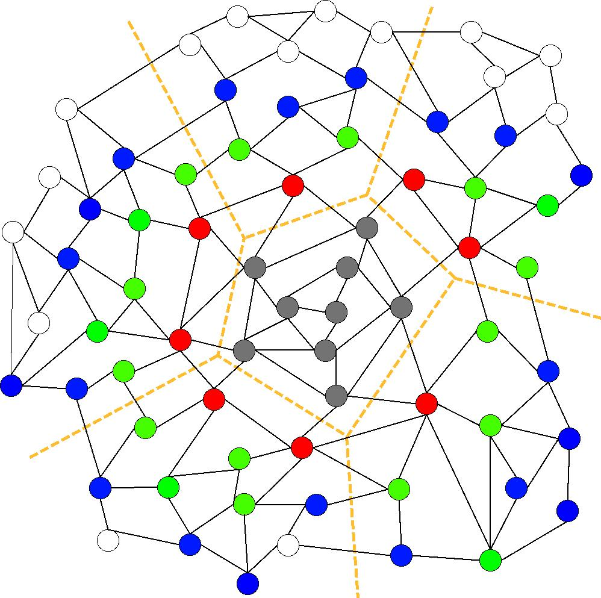
Communication Avoiding Kernels:
The Matrix Powers Kernel : [Ax, A²x, …, A^{k}x]
Same idea works for general sparse matrices
Simple block-row partitioning ➔
(hyper)graph partitioning
Left-to-right processing ➔
Traveling Salesman Problem
Notes:
Red needed for k=1
Green also needed for k=2
Blue also needed for k=3

Slide 94
Minimizing Communication of GMRES to solve Ax=b
GMRES: find x in span{b,Ab,…,A^{k}b} minimizing || Ax-b ||₂
Standard GMRES
for i=1 to k
w = A · v(i-1) … SpMV
MGS(w, v(0),…,v(i-1))
update v(i), H
endfor
solve LSQ problem with H
Communication-avoiding GMRES
W = [ v, Av, A²v, … , A^{k}v ]
[Q,R] = TSQR(W)
… “Tall Skinny QR”
build H from R
solve LSQ problem with H
Sequential case: #words moved decreases by a factor of k
Parallel case: #messages decreases by a factor of k
Oops – W from power method, precision lost!
94

Slide 95
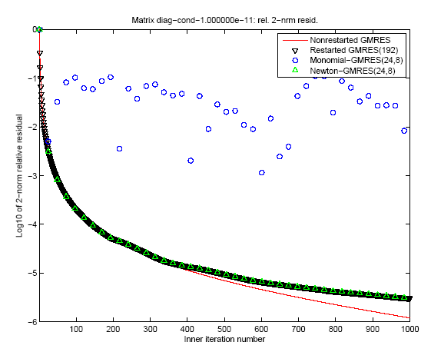
“Monomial” basis [Ax,…,A^{k}x]
fails to converge
Different polynomial basis [p₁(A)x,…,p_{k}(A)x]
does converge
95

Slide 96
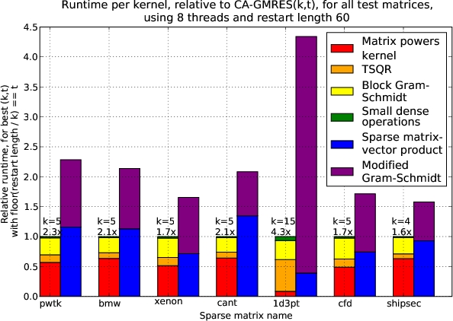
Speed ups of GMRES on 8-core Intel Clovertown
Requires Co-tuning Kernels
[MHDY09]
96

Slide 97
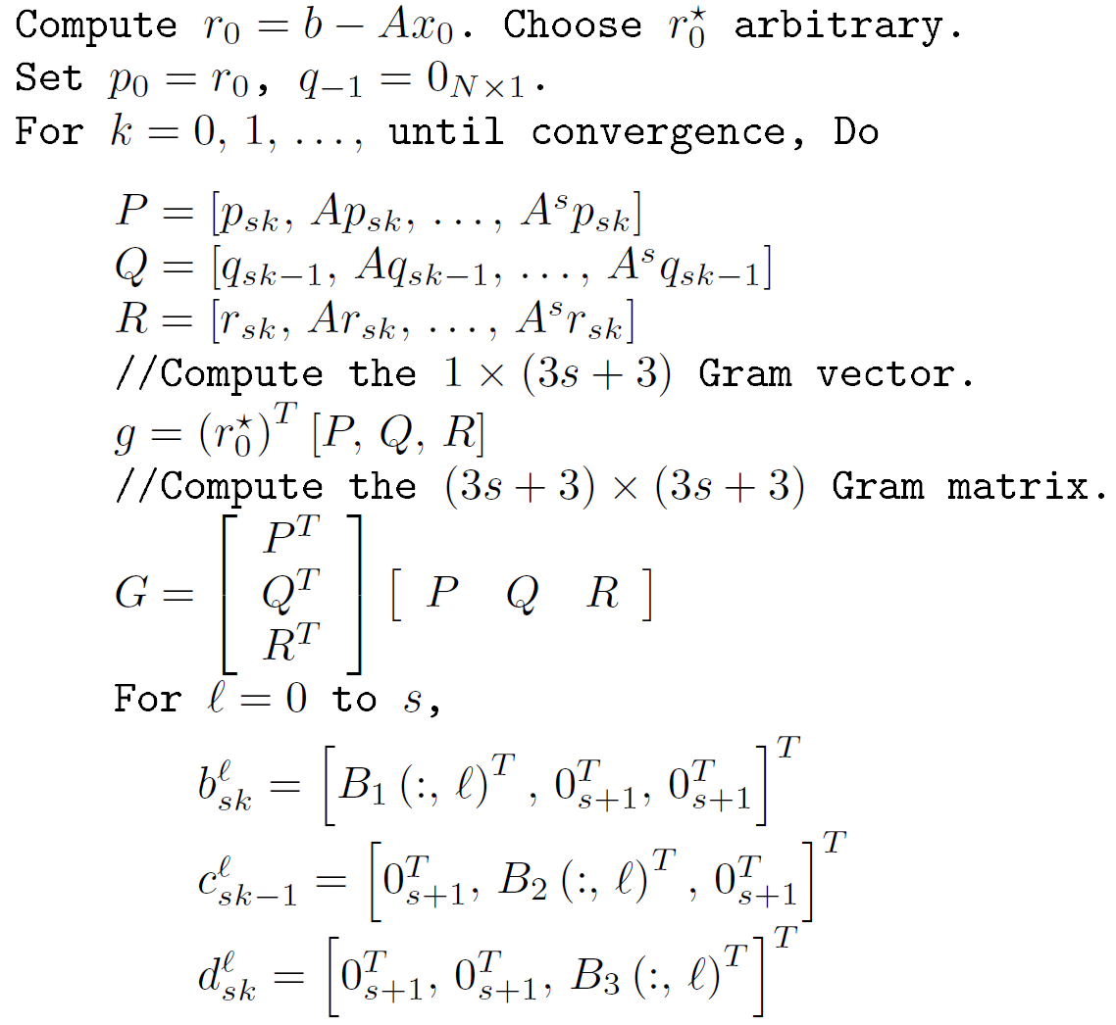
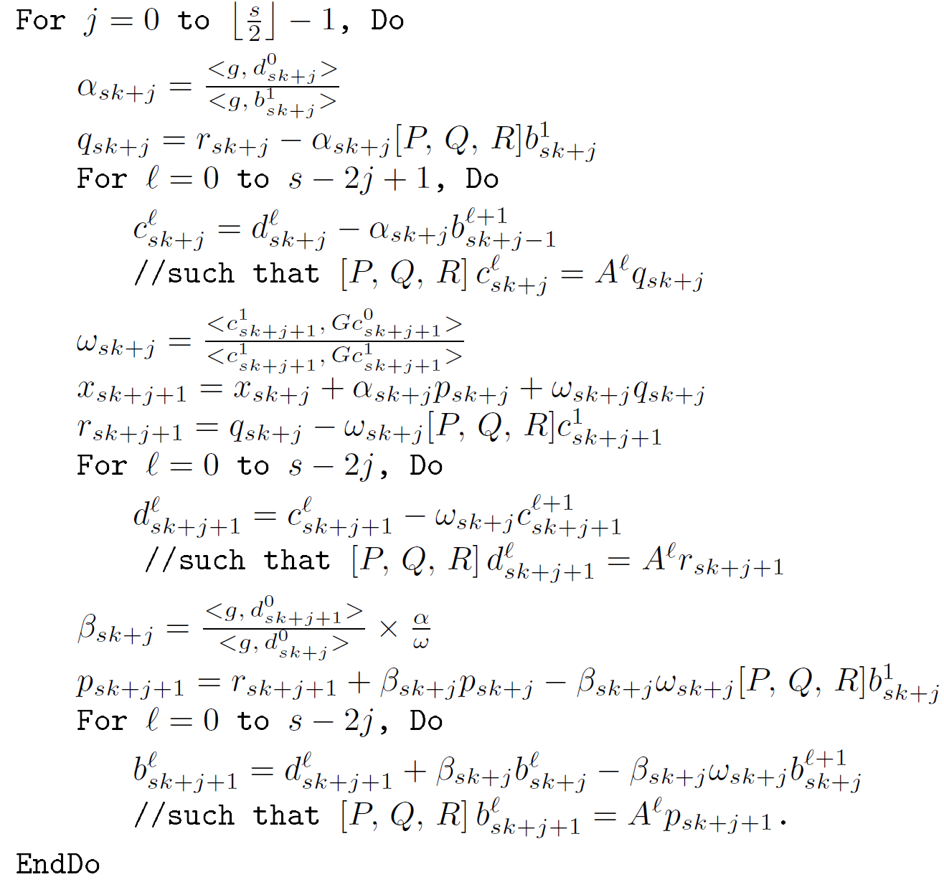
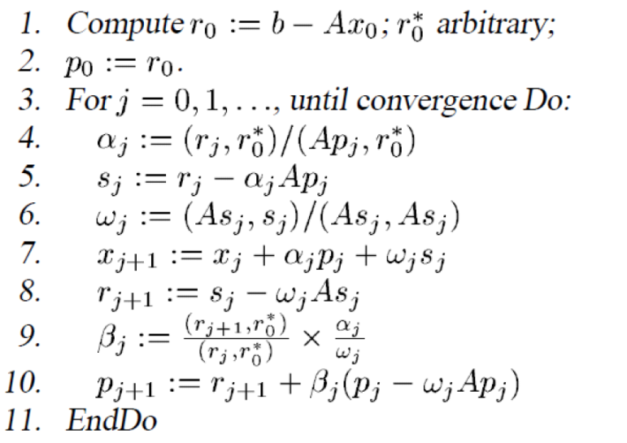

CA-BiCGStab

Slide 98
Notes:
For Matrix pde900, U Florida collection, 2D Model problem, Nx=30, Ny=30, non-normal.
Cond ~ 120

Slide 99
With Residual Replacement (RR)
a la Van der Vorst and Ye
 | Naive | Monomial | Newton | Chebyshev
Replacement Its. | 74 (1) | [7, 15, 24, 31, …, 92, 97, 103] (17) | [67, 98] (2) | 68 (1)

Slide 100
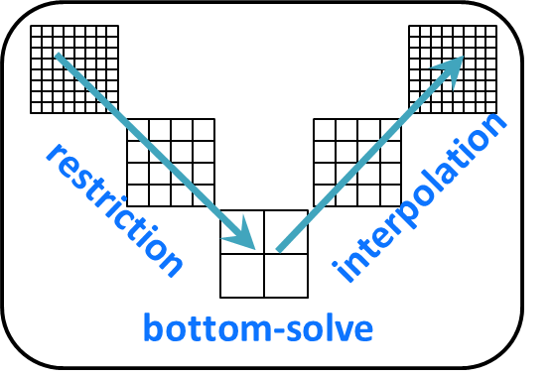
Sample Application Speedups
Geometric Multigrid (GMG) w CA Bottom Solver
  Compared BICGSTAB vs. CA-BICGSTAB with s = 4
  Hopper at NERSC (Cray XE6), weak scaling: Up to 4096 MPI processes (24,576 cores total)
Speedups for miniGMG benchmark (HPGMG benchmark predecessor)
  4.2x in bottom solve, 2.5x overall GMG solve
Implemented as a solver option in BoxLib and CHOMBO AMR frameworks
  3D LMC (a low-mach number combustion code)
    2.5x in bottom solve, 1.5x overall GMG solve
  3D Nyx (an N-body and gas dynamics code)
    2x in bottom solve, 1.15x overall GMG solve
Solve Horn-Schunck Optical Flow Equations
  Compared CG vs. CA-CG with s = 3, 43% faster on NVIDIA GT 640 GPU
Notes:
CA-BICGSTAB improves aggregate performance - degrees of freedom solved per second close to linear
GMG work by Sam Williams, Erin Carson
Horn-Schunck work by Michael Anderson

Slide 101
Tuning space for Krylov Methods
Classifications of sparse operators for avoiding communication
  Explicit indices or nonzero entries cause most communication, along with vectors
  Ex: With stencils (all implicit) all communication for vectors
Indices
 | Explicit (O(nnz)) | Implicit (o(nnz))
Explicit (O(nnz)) | CSR and variations | Vision, climate, AMR,…
Implicit (o(nnz)) | Graph Laplacian | Stencils
Nonzero
entries
Operations
  [x, Ax, A²x,…, A^{k}x ] or [x, p₁(A)x, p₂(A)x, …, p_{k}(A)x ]
  Number of columns in x
  [x, Ax, A²x,…, A^{k}x ] and [y, A^{T}y, (A^{T})²y,…, (A^{T})^{k}y ], or [y, A^{T}Ay, (A^{T}A)²y,…, (A^{T}A)^{k}y ],
  return all vectors or just last one
Cotuning and/or interleaving
  W = [x, Ax, A²x,…, A^{k}x ] and {TSQR(W) or W^{T}W or … }
  Ditto, but throw away W
Preconditioned versions

Slide 102
Summary of Iterative Linear Algebra
New Lower bounds, optimal algorithms, big speedups in theory and practice
Lots of other progress, open problems
  Many different algorithms reorganized
    More underway, more to be done
  Need to recognize stable variants more easily
  Preconditioning
    “Underlapping” instead of “overlapping” Domain Decomposition
    Hierarchically Semiseparable Matrices
  Autotuning and synthesis
    pOSKI for SpMV – available at bebop.cs.berkeley.edu
    Different kinds of “sparse matrices”

Slide 103
Outline
“Direct” Linear Algebra
  Lower bounds on communication
  New algorithms that attain these lower bounds
Ditto for programs accessing arrays (eg n-body)
Ditto for “Iterative” Linear Algebra
Related work
  Write-Avoiding Algorithms
  Reproducibility

Slide 104
Write-Avoiding Algorithms
What if writes are more expensive than reads?
  Nonvolatile Memory (Flash, PCM, …)
  Saving intermediates to disk in cloud (eg Spark)
  Extra coherency traffic in shared memory
Can we design “write-avoiding (WA)” algorithms?
  Goal: find and attain better lower bound for writes
  Thm: For classical matmul, possible to do asymptotically fewer writes than reads to given layer of memory hierarchy
  Thm: Cache-oblivious algorithms cannot be write-avoiding
  Thm: Strassen and FFT cannot be write-avoiding
Notes:
PCM = Phase Change Memory

Slide 105
Measured L3-DRAM traffic on
Intel Nehalem Xeon-7560
Optimal #DRAM reads = O(n³/M^{1/2})
Optimal #DRAM writes = n²
Cache-Oblivious Matmul
#DRAM reads close to optimal
#DRAM writes much larger
Write-Avoiding Matmul
Total L3 misses close to optimal
Total DRAM writes much larger
Notes:
To measure the number of writes to slow memory, we measure the evictions of modified
cache lines from L3 cache as these are obligatory write-backs to the DRAM. We use the C-box
event LLC VICTIMS.M [30] for this. We also measure the number of exclusive lines evicted from L3
using the event LLC VICTIMS.E. We measure the number of reads from the DRAM into L3 cache
necessitated by L3 cache misses with the performance event LLC S FILLS.E

Slide 106
Reproducible Floating Point Computation
Do you get the same answer if you run the same program twice with the same input?
  Not even on your multicore laptop!
Floating point addition is nonassociative, summation order not reproducible
First release of the ReproBLAS
  Reproducible BLAS 1, independent of data order, number of processors, data layout, reduction tree, …
  Sequential and distributed memory (MPI)
bebop.cs.berkeley.edu/reproblas

Slide 107
More possible class projects
Could be one or more of
  Extend lower bounds, new algorithms, compare existing algorithms, use algorithms to improve existing applications, performance analysis/measurement, compiler infrastructure, present existing results…
Extend to machine learning algorithms, other of the ``13 motifs’’

Slide 108
For more details
Bebop.cs.berkeley.edu
  155 page survey in Acta Numerica
CS267 – Berkeley’s Parallel Computing Course
  Live broadcast in Spring 2016
    www.cs.berkeley.edu/~demmel
    All slides, video available
  Prerecorded version broadcast since Spring 2013
    www.xsede.org
    Free supercomputer accounts to do homework
    Free autograding of homework

Slide 109
Collaborators and Supporters
James Demmel, Kathy Yelick, Michael Anderson, Grey Ballard, Erin Carson, Aditya Devarakonda, Michael Driscoll, David Eliahu, Andrew Gearhart, Evangelos Georganas, Nicholas Knight, Penporn Koanantakool, Ben Lipshitz, Oded Schwartz, Edgar Solomonik, Omer Spillinger
Austin Benson, Maryam Dehnavi, Mark Hoemmen, Shoaib Kamil, Marghoob Mohiyuddin
Abhinav Bhatele, Aydin Buluc, Michael Christ, Ioana Dumitriu, Armando Fox, David Gleich, Ming Gu, Jeff Hammond, Mike Heroux, Olga Holtz, Kurt Keutzer, Julien Langou, Devin Matthews, Tom Scanlon, Michelle Strout, Sam Williams, Hua Xiang
Jack Dongarra, Jakub Kurzak, Dulceneia Becker, Ichitaro Yamazaki, …
Sivan Toledo, Alex Druinsky, Inon Peled
Laura Grigori, Sebastien Cayrols, Simplice Donfack, Mathias Jacquelin, Amal Khabou, Sophie Moufawad, Mikolaj Szydlarski
Members of ParLab, ASPIRE, BEBOP, CACHE, EASI, FASTMath, MAGMA, PLASMA
Thanks to DOE, NSF, UC Discovery, INRIA, Intel, Microsoft, Mathworks, National Instruments, NEC, Nokia, NVIDIA, Samsung, Oracle
bebop.cs.berkeley.edu
Notes:
Underlined named visited other site, Mathias and Sophie in Summer 2012
New INRIA Postdoc: Soleiman Yousef

Slide 110
Summary
Time to redesign all linear algebra, n-body,…
algorithms and software
(and compilers…)
Don’t Communic…

